Slide 1
LT4216 Advanced Topics in Linguistics -
CI Analysis of 嘅 "ge2"
Group 4
Kan Ka Ho, Arthur
Lo Tsz Yan, Kate
Lui King Yan Karen
Wu Ming Chun, Strode

Slide 2
Introduction
嘅(ge2) is a sentence final particle in Cantonese
Used in assertions when the speaker wants to make an emphasis
It also adds uncertainty or puzzlement to the sentence

Slide 3
Warming Up

Slide 4
Warming Up
A:港男 B: 港女
A: 今晚食日本菜好唔好?
B: Ok嘅
A: 食完去睇鬼片?
B: 得嘅
A: 同埋我未出糧, 你要比住先, 你唔介意啦?
B: 我唔介意嘅
A: HK boy B: HK girl
A: Wanna go for Japanese cuisine tonight?
B: Ok (ge2)
A: After that, shall we watch a horror movie?
B: Fine (ge2)
A: I haven’t received my salary and you have
to pay first. You don’t mind, right?
B: I don’t mind (ge2)

Slide 5
Warming Up
A:港男 B: 港女
A: 今晚食日本菜好唔好?
B: Ok嘅
A: 食完去睇鬼片?
B: 得嘅
A: 同埋我未出糧, 你要比住先, 你唔介意啦?
B: 我唔介意嘅
A: HK boy B: HK girl
A: Wanna go for Japanese cuisine tonight?
B: Ok (ge2)
A: After that, shall we watch a horror movie?
B: Fine (ge2)
A: I haven’t got my salary and you have to
pay first. You don’t mind, right?
B: I don’t mind (ge2)

Slide 6
Examples
Notes:
https://youtu.be/gk_y7QhfaVc

Slide 7
Summary of empirical data
We will use the following sentence as an example sou1-saan1 hai6 leng3 ge2.
蘇珊 係 靚 嘅
Susan is beautiful SFP.
At-issue meaning : Susan is beautiful.
Secondary meaning : The speaker does not fully agree with the at-issue meaning (i.e. Susan is beautiful, in this case).

Slide 8
Lexicality
The secondary meaning was induced by ge2 only
If deleted, the secondary meaning does not exist
The sentence can still finish without this word
Lexicality is fulfilled
sou1-saan1 hai6 leng3.
蘇珊 係 靚
Susan is beautiful.
Meaning : “Susan is beautiful.”

Slide 9
Commitment
The secondary meaning shown cannot be cancelled
Commitment is fulfilled
*sou1-saan1 hai6 leng3 ge2.
蘇珊 係 靚 嘅
Susan is beautiful SFP.
ngo5 zan1-hai6 gok3-dak1 keoi5 hai6 leng3
我 真係 覺得 佢 係 靚.
I truly think she is beautiful.
*“ Susan is beautiful. I truly think she is beautiful.”

Slide 10
Speaker-orientation
- The speaker makes a contribution to the utterance by the word ge2.
- Embed the sentence under an attitudinal verb → secondary meaning still arises as both parts are speaker’s opinion → contradicted with each other → Speaker-orientation is fulfilled
bie2-dak1 gok3-dak1 sou1-saan1 hai6 leng3 ge2.
彼得 覺得 蘇珊 係 靚 嘅
Peter thinks Susan is beautiful SFP.
daan6 ngo5 gok3-dak1 sou1-saan1 leng3.
但 我 覺得 蘇珊 靚
But I think Susan beautiful.
#“ Peter thinks Susan is beautiful. But I think Susan is beautiful.”

Slide 11
Independence of “what is said”
Homer is negating the proposition: Susan is beautiful (at-issue)
No matter Susan is beautiful or ugly, the secondary meaning still arises
Independence is fulfilled
Bart: sou1-saan1 hai6 leng3 ge2.
蘇珊 係 靚 嘅
Susan is beautiful SFP
Homer: m4-hai6 geoi3 je5 hai6 co3
唔係, 句 野 係 錯!
No, the statement is wrong!

Slide 12
Proposal
Hypothesis:
The Cantonese Sentence Final Particle : ge2 carries a secondary meaning: “The speaker does not fully agree …” and such secondary meaning is a conventional implicature (CI)
Prediction:
ge2 should demonstrate characteristics which are unique to CIs (e.g. invariant under holes, plugs)

Slide 13
Formal Analysis
Lexicality
Commitment
Speaker-orientation
Independence of “what is said”

Slide 14
Our focus sentence
Janice Man (JM) : 我 都 係 普 通 人 嘅
ngo5 dou1 hai6 pou2 tung1 jan4 ge2
At-issue: I am also an ordinary person. Secondary: The speaker (i.e. I) does not fully agree that I am also an ordinary person.
Notes:
Video for the janice man
https://youtu.be/W6yhRbZ7lBI

Slide 15
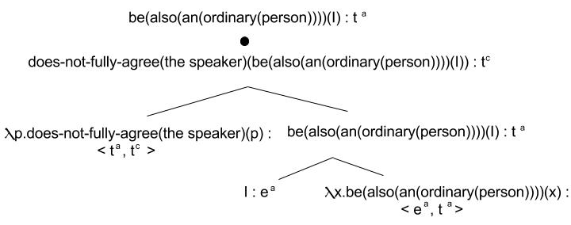
Logical Structure

Slide 16
Lexicality
ge2 is of type < tª , t^{c} > type which contains the output of type t^{c}
CI meaning comes from the word with CI type only
CI application

Slide 17
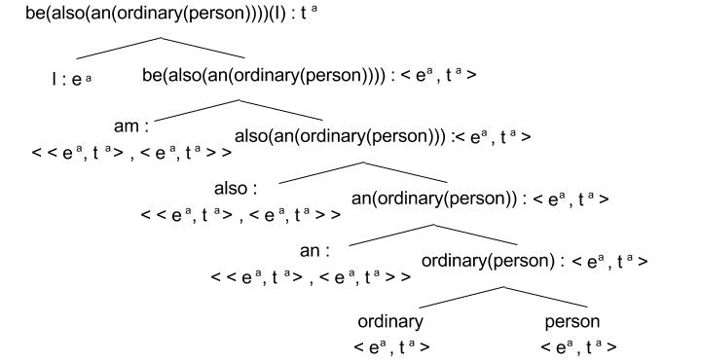
Lexicality (cont’d)
If we delete ge2, only at-issue application can be applied
At-issue application
(all the way)

Slide 18
Commitment
The CI collection rule ensures that if α is of type (extensionally, ) then α is interpreted as an entailment of the sentence.
the at-issue proposition be(also(an(ordinary(person)))(I):tª
Input
λp.does-not-fully-agree(the speaker)(p):<tª,t^{c}>
Result
Does-not-fully-agree(the speaker)(be(also(an(ordinary(person))))(I)):t^{c}

Slide 19
Commitment
Note that
Does-not-fully-agree(the speaker)((be(also(an(ordinary person))))(I))
Type:t^{c}
Therefore, the meaning ge2 is interpreted as an entailment of the sentence(i.e. commitment),
which will be interpreted against the speaker’s model

Slide 20
Commitment & Speaker-orientation
Parsetree interpretation: <⟦(be(also(an(ordinary(person))))(I))⟧^{Mj,g} : tª , ⟦(does-not-fully-agree(the speaker)(be(also(an(ordinary(person))))(I)))⟧^{Mj,g} : t^{c}>
^{Mj} : Interpreted in the speaker’s model (i.e. in Janice Man’s model in this case) ∴ speaker-oriented & speaker’s commitment

Slide 21
Speaker-orientation
Potts (2003): - CIs cannot combine with higher intensional operators - CIs are interpreted as if they were root-level assertions
∴ interpreted relative to the speaker ONLY → cannot be embedded under attitudinal verbs (e.g. believe) E.g. *bie2-dak1 soeng1-seon3 ngo5 dou1 hai6 pou2-tung1 jan4 ge2. *彼得 相信 我 都 係 普通 人 嘅. Peter believe I also am ordinary person SFP *Peter believes I am also (an) ordinary person

Slide 22
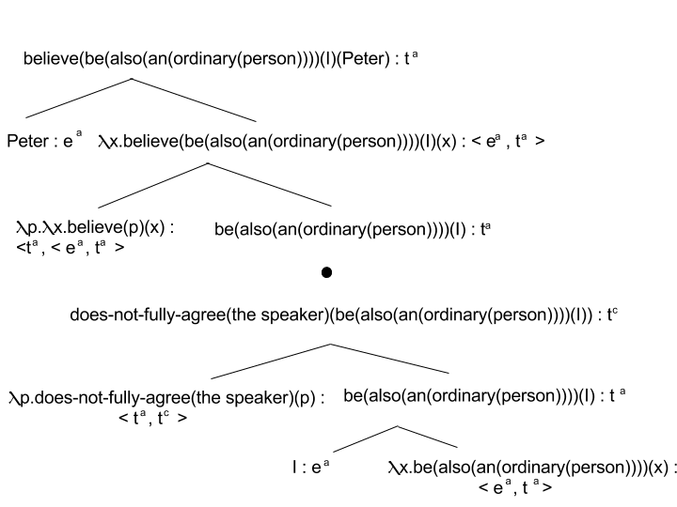
Speaker-orientation (cont’d)
*Not permitted: ‘believe’ taking the at-issue meaning as argument BUT the CI meaning is still interpreted in the speaker’s model → CI cannot be taken as argument in LCI → invariably speaker oriented

Slide 23
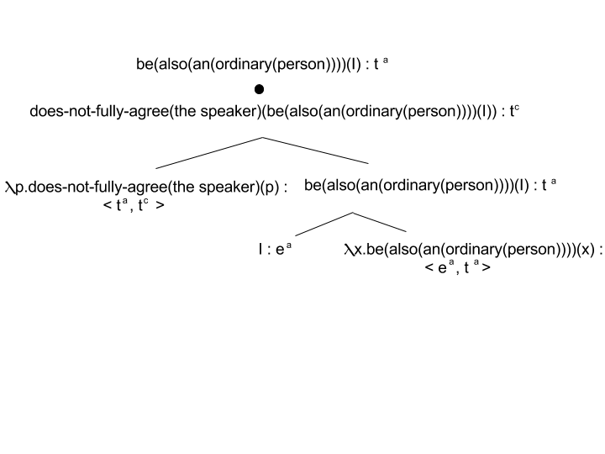
Independence of ‘what is said’
Potts(2003)
CI application yields a pair of expressions (at-issue&CI)
Each computation is interpreted independently by parsetree interpretation

Slide 24
Conclusion
Our hypothesis predicted that ge2 is a Conventional Implicature in Cantonese
It fulfils the 4 criteria defined by Potts, as shown in the formal analysis
Lexicality
Commitment
Spearker-Orientation
Independence of ‘what is said’
∴ Our hypothesis makes the correct predicton

Slide 25
References
Potts, Christopher. 2003. The Logic of Conventional Implicatures: UC Santa Cruz dissertation. 大鳴大放 葉劉淑儀：游蕙禎、梁頌恆宣誓風波 2016 10 22 [Video file]. (n.d.). Retrieved November 5, 2016, from https://www.youtube.com/watch?v=hBHZN6Jsa0k
毛記電視 (Producer). (n.d.). 《100毛 毛記電視 廣告片》Reenex 秀文安仔法式旋轉型廣告雜誌 [Video file]. Retrieved November 5, 2016, from https://www.youtube.com/watch?v=hhZuf2kd2gI
Apple Daily (Producer). (n.d.). 專家Dickson諗過做和尚 慘盈自認宅女 [Video file]. Retrieved November 5, 2016, from https://www.youtube.com/watch?v=rkmSuiu8fzM
Apple Daily (Director). (n.d.). JM承諾改晒英文壞習慣 [Video file]. Retrieved November 5, 2016, from https://www.youtube.com/watch?v=eoAVRQWnNNw&feature=youtu.be

Slide 26
Q & A

