Slide 1

Toward an Experimental Approach to Language and Health Communication
JIA Mian James
Department of English
June 19, 2024

Slide 2

Overview
Language use as a multidisciplinary inquiry
From discourse-analytic to experimental approaches to language and health communication
Strategic agency assignment in public health messaging
Moving the research forward

Slide 3
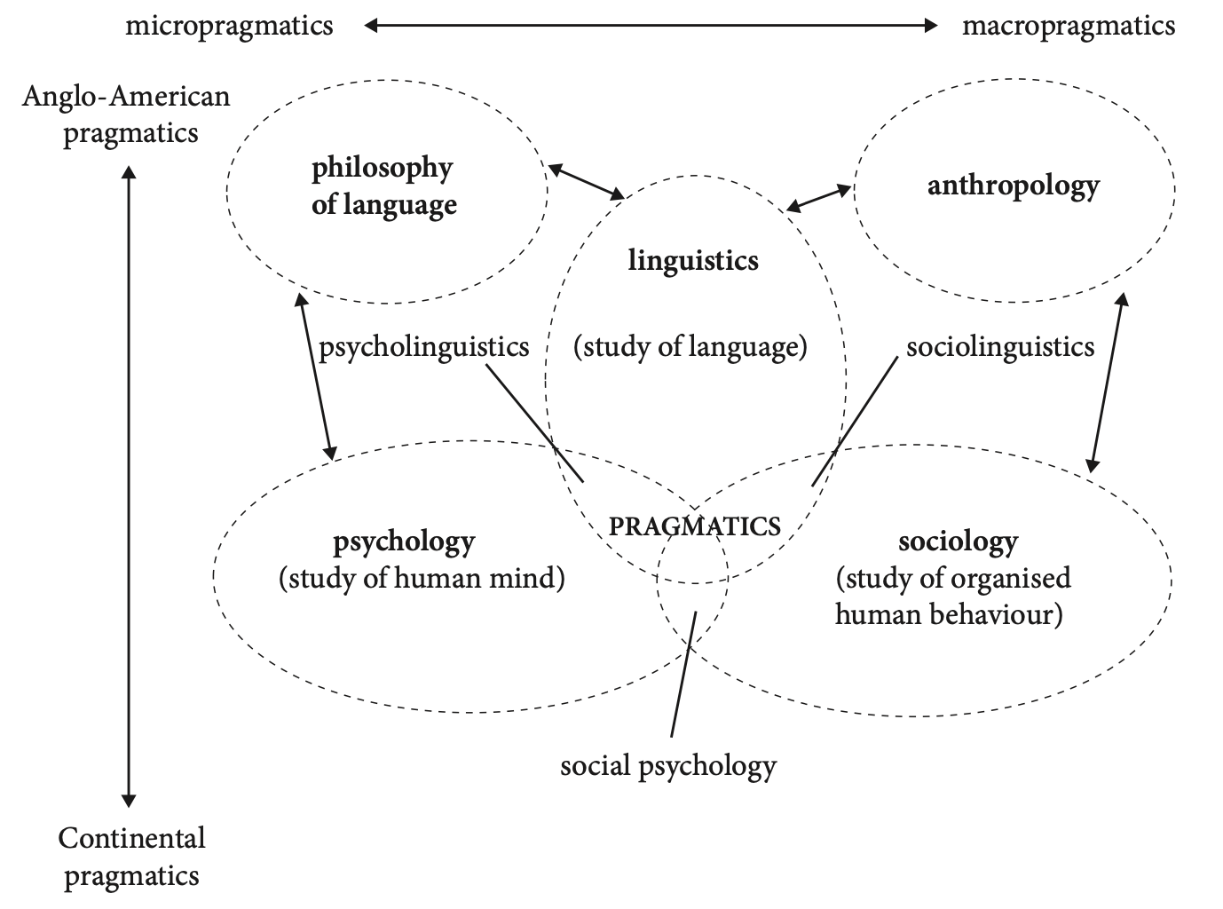
Language Use as a Multidisciplinary Inquiry
(Haugh & Culpeper, 2018)

Slide 4
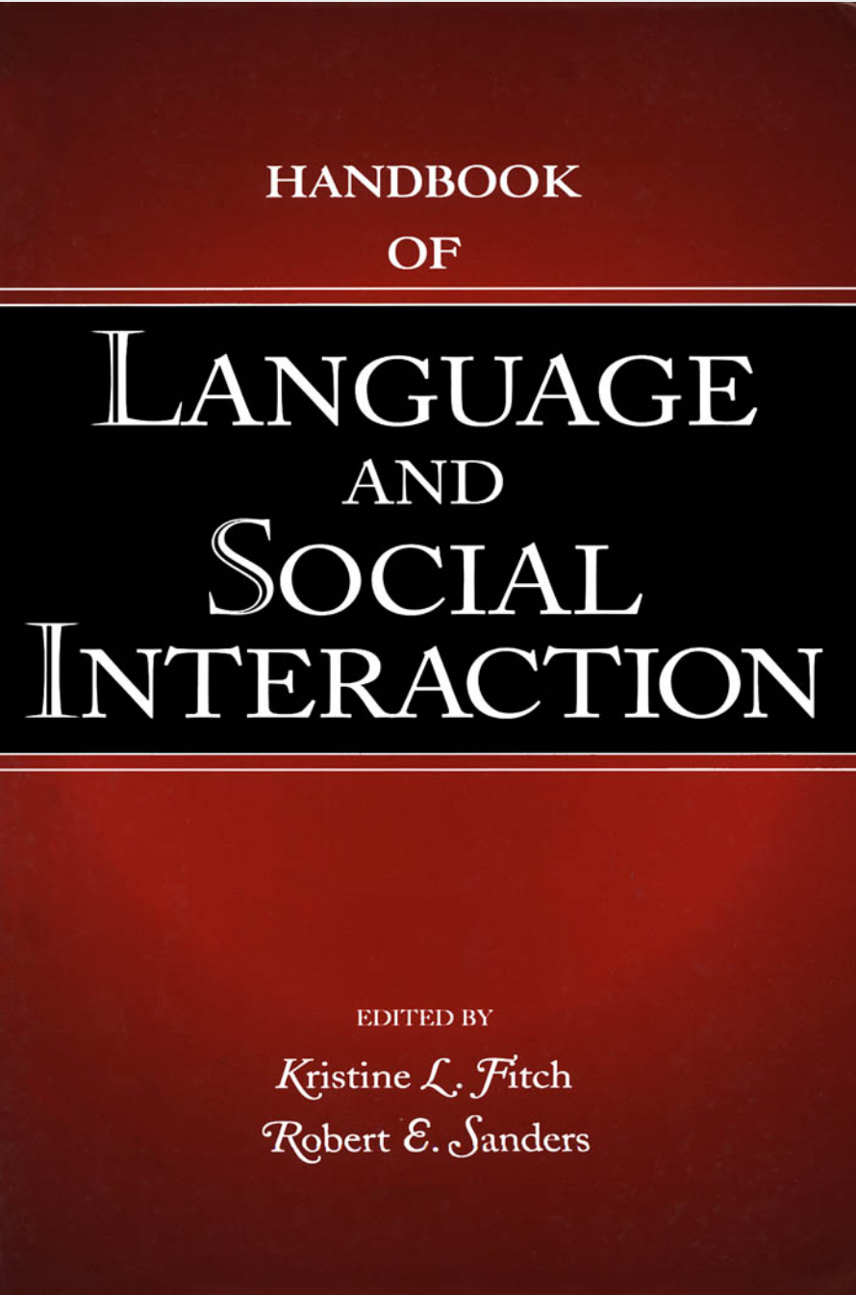
Language Use as a Multidisciplinary Inquiry
LSI AS A CONFEDERATION OF SUBDISCIPLINES
Language Pragmatics
Language and Social Psychology
Conversation Analysis
Discourse Analysis
Ethnography of Communication
(Fitch & Sanders, 2005)

Slide 5

Language Use as a Multidisciplinary Inquiry
SEVEN THEORETICAL APPROACHES
Cultural Approaches
Critical Approaches
Ethnomethodological – CA approaches
Practice approaches
Pragmatics approaches
Multimodal approaches
Social psychological approaches
(Tracy, 2015)

Slide 6
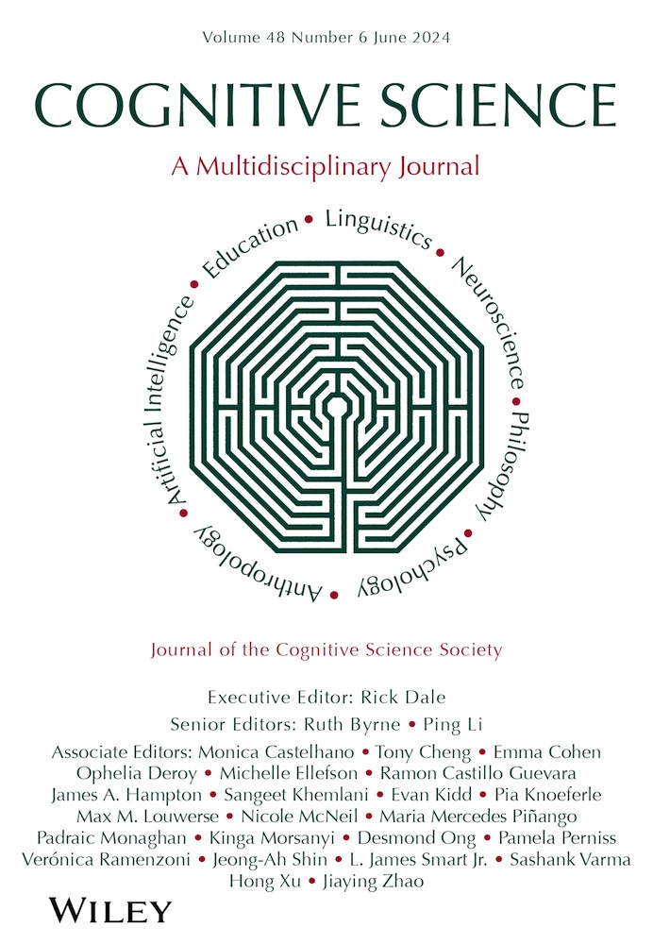
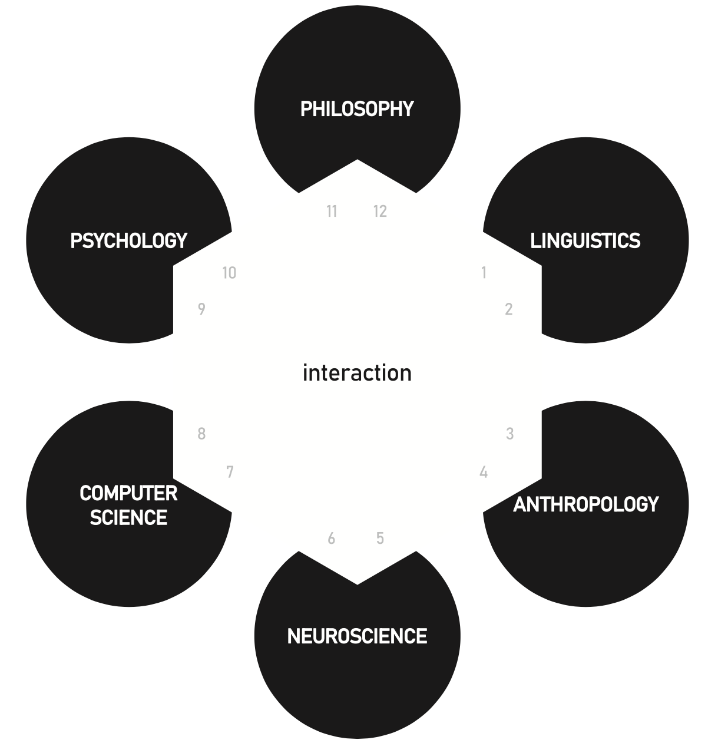
Language Use as a Multidisciplinary Inquiry

Slide 7

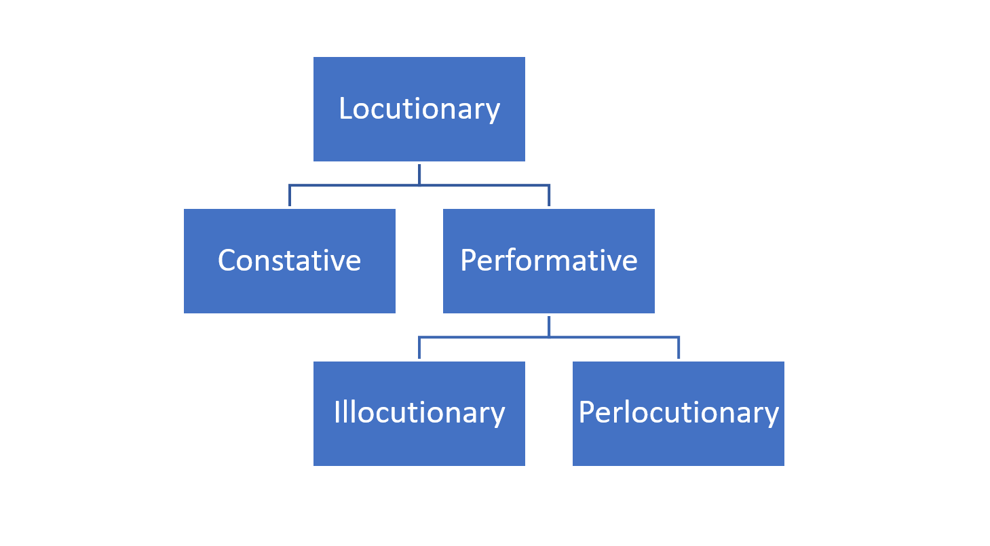
Language as Social Action – The Linguistics Camp

Slide 8
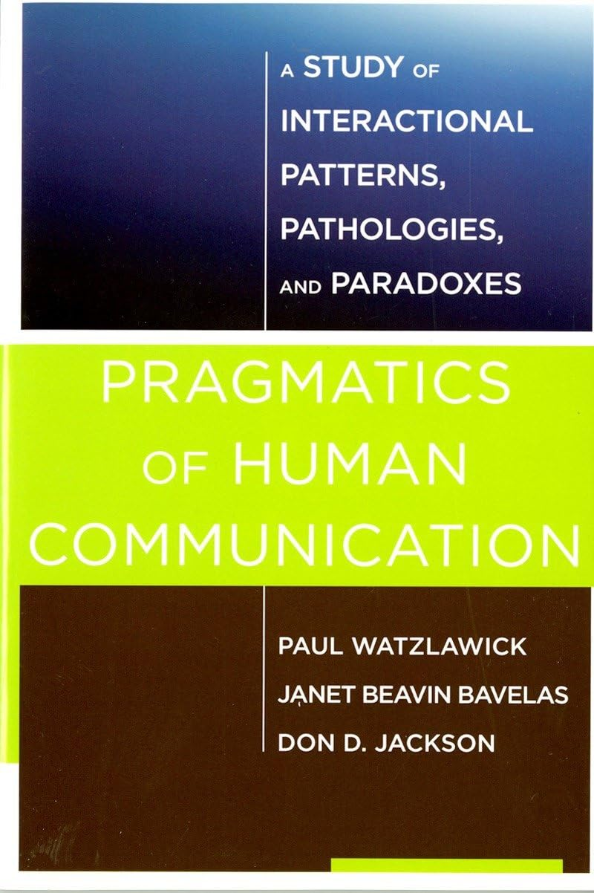

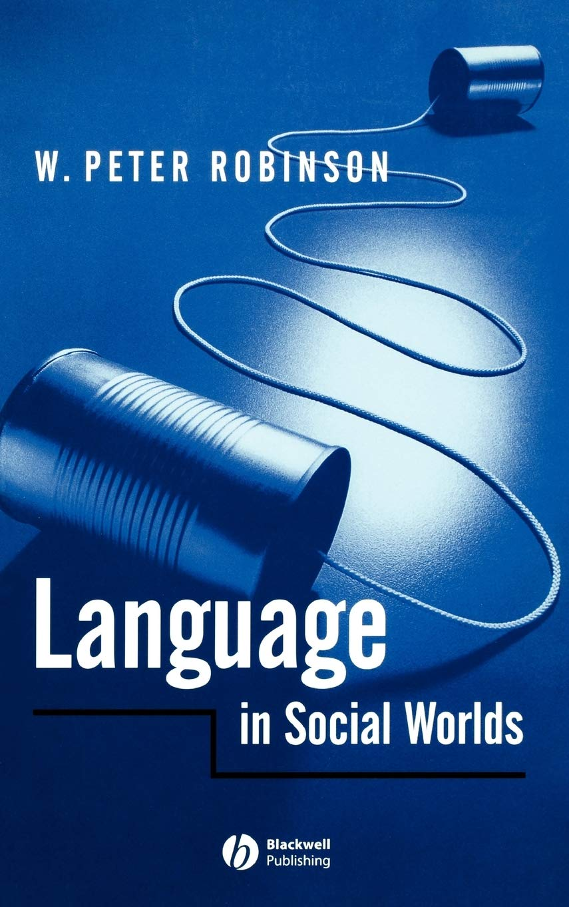


Language as Social Action – The Psychology Camp

Slide 9
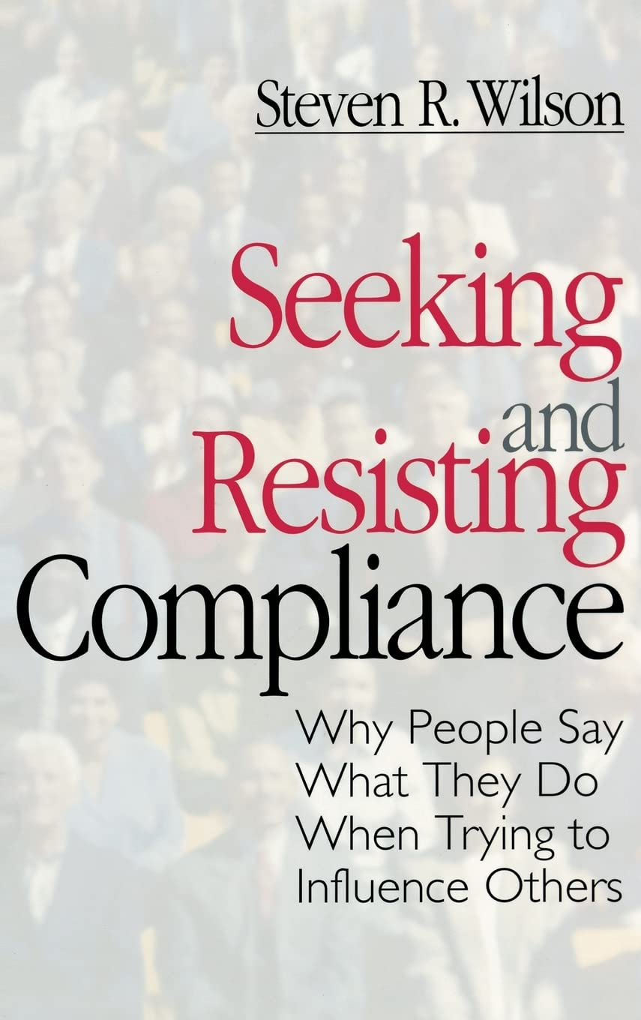
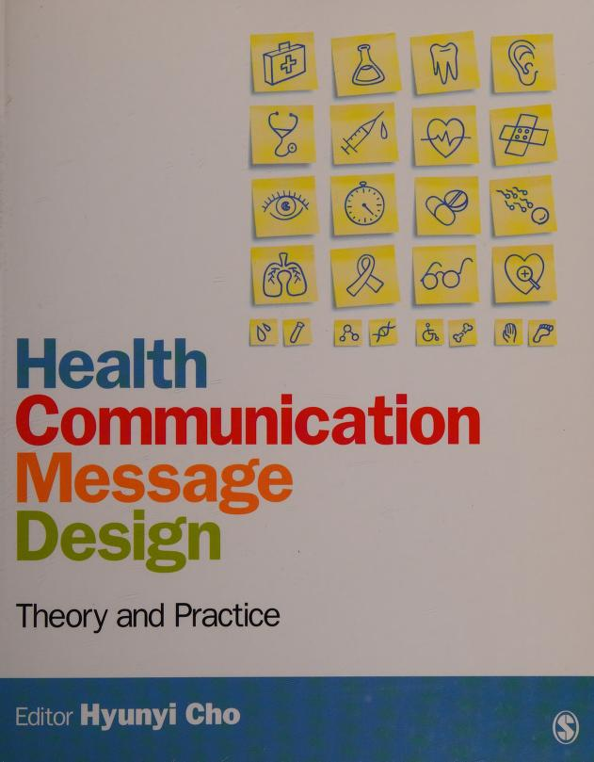
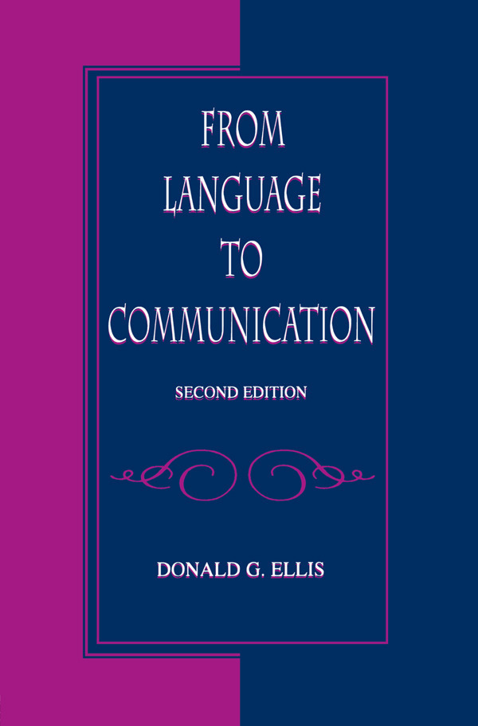


Language as Social Action – The Communication Camp

Slide 10



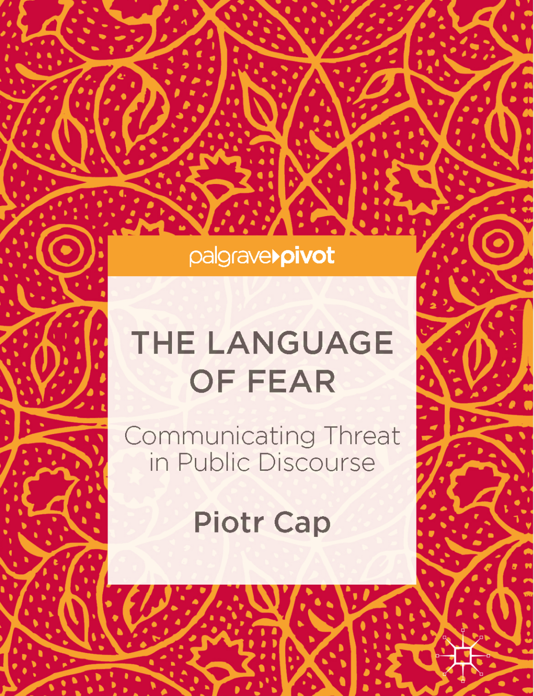

Discourse-Analytic Approaches to Health Communication

Slide 11
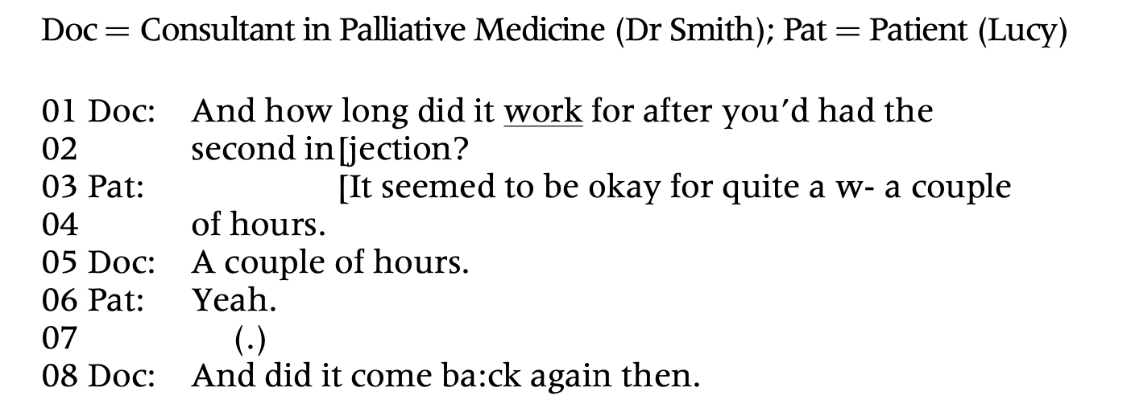
Doctor-Patient interaction at a UK Hospice (Jenkins et al., 2021, Applied Linguistics)
Discourse-Analytic Approaches to Health Communication

Slide 12
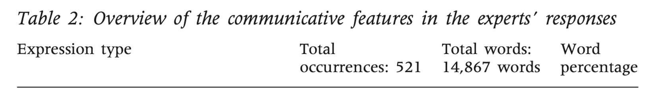
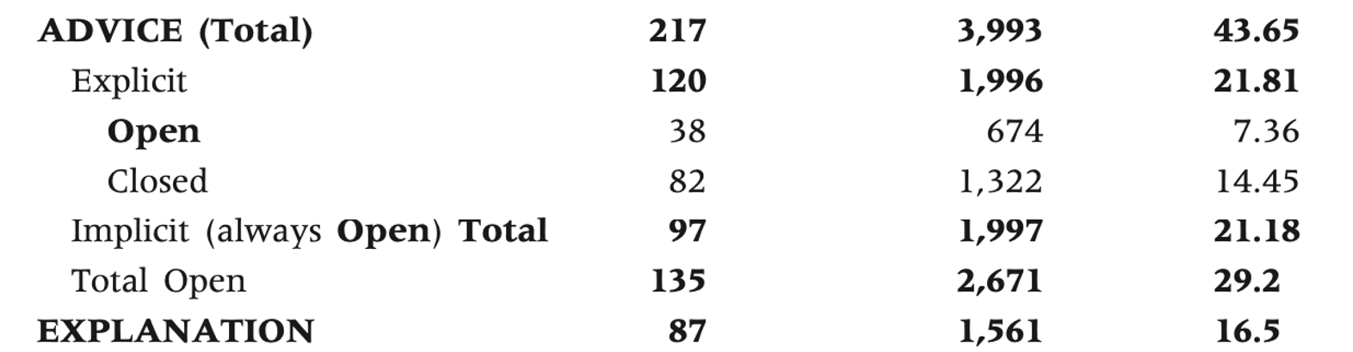
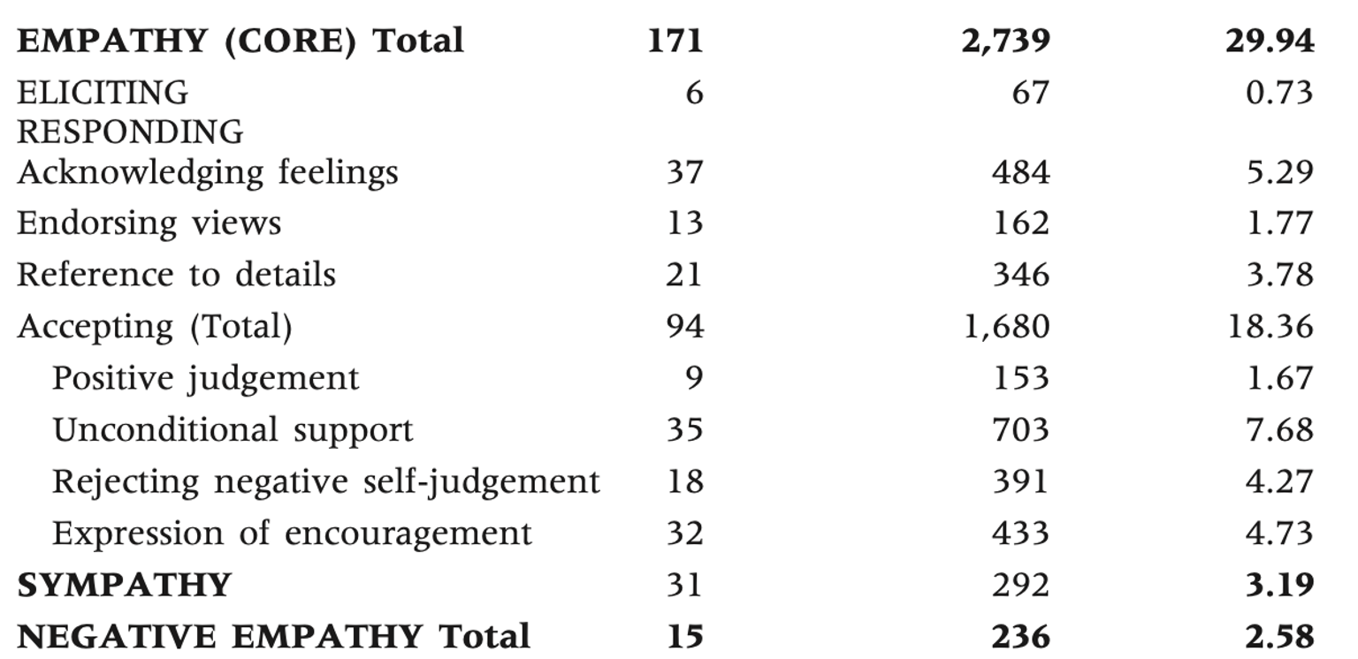
Advice in Ask-the-Expert health website (Pounds et al., 2018, Applied Linguistics)
Discourse-Analytic Approaches to Health Communication

Slide 13
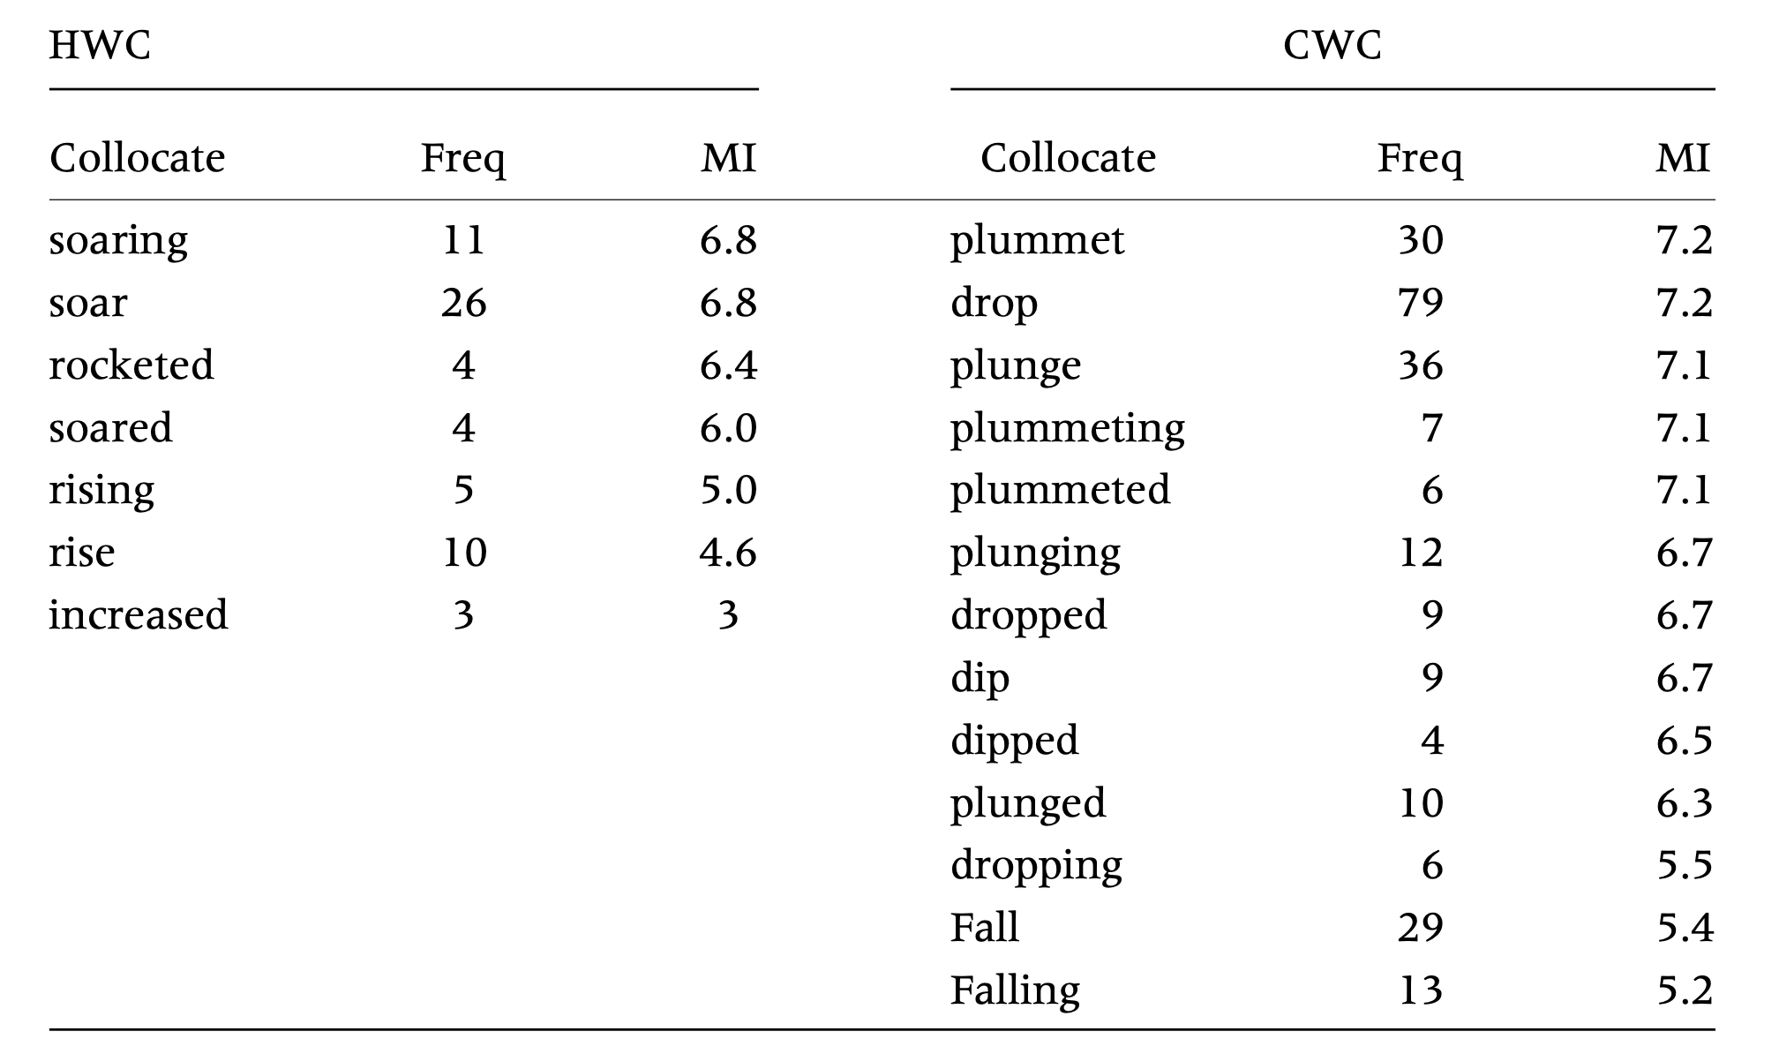
Framing in weather warning messages (Tang, 2022, Applied Linguistics)
Discourse-Analytic Approaches to Health Communication

Slide 14
An Experimental Approach to Language and Health Communication
(Jia, 2022, Applied Linguistics)
Communication Theories
Linguistic Theories
Experimentation
Communicative Effects of Language

Slide 15
Case Study: Strategic Agency Assignment in Public Health Messaging
Extended Parallel Process Model
Proto-Thematic Roles
A/B Message Testing
Persuasive Effects of Linguistic Agency Assignment

Slide 16
Extended Parallel Process Model
(Witte, 1992, Communication Monographs)
Health Message
Threat Appraisal
1. Severity
2. Susceptibility
Efficacy Appraisal
1. Response efficacy
2. Self-efficacy
Message Accepted
Yes
High
No
Low
Behavior Change
Message Rejected
Fear
Message Rejected

Slide 17
Extended Parallel Process Model in Public Health Messaging
Health Message
Threat Appeal
1. Severity
2. Susceptibility
Efficacy Appeal
1. Response efficacy
2. Self-efficacy
Effective Messaging
Yes
High
Strategic Language Choice

Slide 18
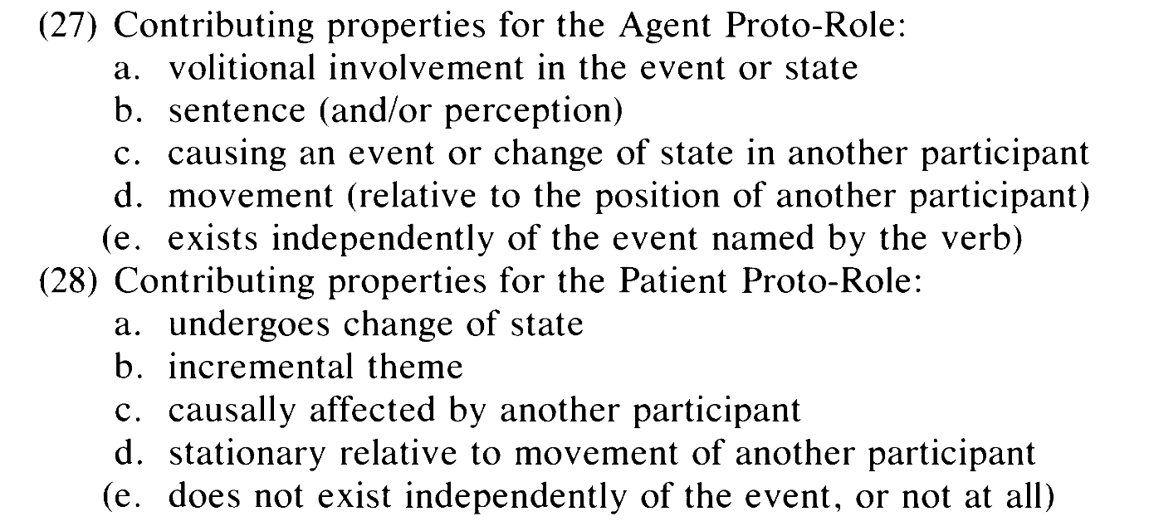

Properties of Proto-Agent and Proto-Patient Roles
(Dowty, 1991, Language)

Slide 19
Agency Assignment in Printed Educational Materials about H1N1
(McGlone et al., 2013, Journal of Health Communication)
Human agency | Virus agency
We are approaching the flu season. | The flu season is approaching.
Younger adults are more likely to contract the virus than older adults. | The virus is more likely to attack younger than older adults.

Slide 20
Extended Parallel Process Model in Public Health Messaging
Health Message
Threat Appeal
1. Severity
2. Susceptibility
Efficacy Appeal
1. Response efficacy
2. Self-efficacy
Effective Messaging
Yes
High
Human vs. Viral Agency Assignment

Slide 21
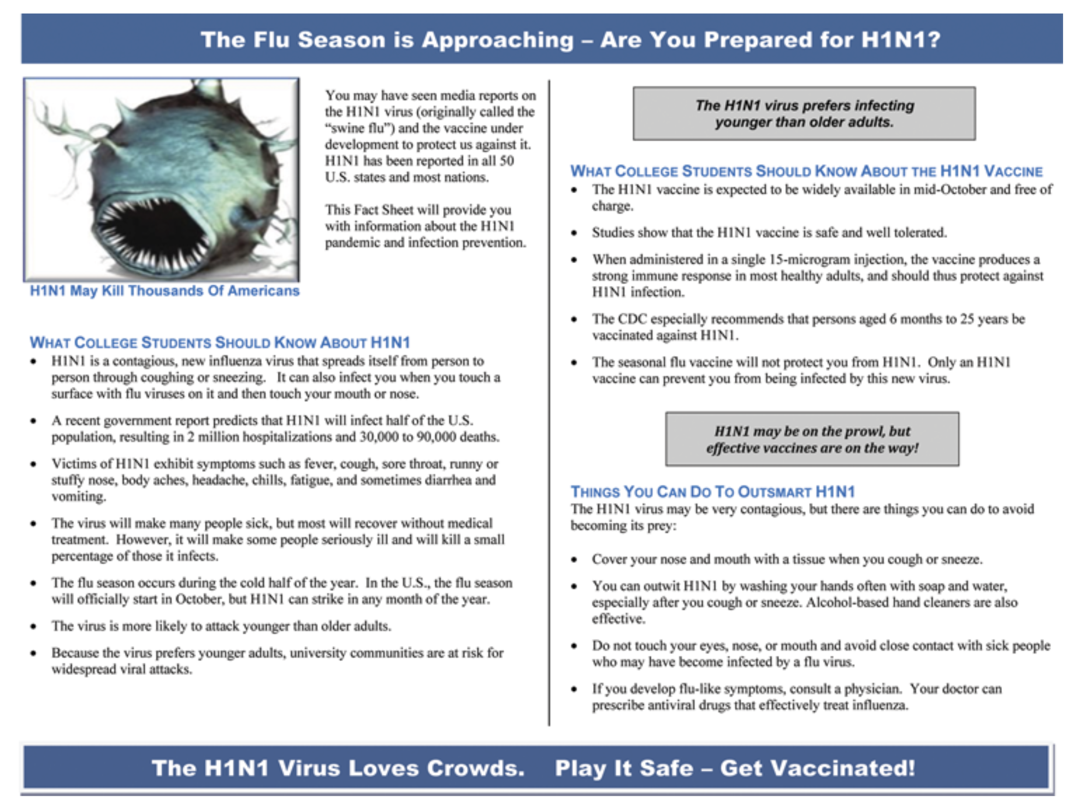
Agency Assignment in Printed Educational Materials about H1N1
(McGlone et al., 2013, Journal of Health Communication)

Slide 22
Agency Assignment in Printed Educational Materials about H1N1
(McGlone et al., 2013, Journal of Health Communication)
Measures
  Severity. e.g., virus poses serious risk
  Susceptibility. e.g., at risk for infection
  Self-efficacy. e.g., able to get vaccine
  Response-efficacy. e.g., vaccine will prevent infection
  Intention to get vaccinated. e.g., will get vaccine when available
Virus agency => Higher severity, susceptibility, response efficacy, intention. self-efficacy (ns)

Slide 23

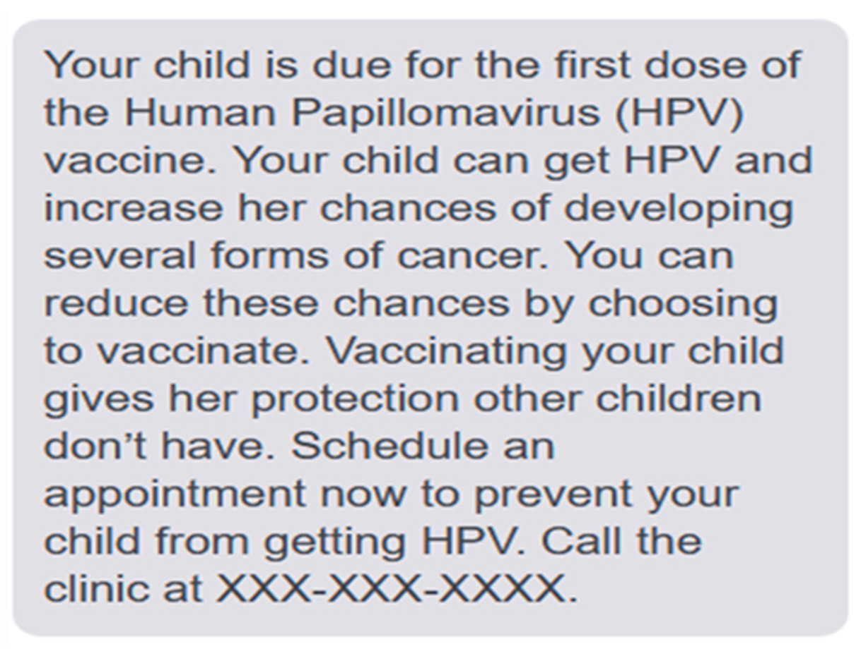
Agency Assignment in Other Health Educational Contexts
(McGlone et al., 2024, Vaccines)
(Chen et al., 2015, Journal of Health Communication)

Slide 24
Agency Assignment in Other Health Educational Contexts
E. coli, Necrotizing fasciitis, Salmonellosis, Carbapenem-resistant Klebsiella pneumonia (more severe and susceptible) (Bell et al 2014a)
HPV (more severe, effective, favorable) (Bell et al, 2014b);
Colon cancer (greater fear) (Chen et al, 2015)
Radon gas (more severe) (Dragojevic et al, 2014)
PHR (better protection, support recommendation, more comfortable) (Glowacki, 2016).
COVID-19 (more be blamed) (Jia & Zhang, forthcoming)
COVID-19 Vaccines (behavioral intention) (Anthony et al., 2022)
Tornados (higher freedom threat) (Ma et al., 2021)
Hurricanes and floods (more severe) (Ma & Miller, 2023)
HPV in Spanish (more severe) (McGlone et al., 2017)

Slide 25
Moderating Role of Locus of Threat in Agency Assignment
(Zhang, Jia & McGlone, 2023, Health Communication)
Exogenous threat:
  Radon gas (Dragojevic et al., 2014), HPV (McGlone et al., 2017; Zhang & McGlone, 2020), E.coli and others (Bell et al., 2014), COVID-19 (Ma & Miller, 2021), tornado (Ma et al., 2021), flood (Ma & Miller, 2022)
  Virus agency is more desirable.
Endogenous threat:
  Obesity (McGlynn & McGlone, 2018), Type II diabetes (Glowaki et al., 2016), Antibiotic stewardship (Zhang, Jia, McGlone et al., 2023)
  Human agency assignment is more desirable.

Slide 26
Moving the Research Forward
Greater Integration of Linguistic Theories
Greater Experiment-Grounded Discourse Studies
Greater Exploration of Different Linguacultures

Slide 27
Moving the Research Forward
Greater Integration of Linguistic Theories
Greater Experiment-Grounded Discourse Studies
Greater Exploration of Different Linguacultures

Slide 28
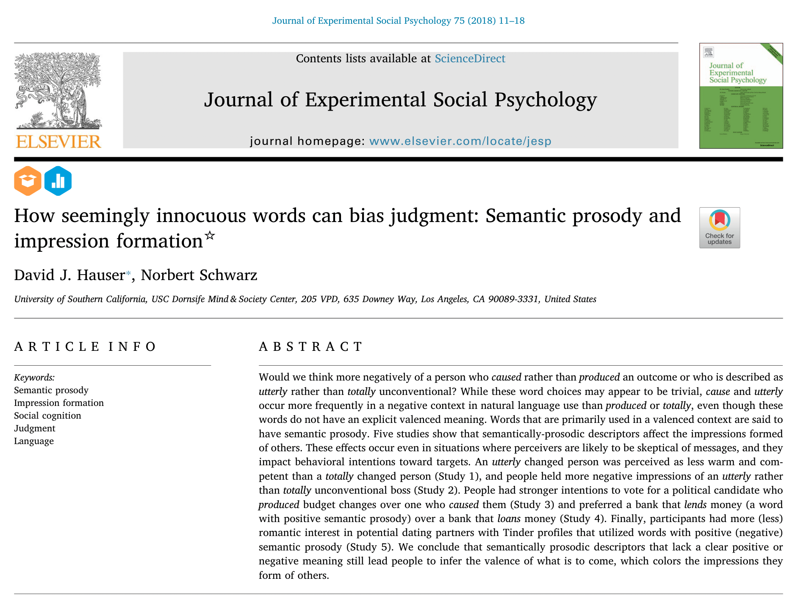

Slide 29
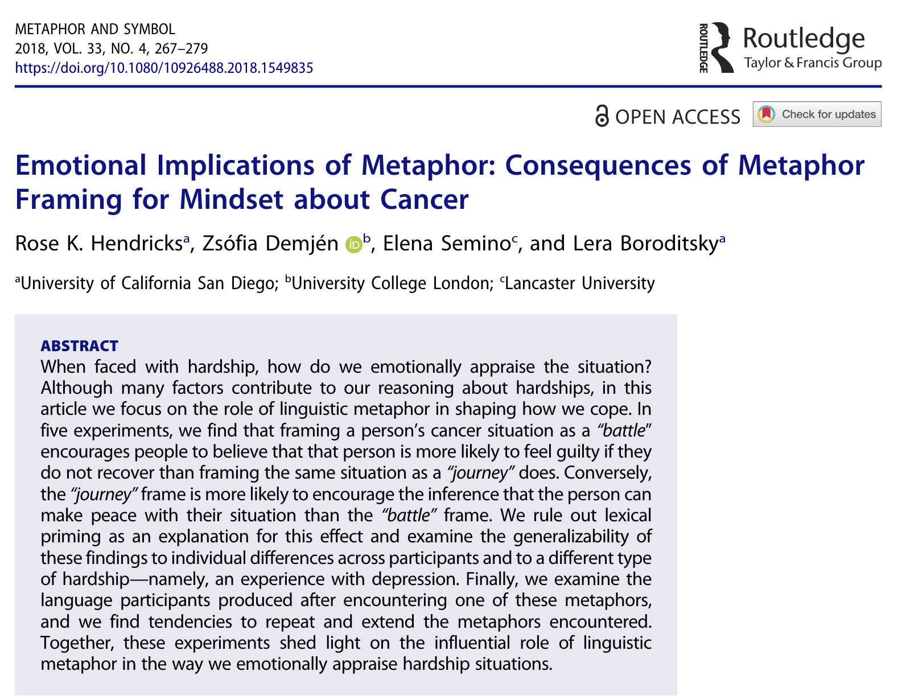

Slide 30
Moving the Research Forward
Greater Integration of Linguistic Theories
Greater Experiment-Grounded Discourse Studies
Greater Exploration of Different Linguacultures

Slide 31

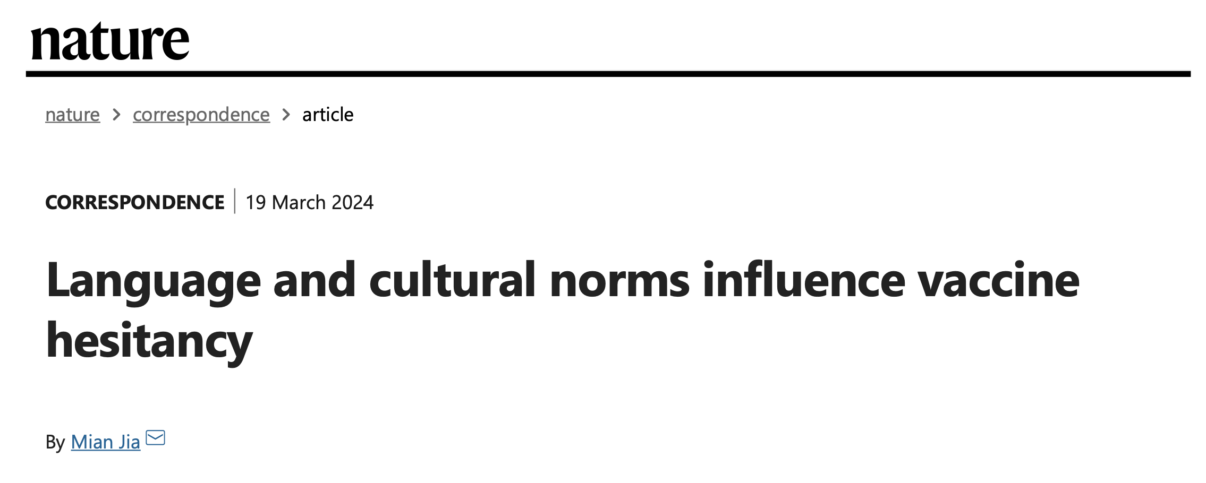
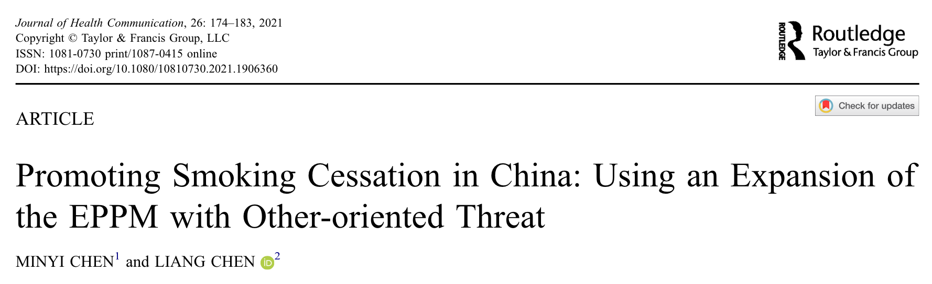
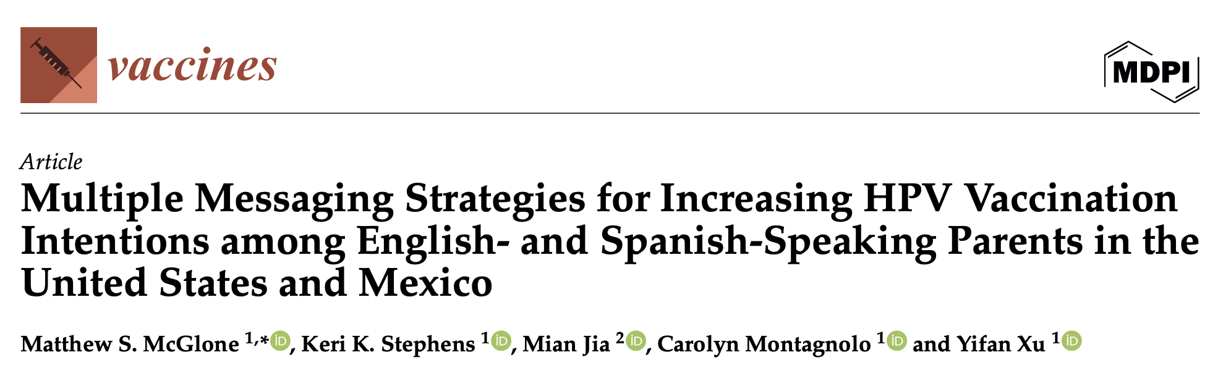
Moving the Research Forward

Slide 32
Moving the Research Forward
Greater Integration of Linguistic Theories
Greater Experiment-Grounded Discourse Studies
Greater Exploration of Different Linguacultures

Slide 33

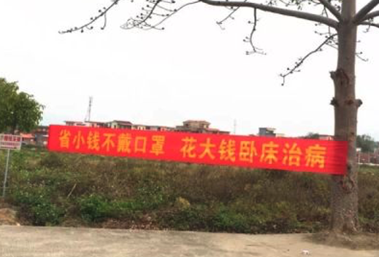
Extended Parallel Process Model in COVID-19 Messaging
(Jia & Zhao, 2023, Pragmatics and Society)
If you eat regulated bushmeat, the central position in hell will be reserved for you.
Save a little by unmasking, spend a lot in the hospital.

Slide 34
Extended Parallel Process Model in COVID-19 Messaging
(Jia & Zhao, 2023, Pragmatics and Society)
COVID-19 Sign
Threat Appeal
1. Severity
2. Susceptibility
Efficacy Appeal
1. Response efficacy
2. Self-efficacy
Effective Messaging
Yes
High
COVID-19 Sign
Threat Appeal
152 (94%)
Efficacy Appeal
72 (44%)
Effective Messaging
Yes
High
Threat Appraisal + Efficacy Appraisal
17 (11%)

Slide 35
Selected References
Jia, M. & Zhang, T. Z. (forthcoming). Toward an experimental approach to health discourse: The effects of agency assignment in public health messaging. In Huang, L. & Syed, A. (eds.), Charting new territories in discourse analysis across health contexts. Routledge.
Jia, M. & Zhao, Y. (2023). Fear appeals in public signs of COVID-19 prevention in Chinese local communities. Pragmatics and Society, 14(2), 281–305. https://doi.org/10.1075/ps.22009.jia
Jia, M. (2022). Toward an integrated understanding of language and health communication: Discourse-analytic and message design approaches. Applied Linguistics, 43(6), 1217–1221. https://doi.org/10.1093/applin/amac063
Jia, M. (2024). Language and cultural norms influence vaccine hesitancy. Nature. 627, 489–489. https://doi.org/10.1038/d41586-024-00826-x
McGlone, M. S., Stephens, K. K., Jia, M., Montagnolo, C., & Xu, Y. (2024). Multiple messaging strategies for increasing HPV vaccination intentions among English- and Spanish-speaking parents in the United States and Mexico. Vaccines, 12(6), 650. https://doi.org/10.3390/vaccines12060650
Zhang, T. Z., Jia, M., & McGlone, M. S. (2023). Combating antibiotic resistance via linguistic agency assignment. Health Communication, 38(14), 3287–3300. https://doi.org/10.1080/10410236.2022.2147125

Slide 36
Thank you!
James Mian Jia
mianjia@cityu.edu.hk

