Slide 1

Emotional Words: Faster than Thought
ENT Department, University Hospital Jena
Experimental ENT Research
Univ. Prof. Dr. Christian Dobel

Slide 2



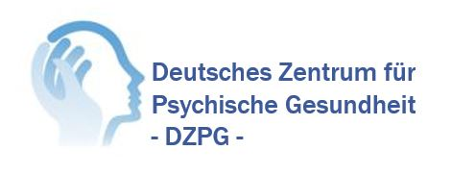
Conflict of interest: none

Slide 3
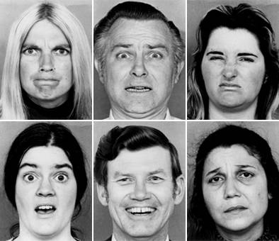
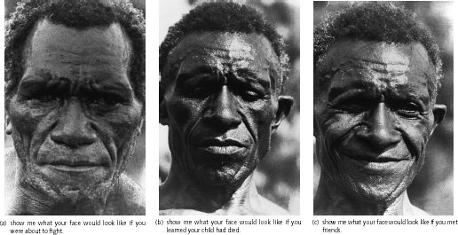



On emotions (briefly, incomplete and maybe not sufficient)
Distinct states of emotions have been described, such as happiness, fear, anger, disgust etc. (Darwin,1872/1898; Ekman & Friesen, 1971)
Universal, innate, also present in other primates
Some important functions: necessary for survival, allocation of ressources, social signal system, regulation and control of behaviour
Test for your students: what is the function of a broken heart?
A more novel approach: Feldman Barrett (2017): How emotions are made

Slide 4
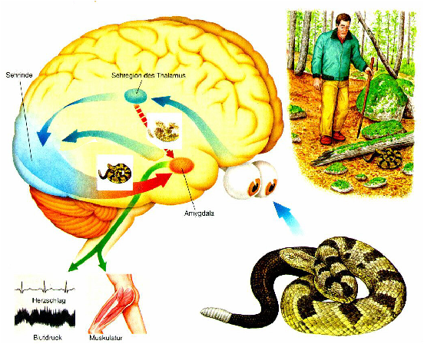
A stereotypical situation and its neural, neurophysiological and behavioral consequences
Situations of threat require fast recognition and approach to the problem: fight or flight

Slide 5
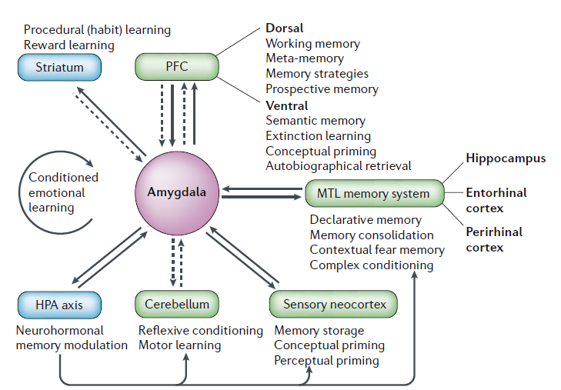
A brief introduction to the emotion network
Pessoa, 2017
LaBar & Cabeza, 2006
The highly complex connections evidence the interplay of emotions with other aspects like regulating and controlling behaviour

Slide 6



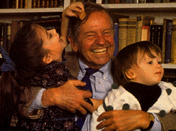












How to investigate emotions (quick and dirty):
pleasant
Appetitive gradient
approach
VALENCE
AROUSAL
withdrawal
unpleasant
Aversive gradient
Bradley and Lang, 2004

Slide 7
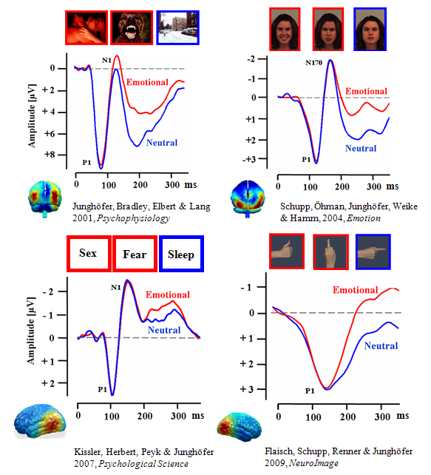

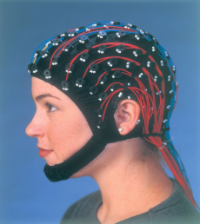
Characteristics of emotions: fast and efficient
For the measurement of fast brain responses:
Electro- and Magnetoencephalography

Slide 8
Two major ERP/ERF components
The gold standard: two reliable emotion sensitive ERPs:
Early posterior negativity (EPN, 120-300ms, posterior electrodes)
  in response to different arousing stimuli (e.g. faces, scenes, words, gestures)
  index of “natural selective attention” or “motivated attention”
  automatic extraction of emotional features/ aspects
The late positive component (LPC) (> 350 ms, centroparietal electrodes)
  associated with task demands such as attentional capture, evaluation, or memory encoding (Kissler et al., 2009)
  Evaluation of emotional/neutral stimulus

Slide 9
What are we talking about?
Emotion?
Yes: importance, significance, valence, arousal…
No: no autonomic measures like heartbeat, skin conductance etc. Emotions need a body.
Cognition?
Yes: description within a processing framework, enhanced processing, automatic etc.
No: why would we then need a definition for emotion?
Cognition for emotion? Emotional cognition?
Why not? The point is: it starts with the brain (but it is context dependent)
Proposal: It depends on your definition of emotion and which aspects are most important to you!

Slide 10
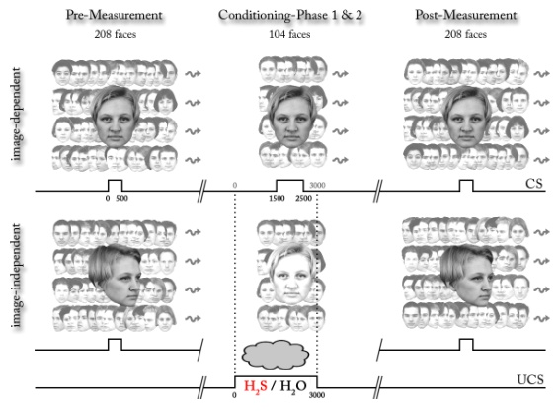
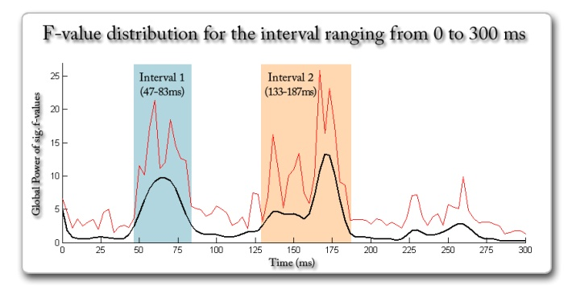
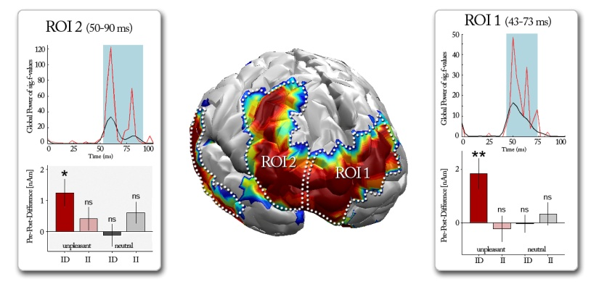
And even faster and more efficient
Steinberg, Dobel et al., 2012

Slide 11

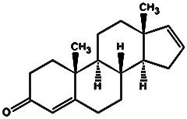
A human chemosignal?
The steroid androstadienone (AND):
proposed to be a human sexual hormone

Slide 12
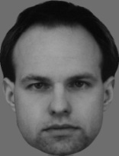
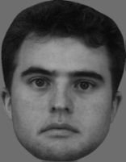
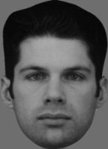
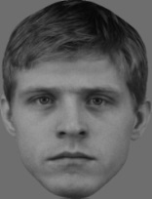

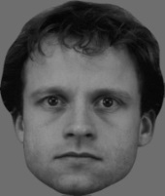
Stimuli
Conditioned stimuli (CS):
78 pictures of neutral
male faces
Unconditioned stimuli (US):
Three odors
AND with solvent
Vanillin with solvent
Pure solvent (propylenglycol)

Slide 13
What is the property of AND?
**
**
8
Valence and Arousal :
AND = solvent (p = 1.0)
6
4
2
AND
Van
solv
0

Slide 14
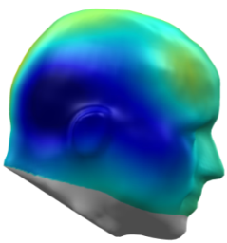
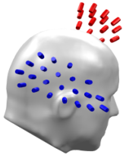
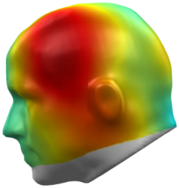
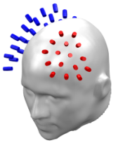
Evoked magnetic fields during EPN interval
**
AND^{(post-pre)} - solv^{(post-pre)}
4
**
0
Van
-4
AND
solv
-8
-12
-16
regional amplitude differences [fT]
F_{(2,38)} = 4.9, p = .013
-20
16
**
12
8
4
AND
Van
solv
Session x Odor x Hemisphere:
F_{(2,38)} = 7.434, p = .002
0
-4
F_{(2,38)} = 3.447, p = .042

Slide 15
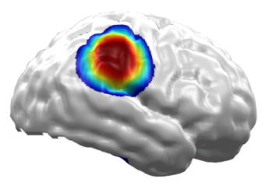
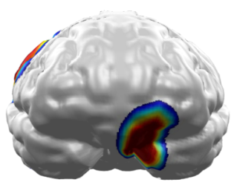
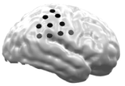
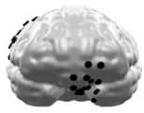
Estimation of neural generators (L2MN) during EPNm
right temporo-parietal junction:
left orbito-frontal cortex:
2
*
2
*
regional amplitude differences [pA/mm²]
regional amplitude differences [pA/mm²]
1
1
AND
solv
0
0
AND
solv
-1
-1
F_{(1,19)} = 7.3, p <.05
F_{(1,19)} = 5.8, p <.05
-2
-2

Slide 16



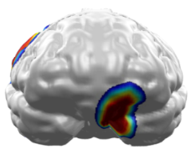
AND enhances emotional processing of socially relevant stimuli
Modulation of the arousal-sensitive Early Posterior Negativity (EPNm)
  Enhanced processing of AND-conditioned relative to solvent-conditioned male faces between 130 and 290ms after stimulus onset
Estimated neural generators in brain regions crucially involved in processing of visual social stimuli and emotion
right TPJ
multisensory association area, vision & olfaction
left OFC
preference for appetitive stimuli
Klinkenberg, Dobel et al., under rev.

Slide 17

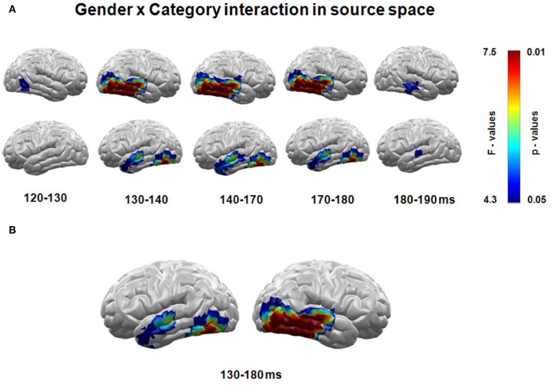
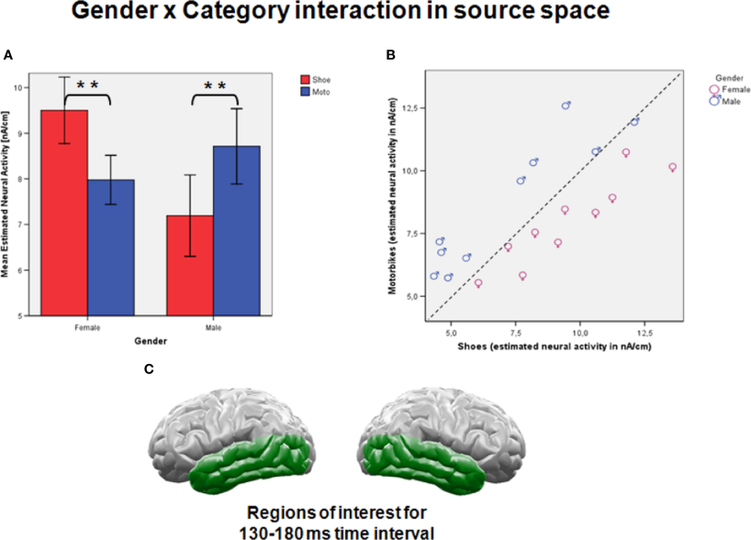
When the brain knows more about you than yourself
Junghöfer, Kissler & Dobel 2010

Slide 18
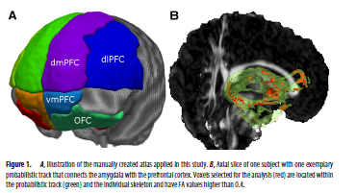
Probing the network with DTI in anxious persons
Diffusion Tensor Imaging as a method to study structural / functional connections: mapping the fibre architecture
Eden et al., (2015b)

Slide 19
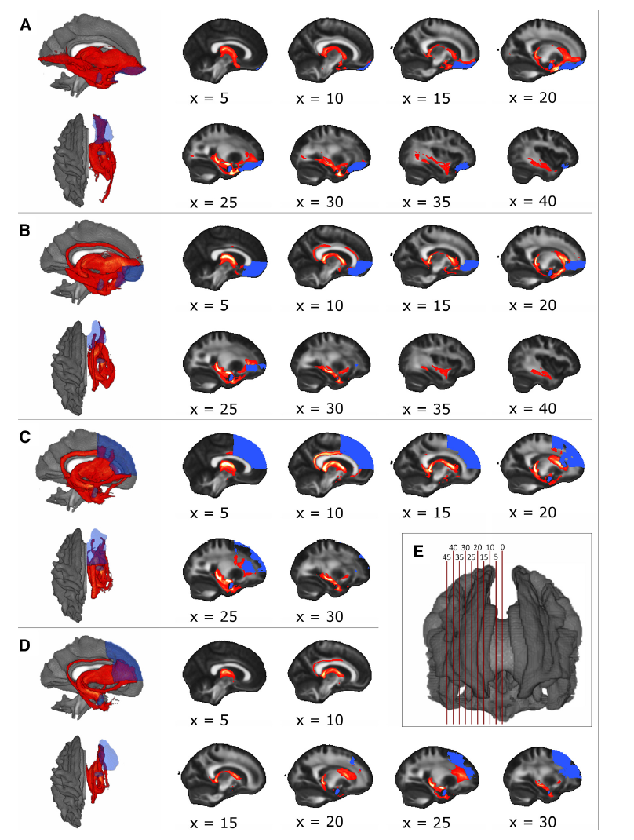
Probing the network with DTI: display of connections
From amygdala to:
A: orbitofrontal cortex
B: ventromedial PFC
C: dorsomedial PFC
D: dorsolateral PFC
E: tracts localization from medial to lateral
Message:
Stronger connectivity between amygdala and vmPFC and OFC of the right hemisphere in persons with low anxiety
Stronger connectivity between amygdala and vmPFC, OFC, dmPFC and dlPFC of the left hemisphere in persons with high abilities to regulate anxiety (reappraisal use)
Different involvement of the hemispheres in anxiety and anxiety regulation

Slide 20
Why in all earth words as stimulus material?
Do mechanisms of motivated or emotional attention apply to culturally learned stimuli?
Emotional words are experimentally very important, because their appearance on the surface is so homogeneous and similar, i.e. arbitrary mapping
Their emotional valence and arousal can be tailored to specific clinical groups
Words are less stressful than visual or auditory emotional scenes
Mapping pseudowords with meaning allows to track the emotional significance of a stimulus from neutral to emotional, e.g. in combination with implicit and explicit measures (a very large topic in itself…)
…

Slide 21
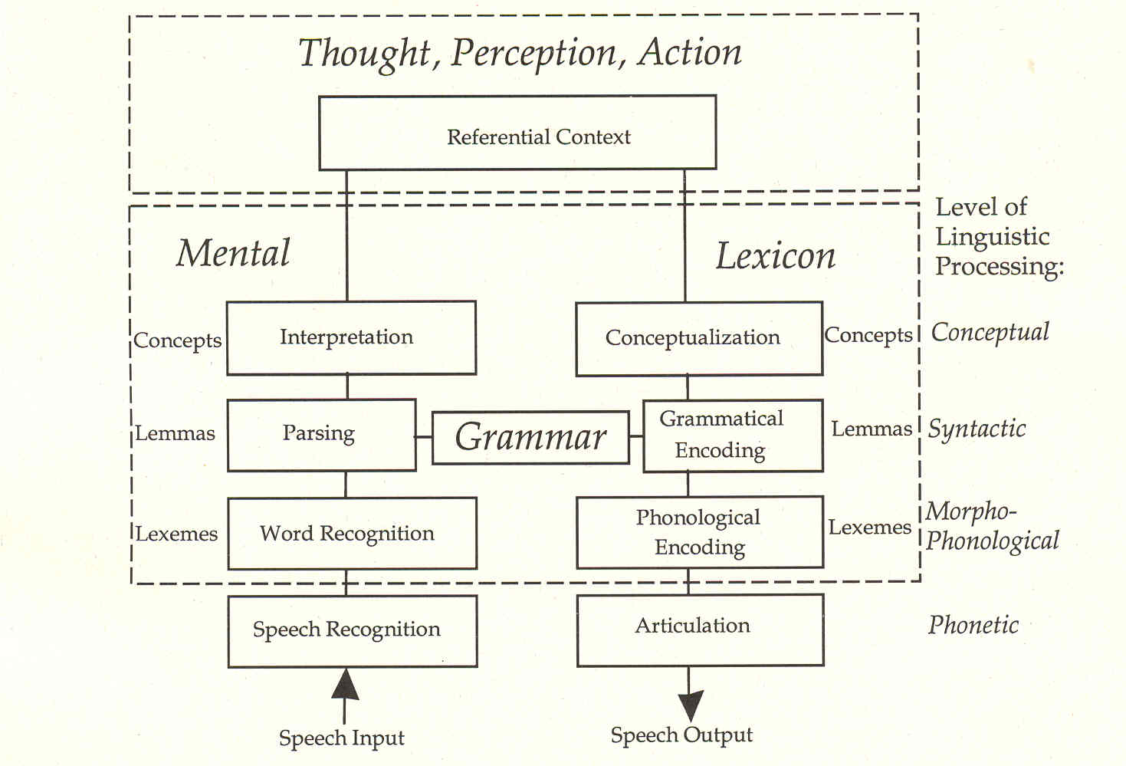
An overarching proposal…
Kempen, 2002

Slide 22








Learning Words, e.g. for emotional concepts
correct
incorrect
correct
binu
learning pass 1
incorrect
bane
etc.
correct
binu
learning pass 2
bane
incorrect
etc.
e.g. Dobel et al., 2009; 2010

Slide 23


Learning emotional words in anxious persons
Eden et al., 2014

Slide 24
Learning emotional words in anxious persons
During learning a bias for emotional words is only briefly visible
A memory bias for emotional words becomes visible after only 5 learning instances and remains present up to two weeks after learning (even for explicitly not remembered words)
Persons with high trait anxiety show a general trend to evaluate items negatively even completely neutral ones (Eden et al., 2014)

Slide 25
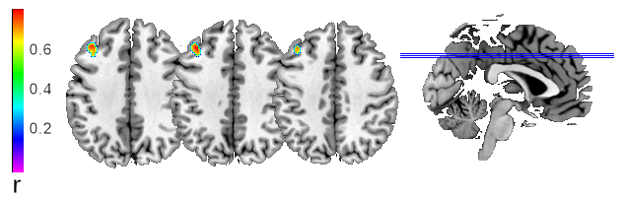
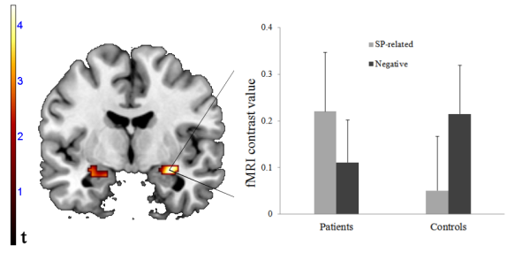
The Anxiety Network: Amygdala and Pfc
For negative words: functional connectivity between amygdala and dlpfc correlates negatively with trait anxiety (Laeger et al., 2013)
Disorder relevant words evoke different brain responses than generally negative words (Laeger, Dobel et al., 2014a)
For names assoicated with fearful faces: functional connectivity between amygdala and dlpfc as well as ofc correlates negatively with social phobia scale (Laeger et al., 2014b)
Even very brief and shallow learning of emotional words results in higher amygdala activity for emotionals words – even for those not remembered (Eden et al., 2015)
Evidence for the regulating function of the PFC

Slide 26
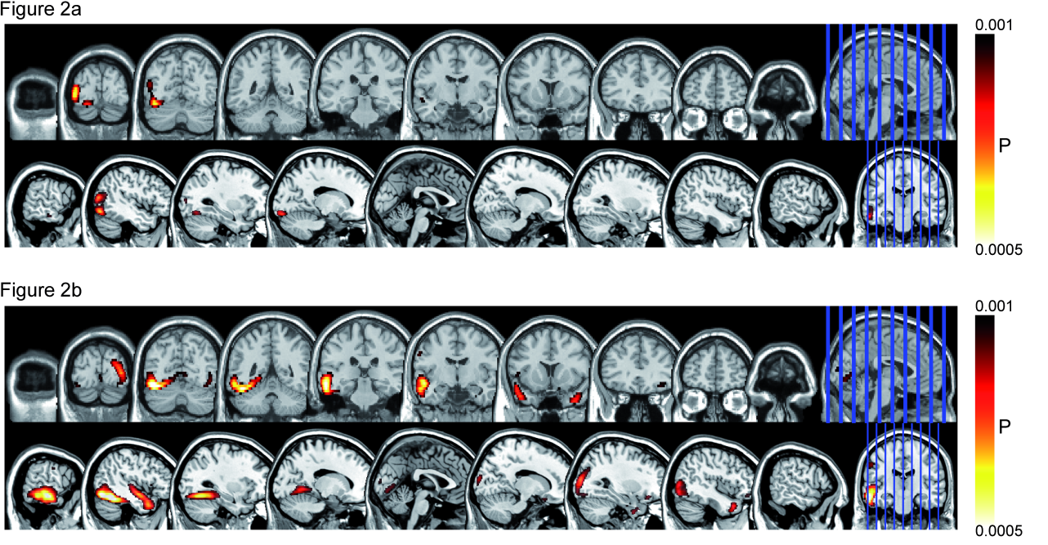
Emotional words: faster than thought
80-120 ms
200-300 ms
Emotional > neutral
80 – 120 ms: higher activity in left temporal regions (see also Zauner et al., 2014)
200 – 300 ms: higher activity in occipital, parietal and posterior limbic structures (Keuper et al., 2013a)

Slide 27
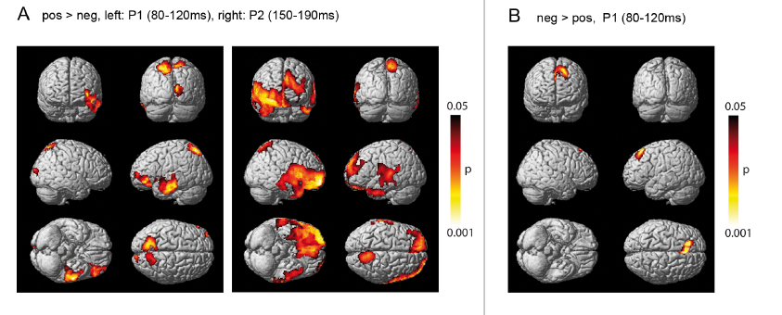
Emotional words: faster than thought
Keuper et al., 2013 b

Slide 28

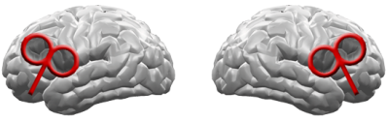
Probing the network with TMS
1) cTBS (Huang et al. 2005)
Within-subject-design
  cTBS right vs. left (ISI: 48h)
  word valence: pos vs. neg vs. neut
cortical inhibition ~1hour
2) Simultaneous MEG and EEG
3) Behavioral measures
~ 250 ms
+
700 ms
love
~ 250 ms
+
700 ms
hate
~ 250 ms
+
700 ms
sleep

Slide 29
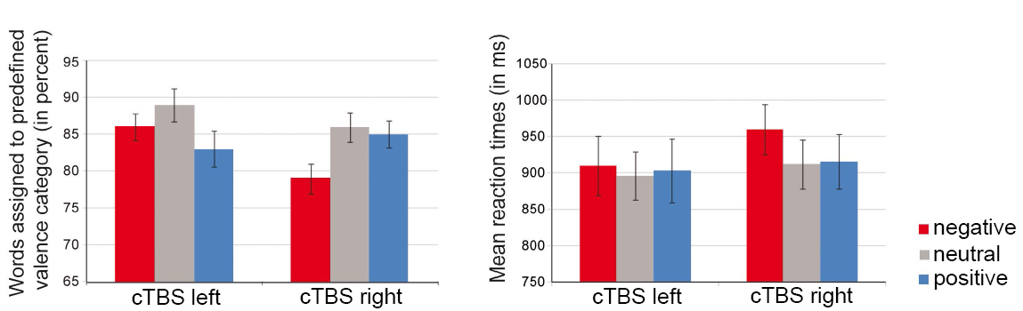
Probing the network: behavioral measures
Message: Interaction: stimulation site * valence (p= .012)
After right hemispheric inhibition positive words are rated as positive more often
After left hemispheric inhibition negative words are rated as negative more often
Roesmann et al. (2019)

Slide 30
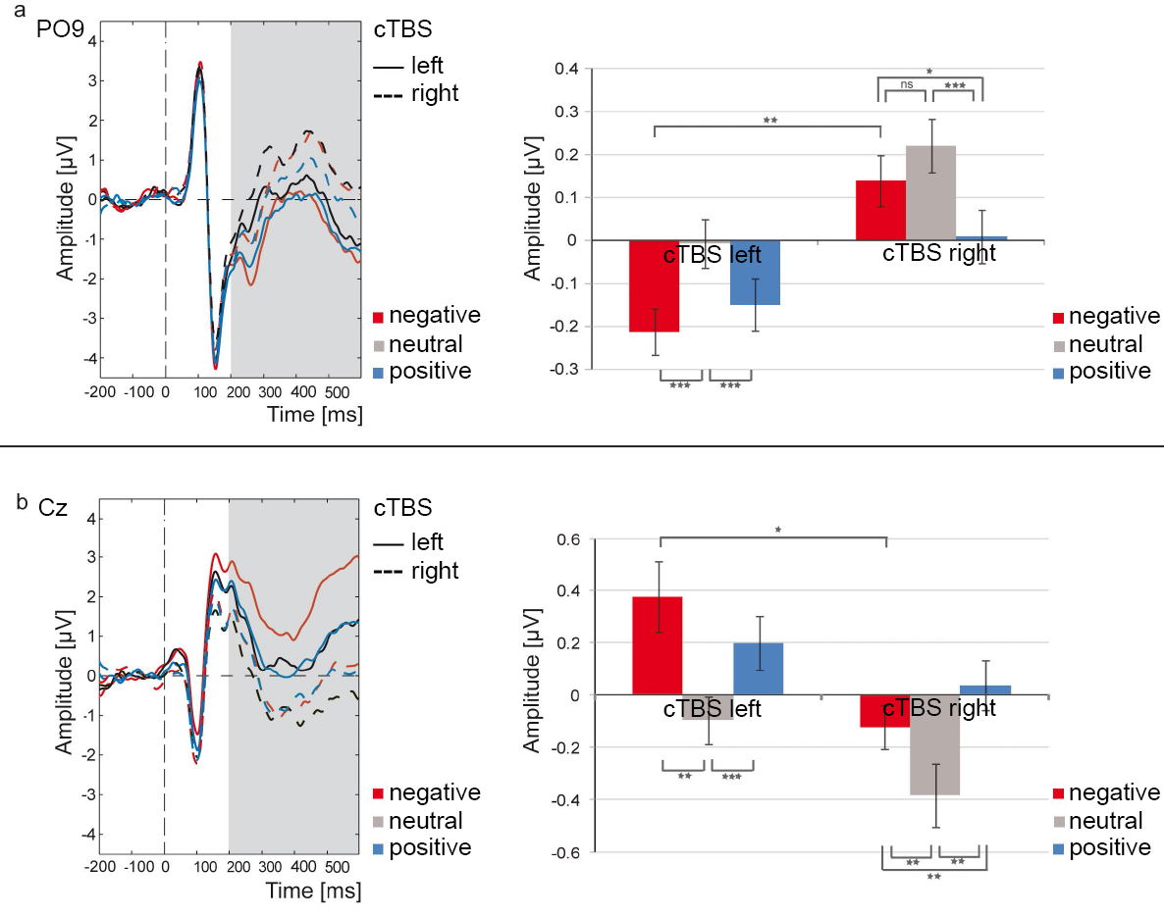
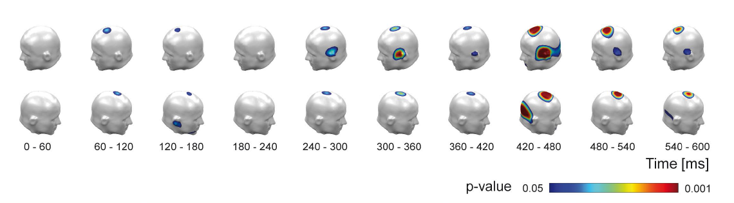
Probing the network: ERP results
Message:
Early brain responses indicate:
left-hemispheric stimulation resulted in enhanced processing of negative words, whereas right-hemispheric stimulation led to enhanced processing of positive words

Slide 31
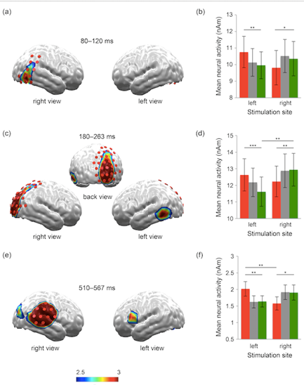
Probing the network: MEG results / source localization
Message:
TMS changes the very fast processing of emotional words
Roesmann et al. (2019)

Slide 32
Wrapping up…
The brain devotes a large network for processing of emotional stimuli
Such stimuli including words are processed by a fast and efficient manner; the underlying mechanisms are yet poorly understood
TMS applied to cortical parts of the emotion networks influences perception and apprehension of emotional words; this might constitute the mechanisms for the antidepressant and anxiolytic effects of TMS
Even persons with subclinical levels of anxiety (persons at risk to develop an anxiety disorder) display altered connectivity in amygdala – PFC connections for anxiety and regulation of anxiety
This approach allows us to follow the history/development of specific stimuli and their processing over time – an important approach for clinical research

Slide 33
Open questions = Discussion
What is the cognitive status of the early brain responses?
What is the function of the early responses? Gating of attention for future occasions or more?
What are the characteristics of emotional stimuli on large scale networks that take dynamic changes into account?
How does this network function in clinical cases, e.g. anxiety and depression?
Why is this interesting for linguists? Let me guess…

Slide 34






Thank YOU for your attention
Thank YOU for all the rest (and your attention):
Institute for Biomagnetism and Biosignalanalysis, University of Münster
Markus Junghöfer
Kati Keuper
Annuschka Eden
Torge Dellert
Marisa Nordt
kbo-Inn-Salzach Klinikum
Peter Zwanzger
Department of Psychology, University of Münster
Pienie Zwitserlood
Department for Psychiatry and Psychotherapy, University of Münster
Inga Laeger
Department of Psychology, University of Bielefeld
Johanna Kissler

Slide 35

My life now…

