Slide 1
Communication & PR

Slide 2
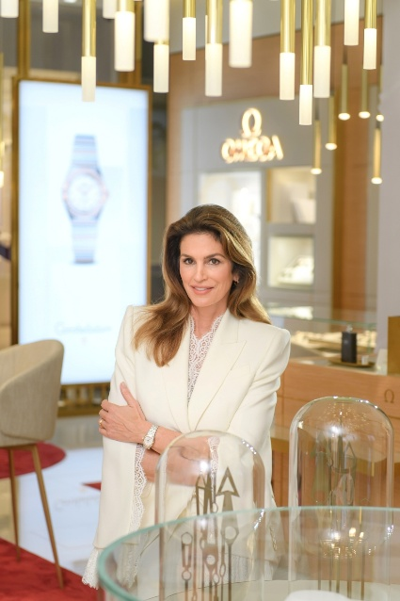
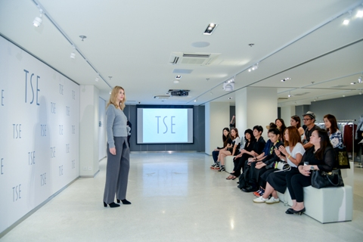
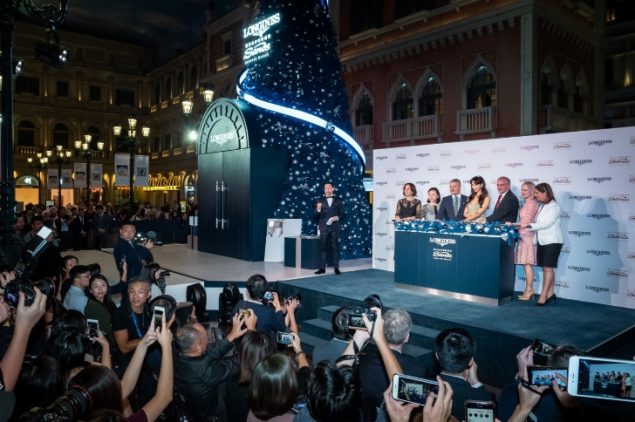
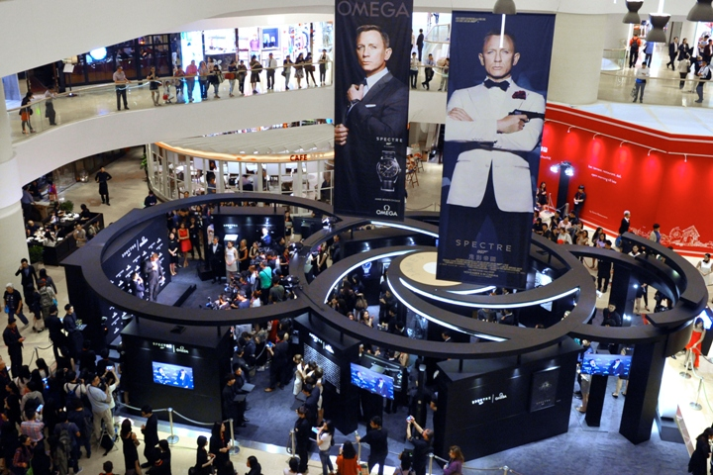
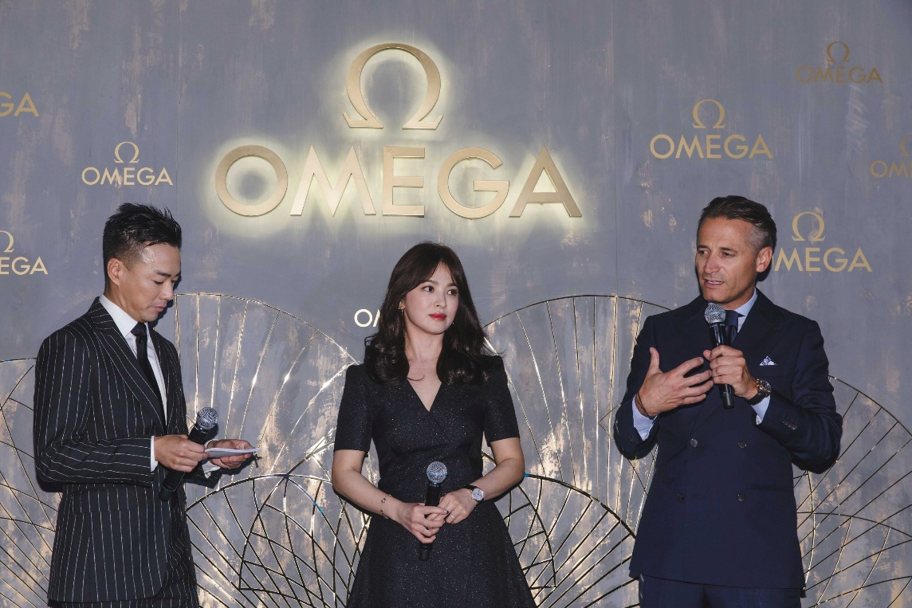
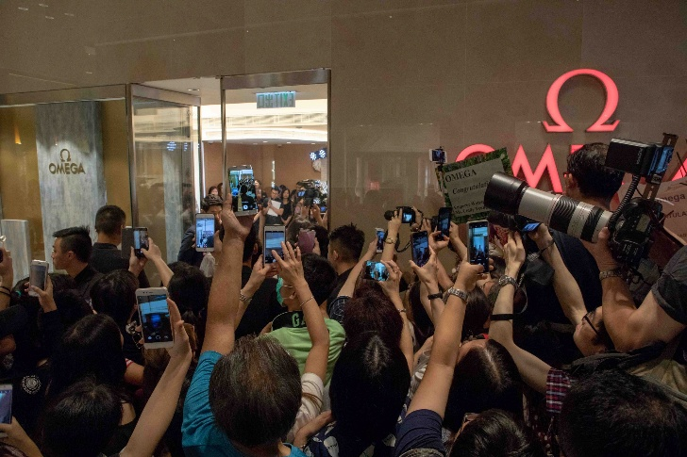
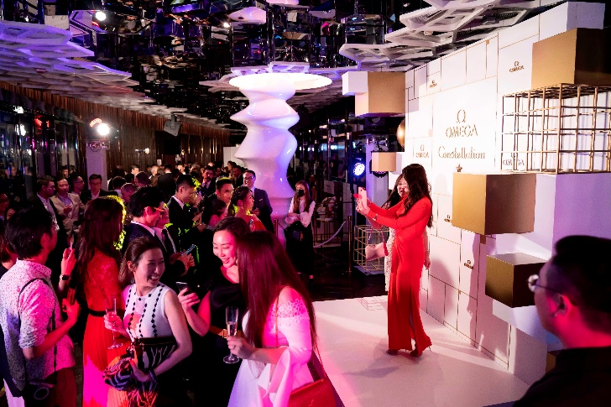
Product launching event
Media invitation and publicity
Event management
Artists liaison and management

Slide 3
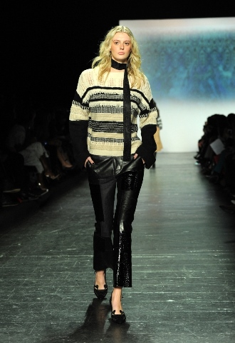
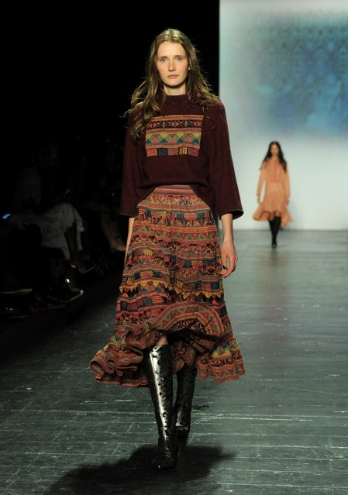
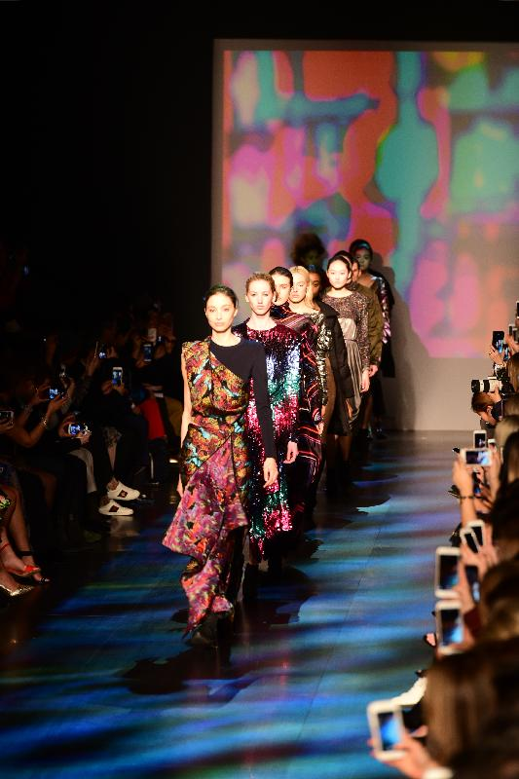
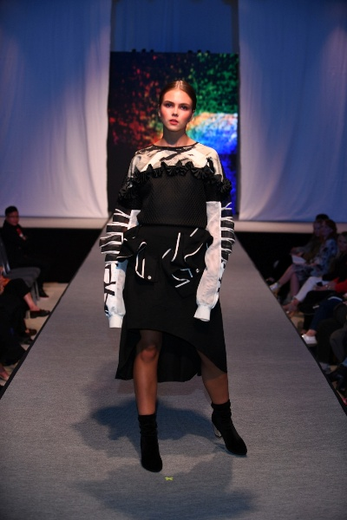
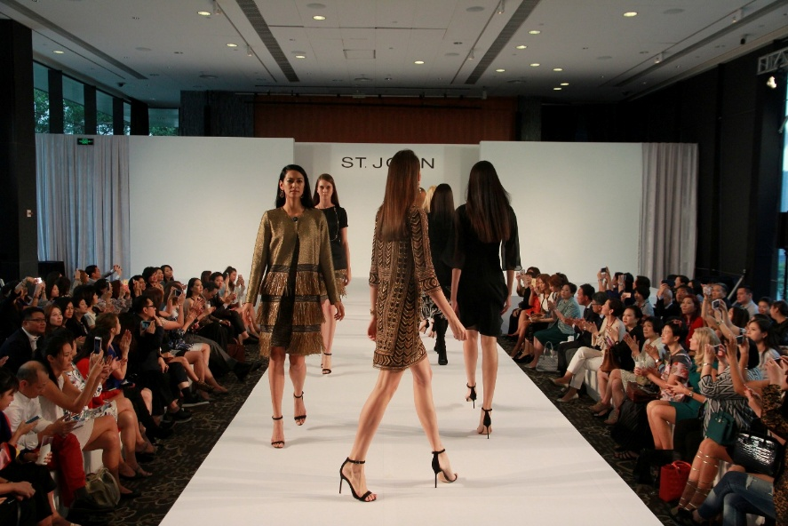
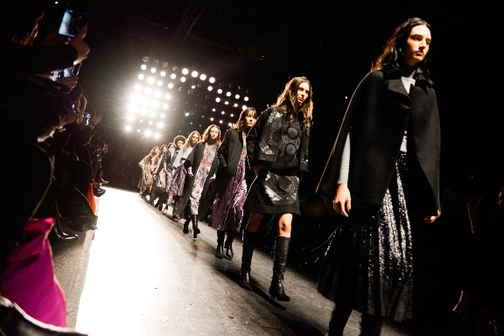
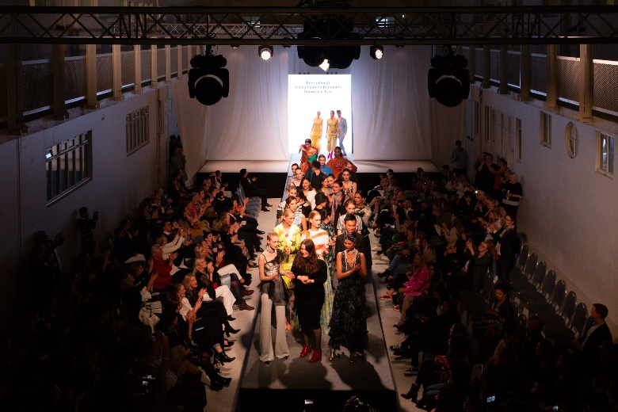
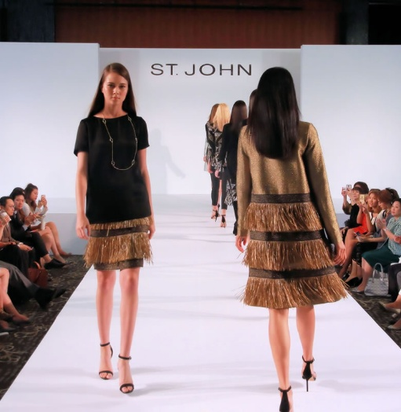
Catwalk show
Media invitation and publicity
Event management & show production
Artist liaison
New York Fashion Week 2016

Slide 4
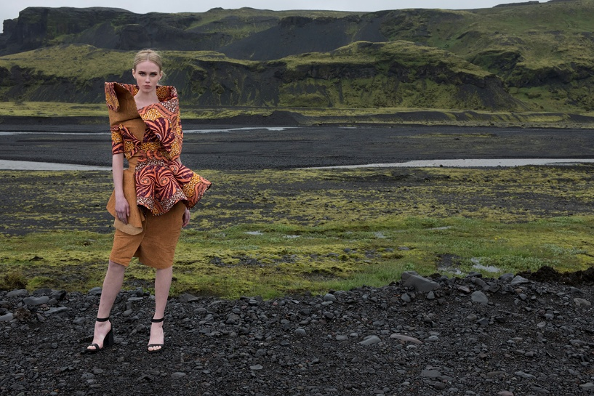
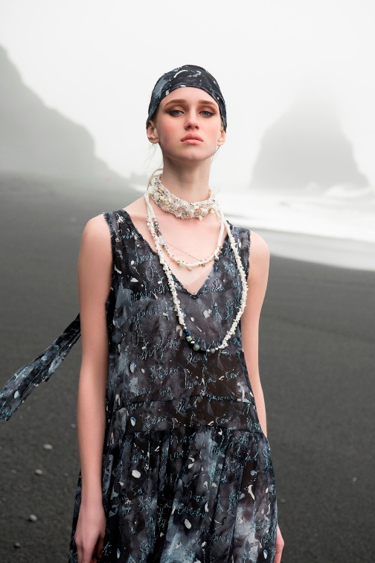
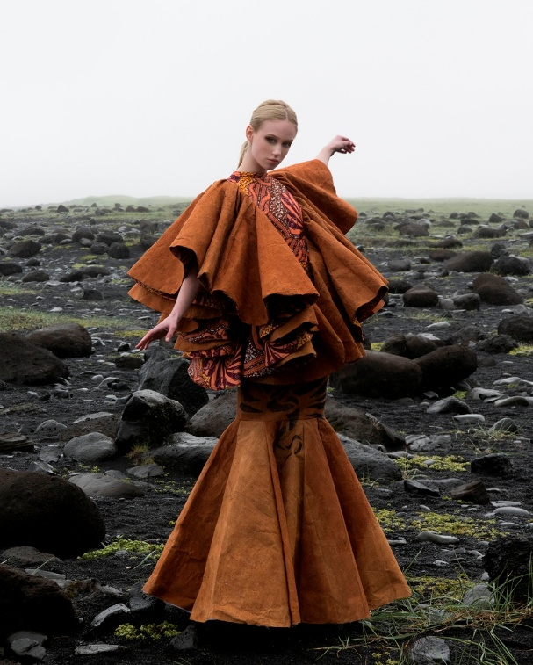
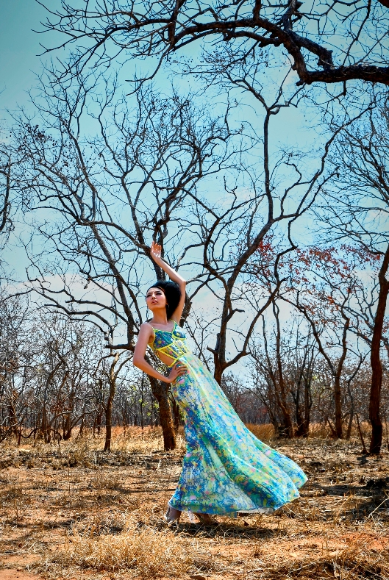
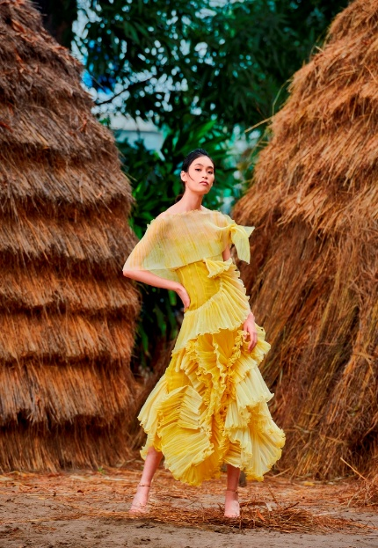
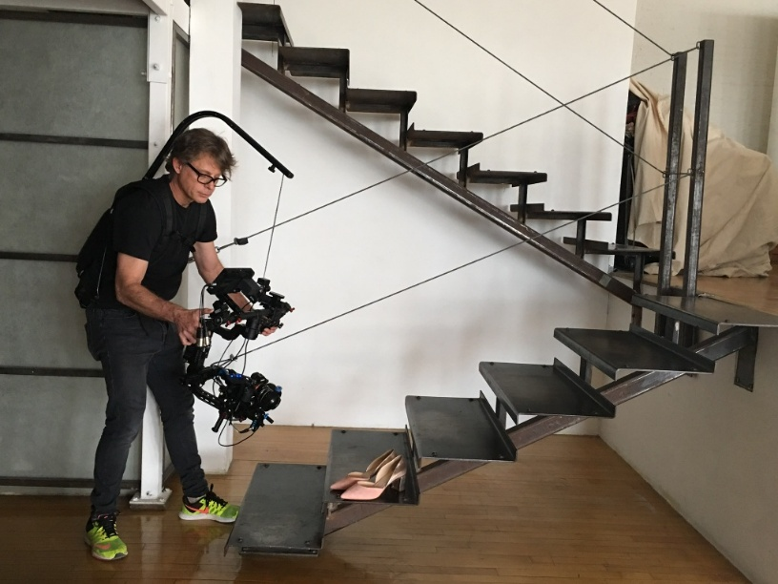
Fashion Photoshoot
Artist liaison and management
Shooting co-ordination and on-site arrangement

Slide 5
Brand Marketing

Slide 6
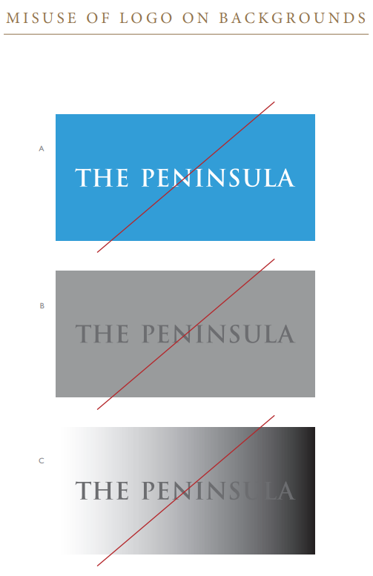
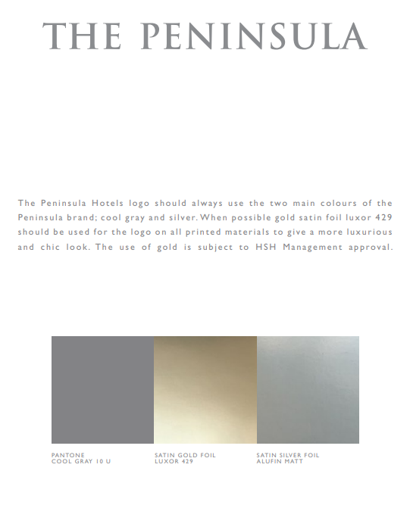
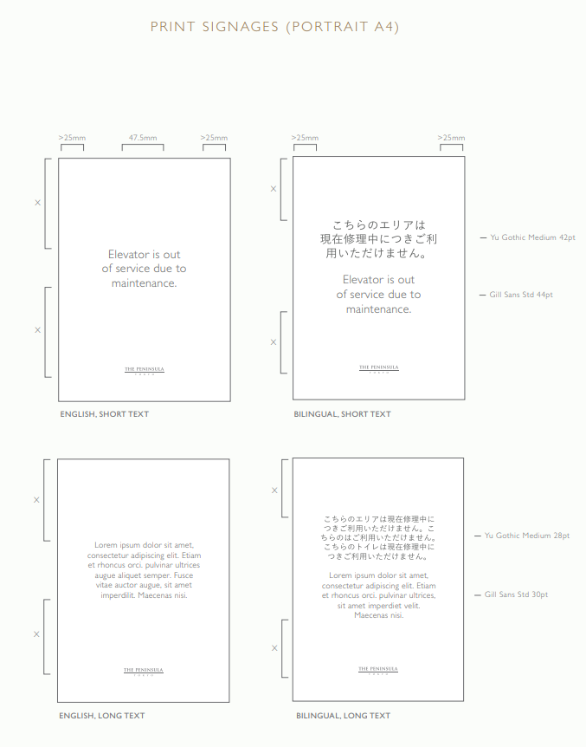
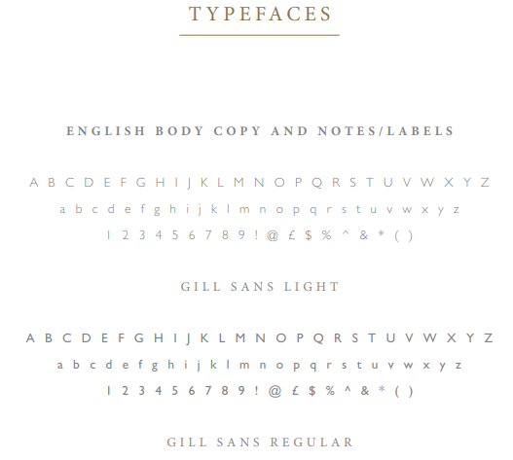
Brand marketing
BRAND POSITIONING
Commitment to uphold brand standards that reflect the essence of luxury hospitality
BRAND DEVELOPMENT
Brand messaging consistency – ensure consistency across all platforms and touchpoints
Brand standards management (creation & proofreading) – logos, collaterals, marketing and promotional materials, signages, displays, etc.

Slide 7
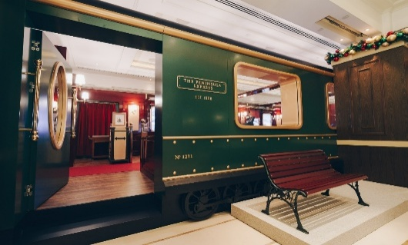
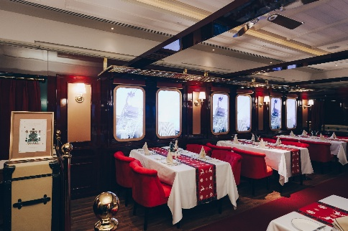
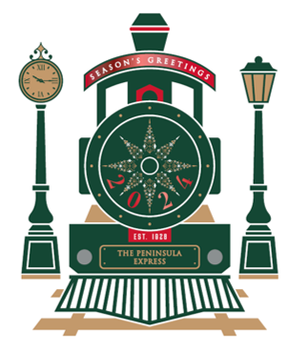
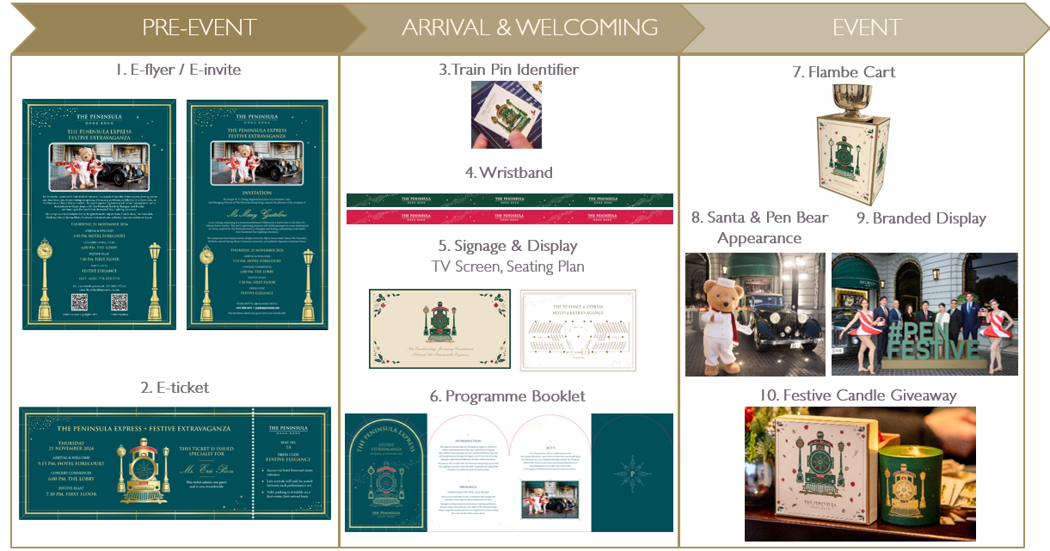

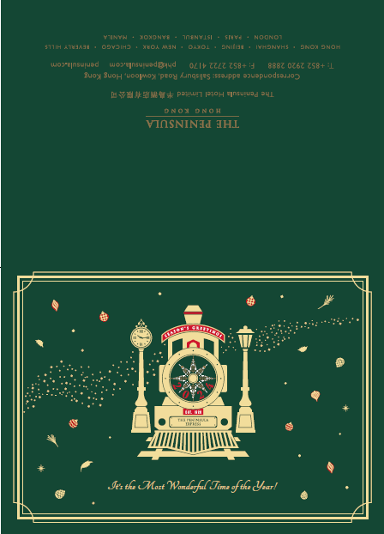
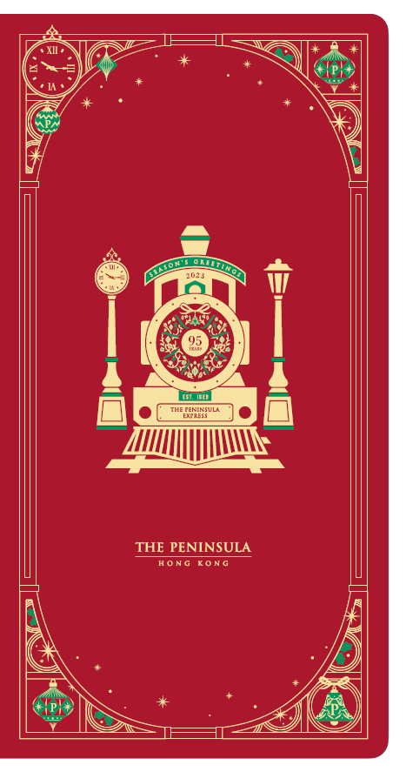
Brand marketing
CAMPAIGNS & PROMOTIONS
Brand awareness initiatives, including event-based and seasonal promotions (e.g. Festive, CNY)
- Print material e.g. menus, marketing collateral, signage, displays
- Cross-functional coordination (Sales, F&B, Operations, Production House)
Festive campaign

Slide 8
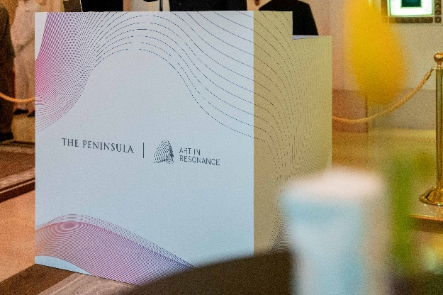
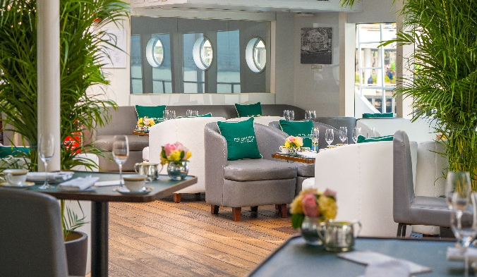
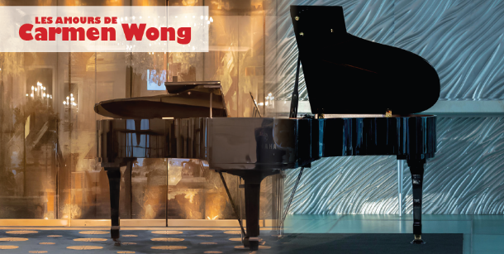
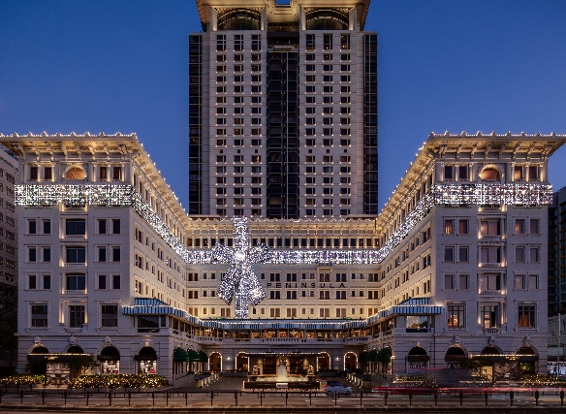
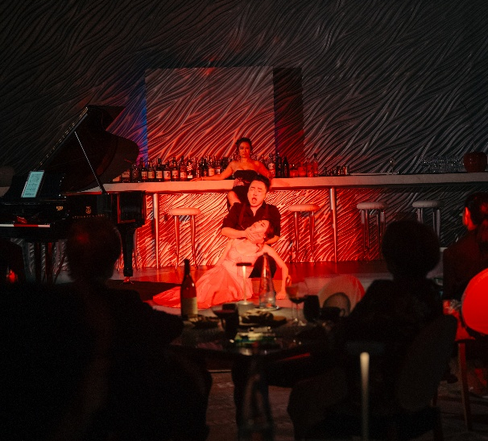
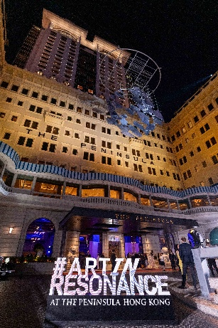
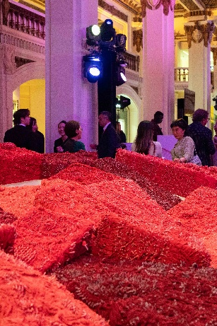
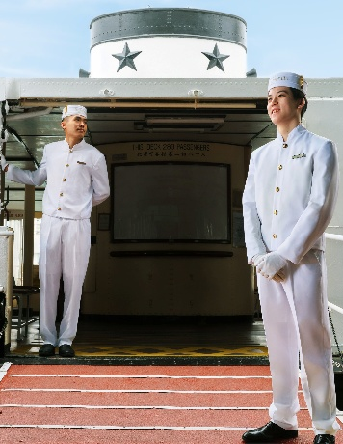
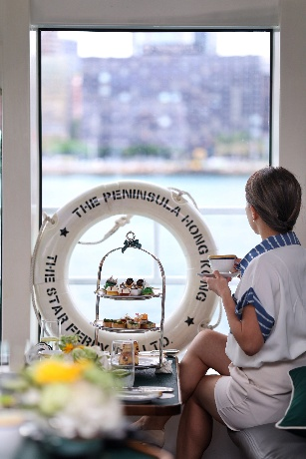
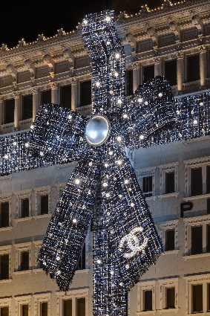
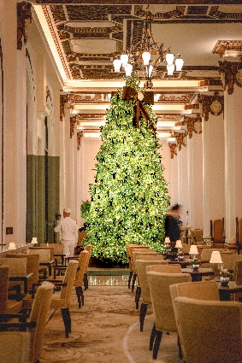
Brand marketing
CAMPAIGNS & PROMOTIONS
Brand collaborations and partnership (e.g. Art In Resonance, Star Ferry, French May, Chanel)
- Print material e.g. menus, marketing collateral, signage, displays
- Cross-functional coordination (Sales, F&B, Operations, Head Office, partners)
Art In Resonance
Star Ferry
French May
Chanel

Slide 9
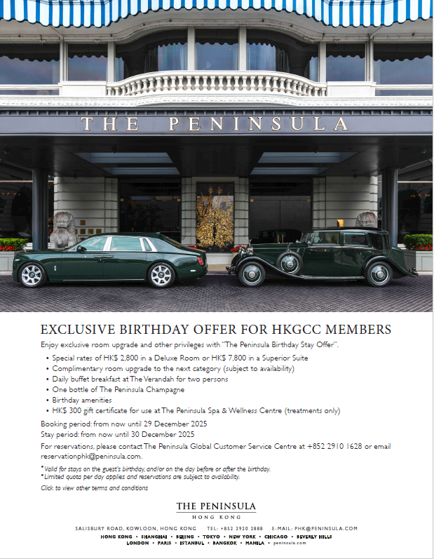
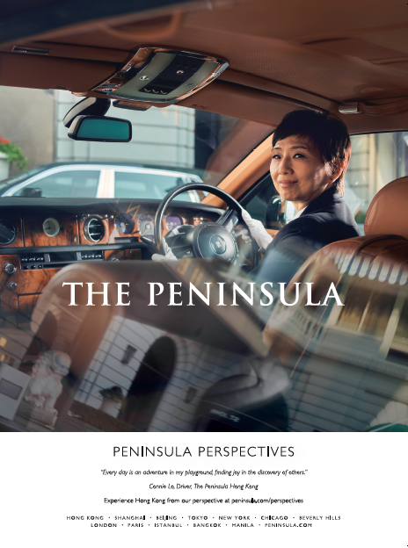
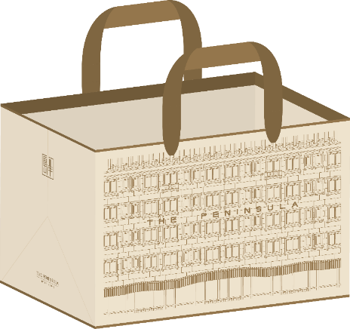

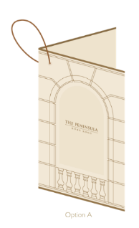

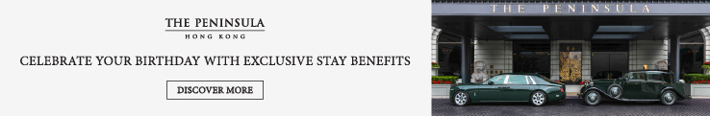
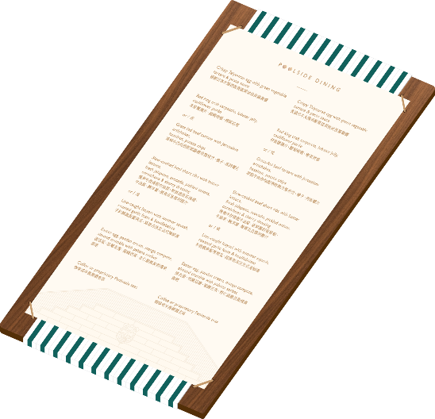
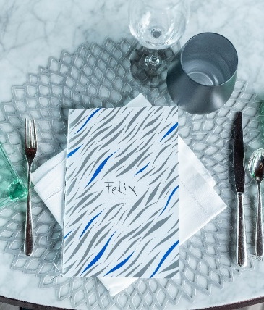
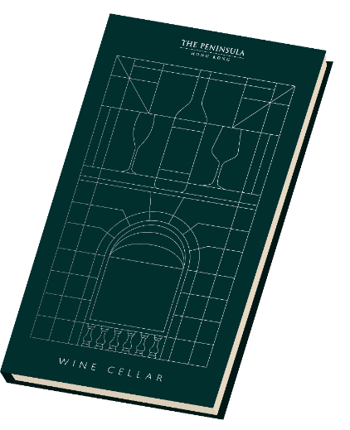



Brand marketing
DESIGN & CONTENT CREATION
Marketing collateral and packaging design and production
Merchandise & giveaways
Brand assets (photos & videos) creation

Slide 10







Brand marketing
DESIGN & CONTENT CREATION
Marketing collateral and packaging design and production
Merchandise & giveaways
Brand assets (photos & videos) creation

Slide 11











Brand marketing
DESIGN & CONTENT CREATION
Marketing collateral and packaging design and production
Merchandise & giveaways
Brand assets (photos & videos) creation

