Slide 1





LT Career Talk
Vincent Ng
LLA (2019-2024)

Slide 2
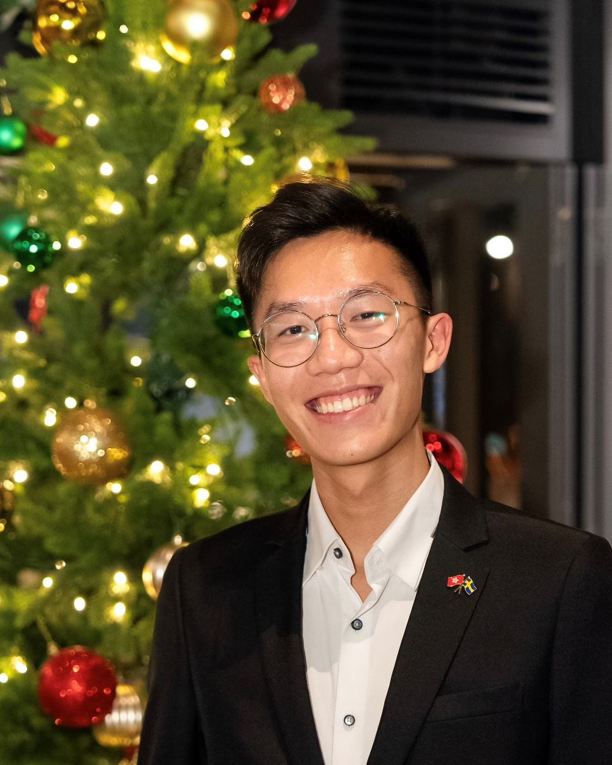
Who am I?
Vincent Ng
CityU (2019-2024)
Linguistics and Language Applications (LLA)
Exchange semester at Oslo University (2022)
Social Secretary & Administrative Officer at the Consulate General of Sweden in Hong Kong
02

Slide 3
Career Journey
03

Slide 4
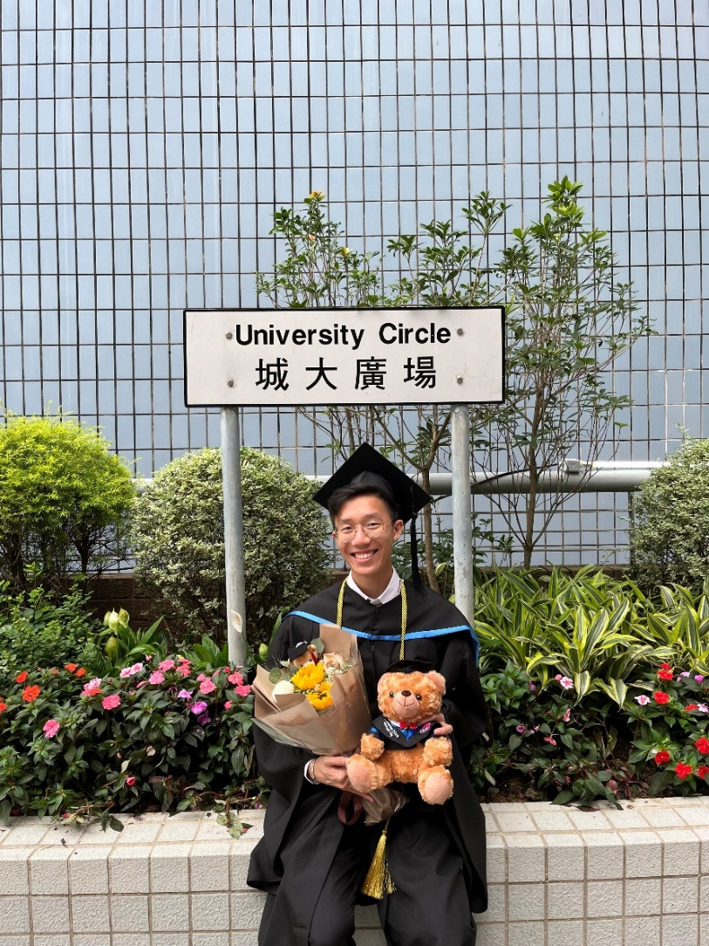


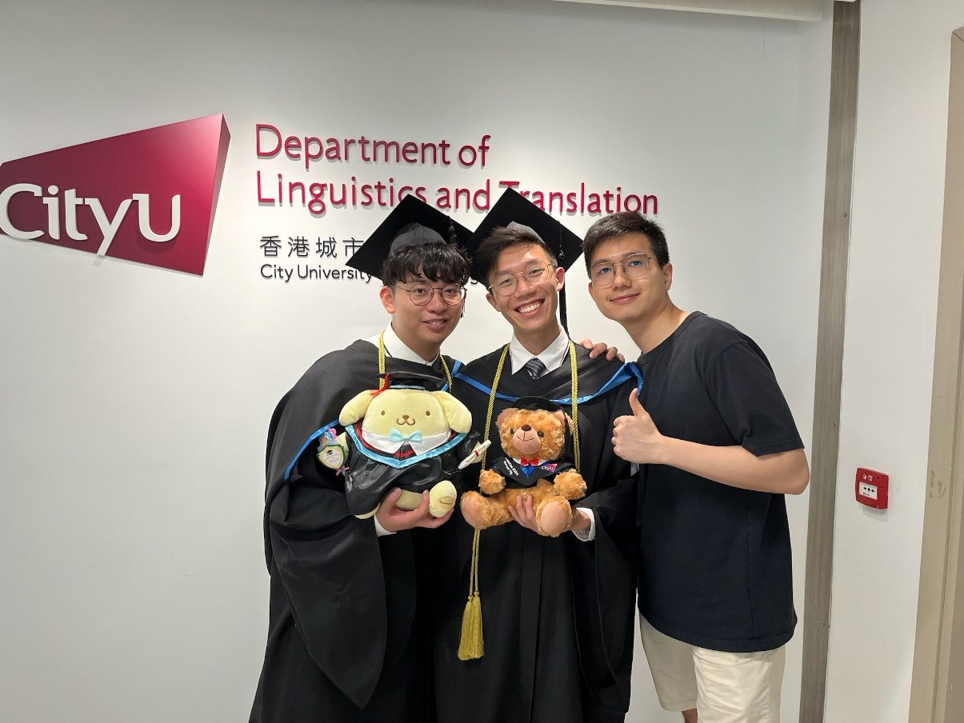
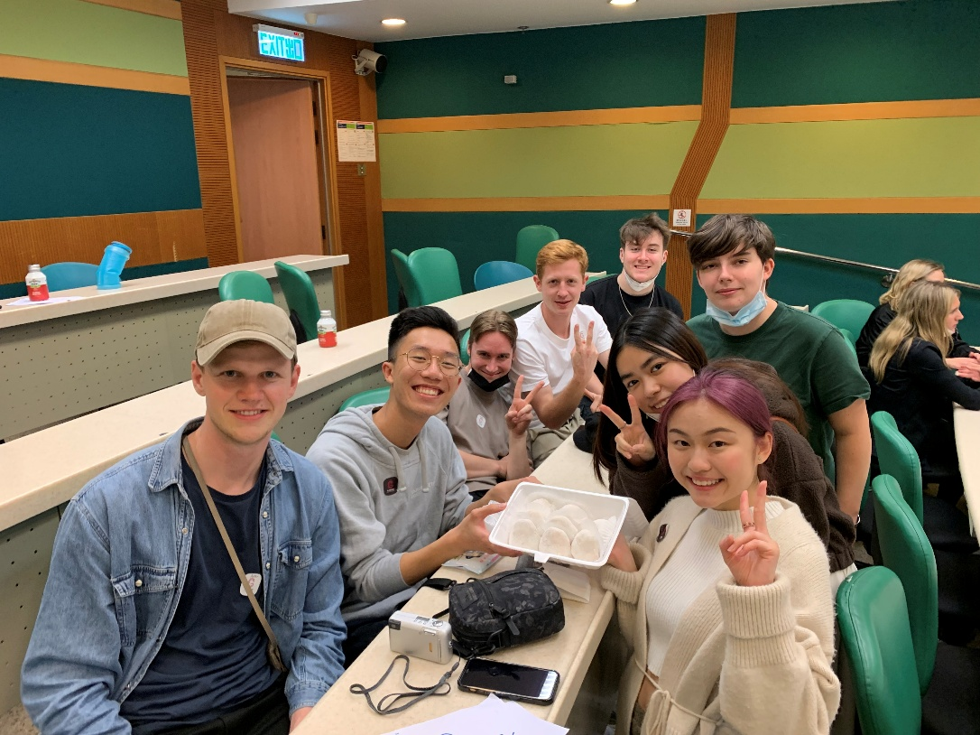
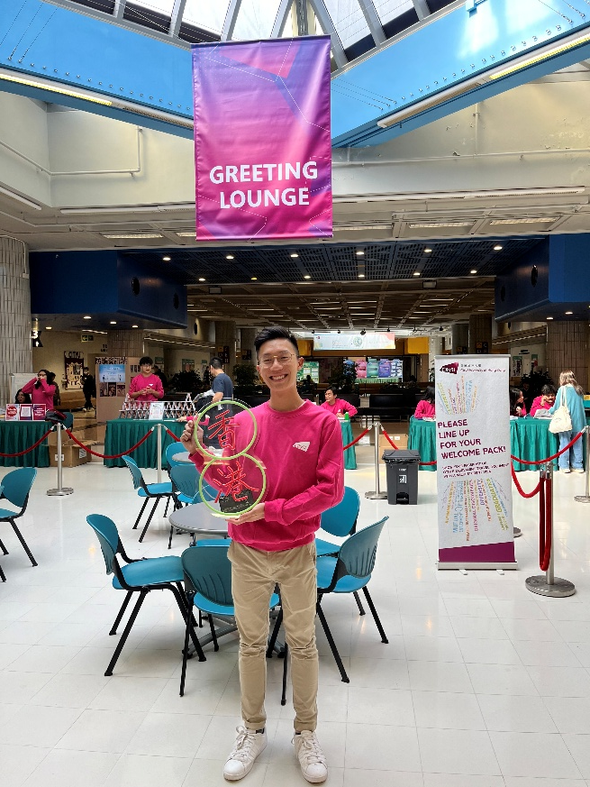
Career Journey
04

Slide 5
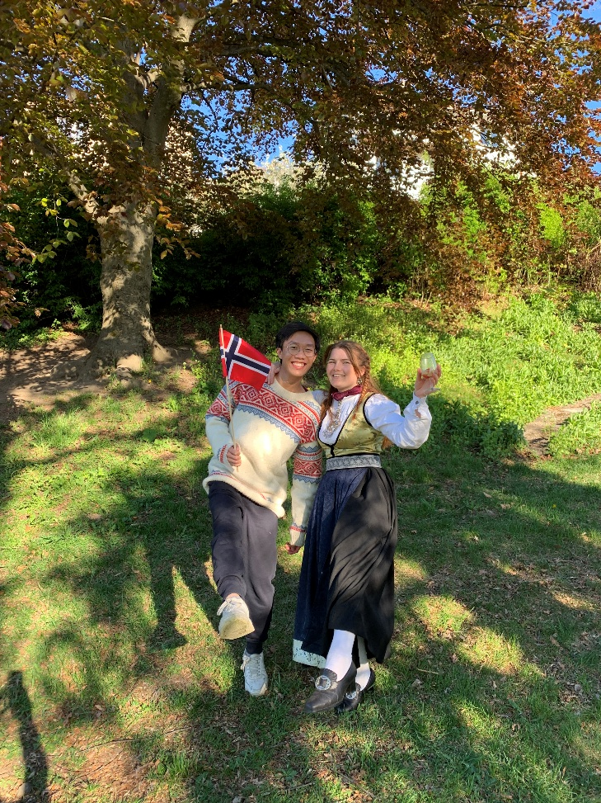

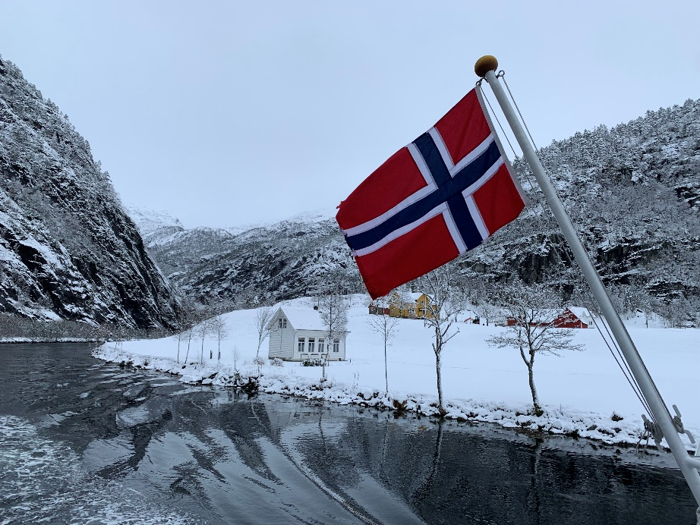
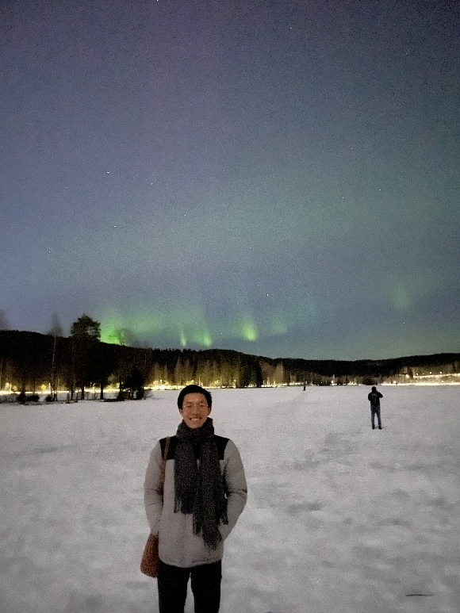
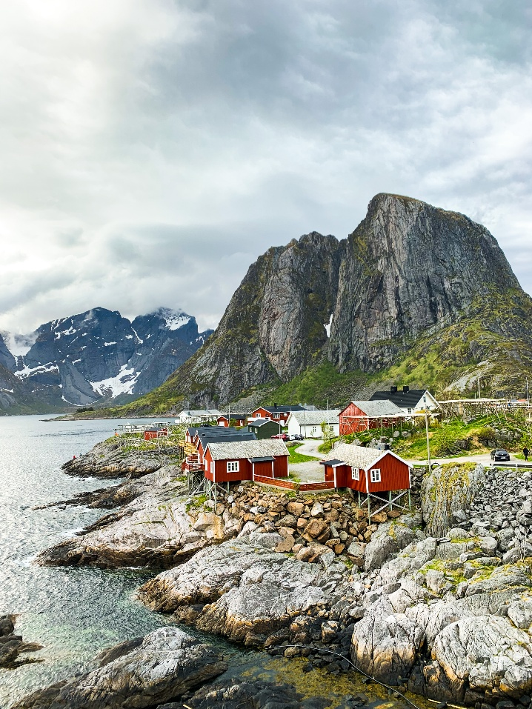

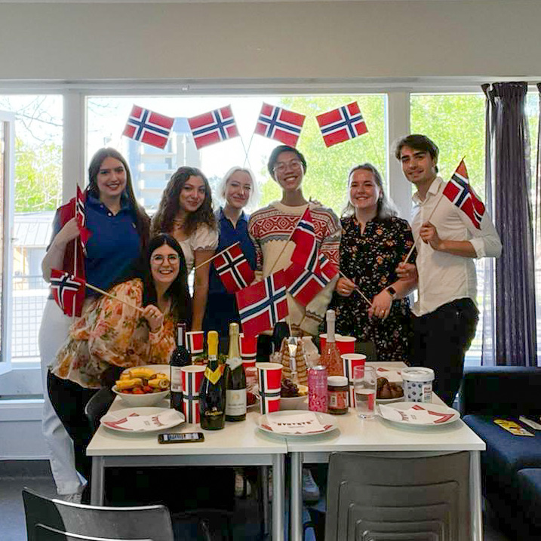
Career Journey
05

Slide 6
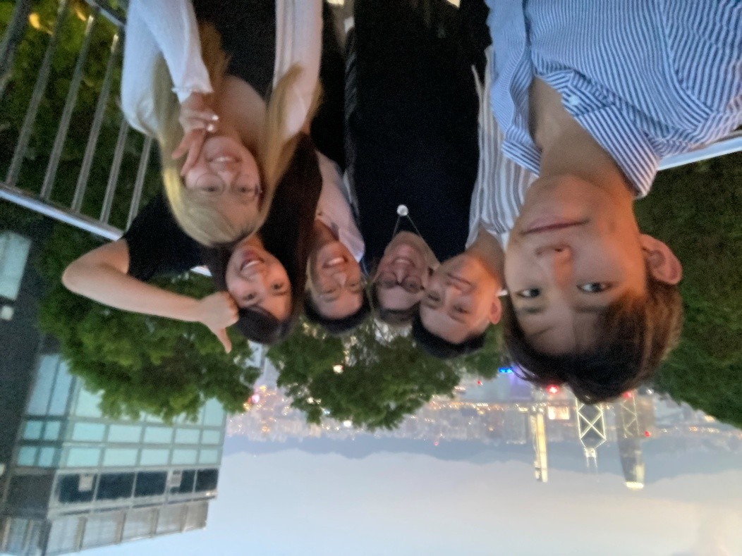
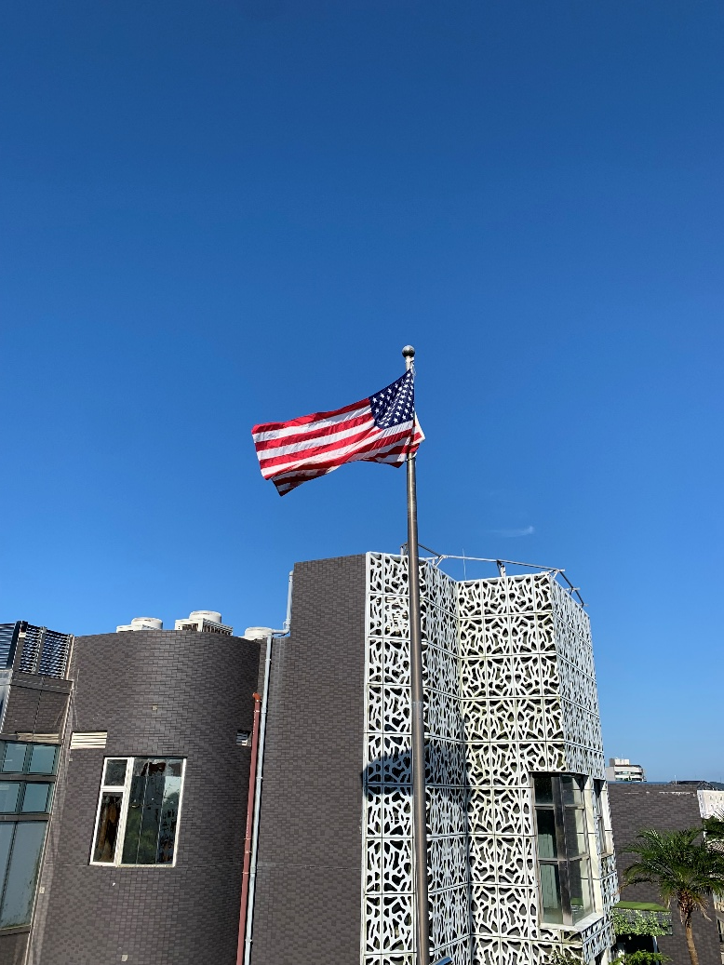
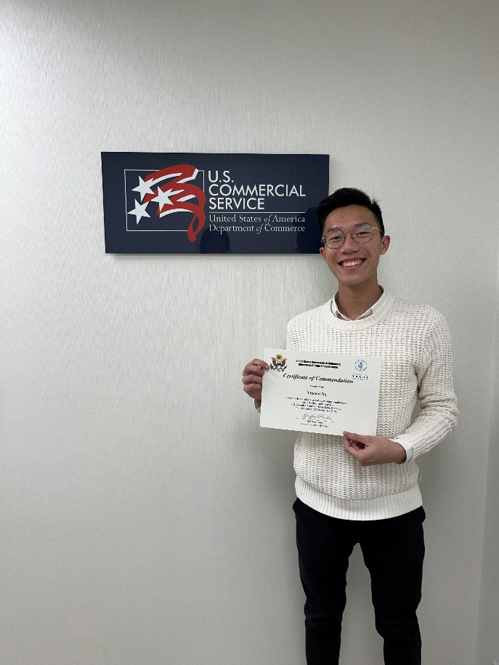
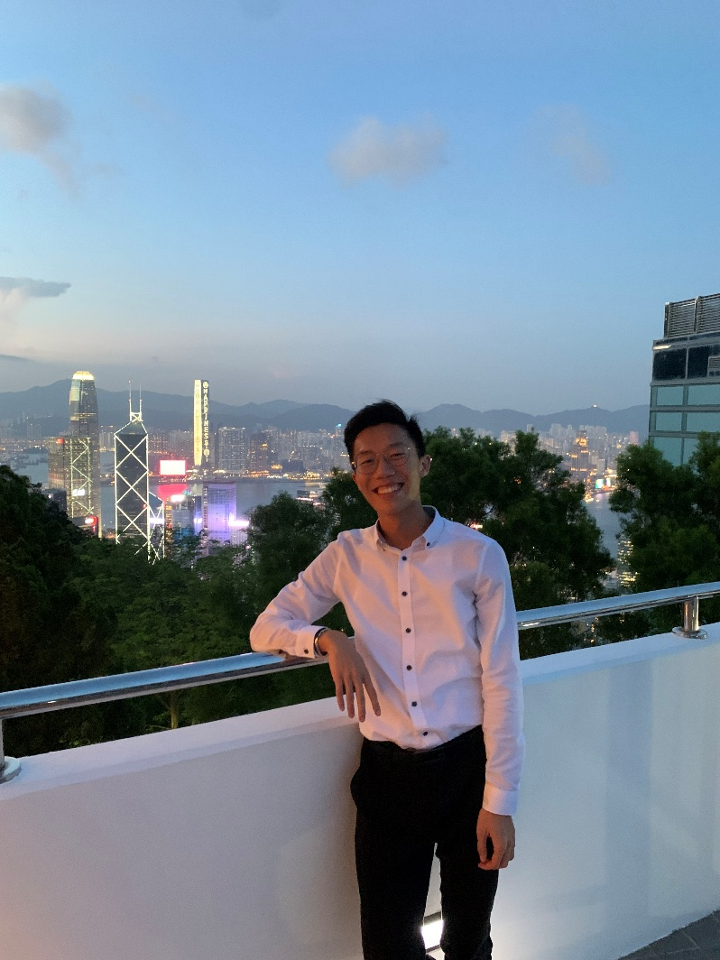
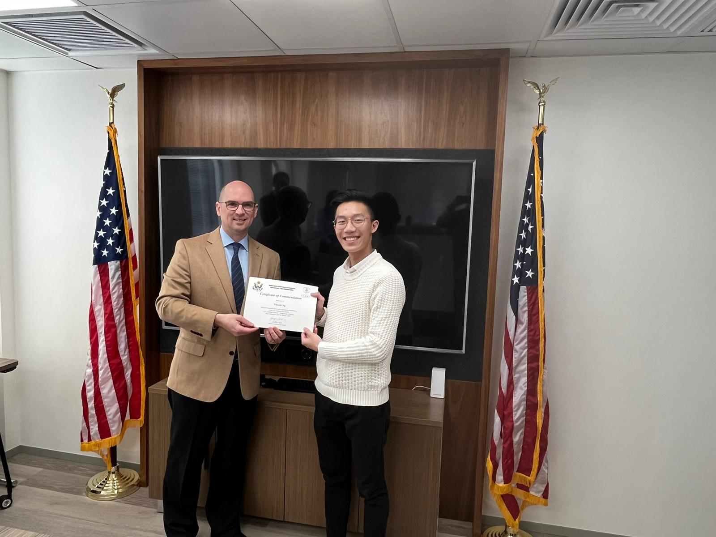
Career Journey
06

Slide 7
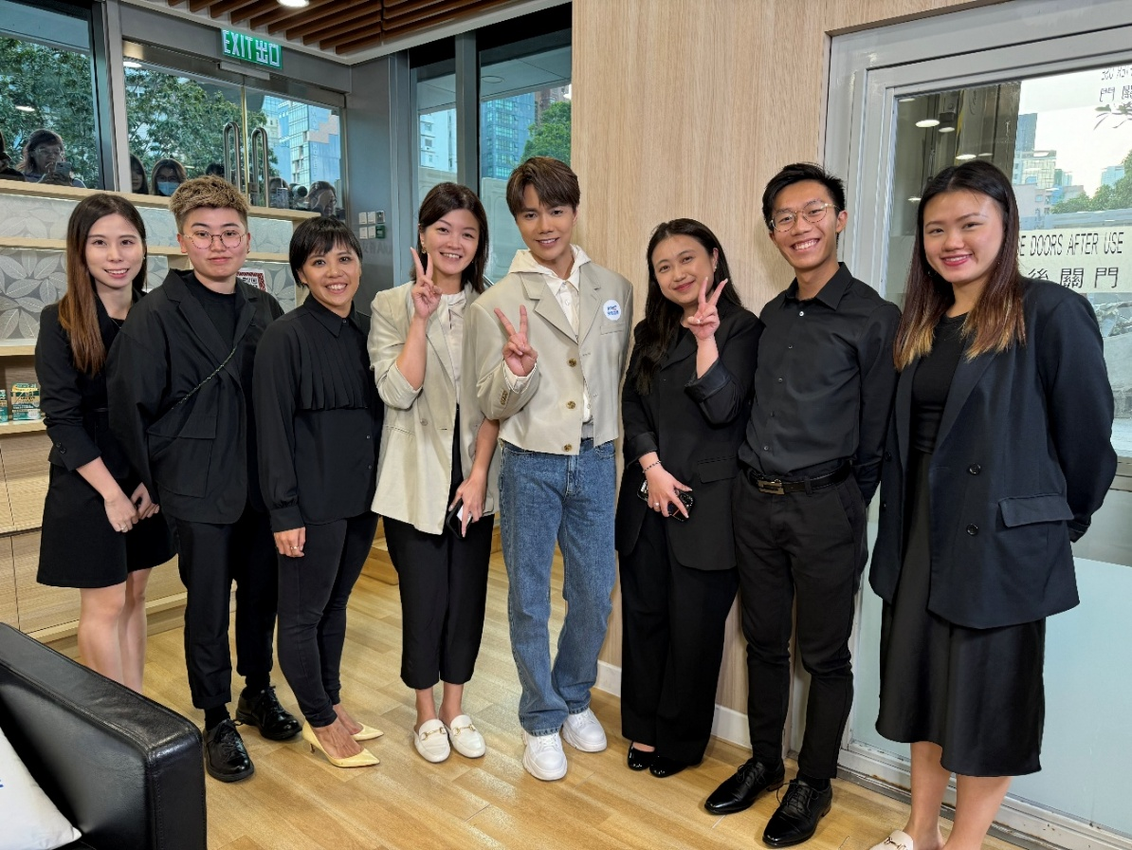
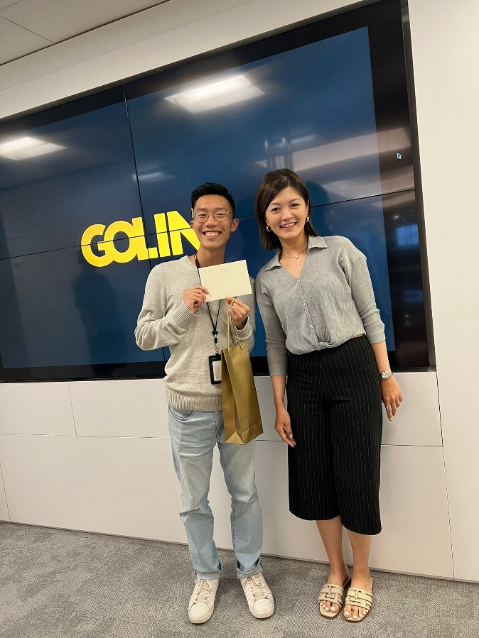
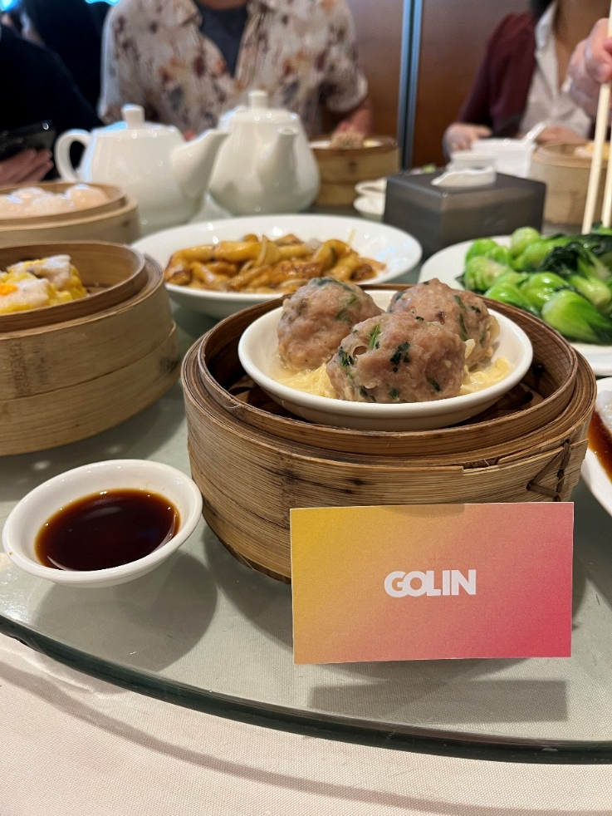
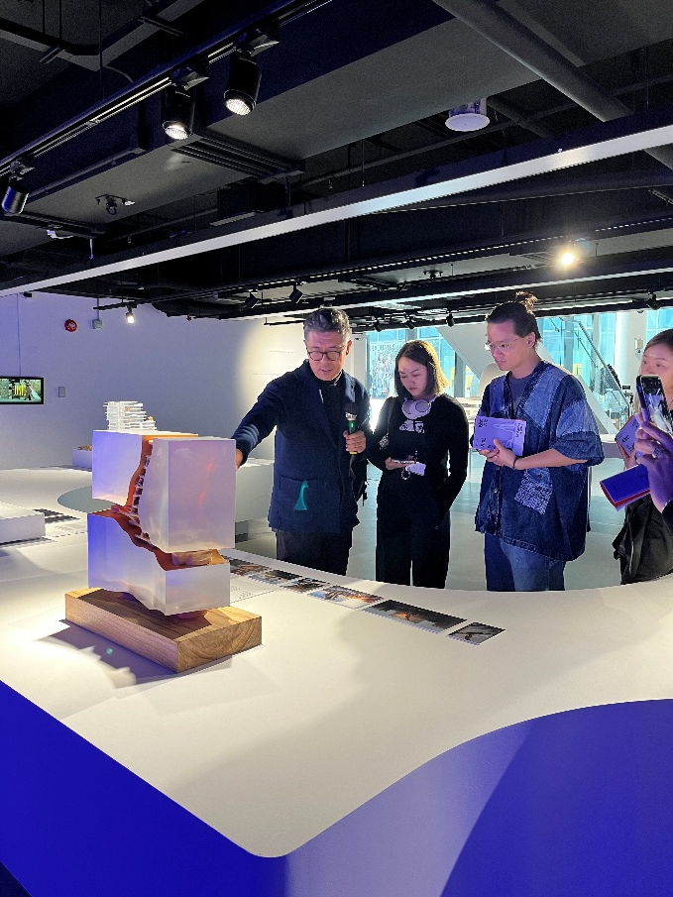
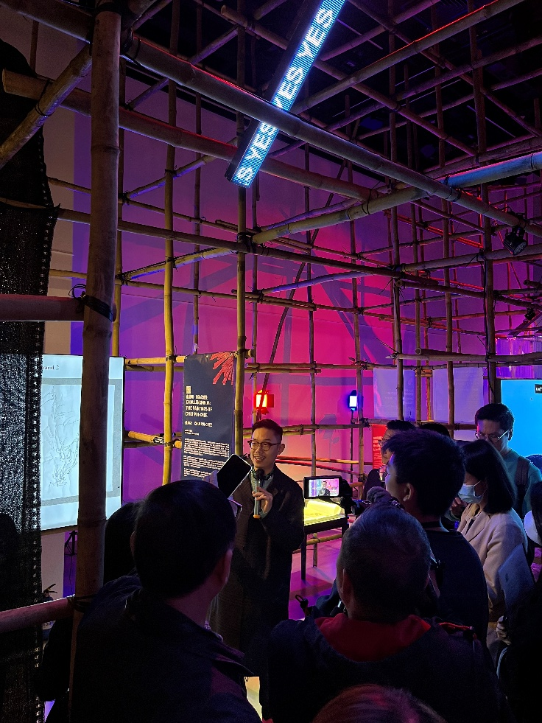
Career Journey
07

Slide 8
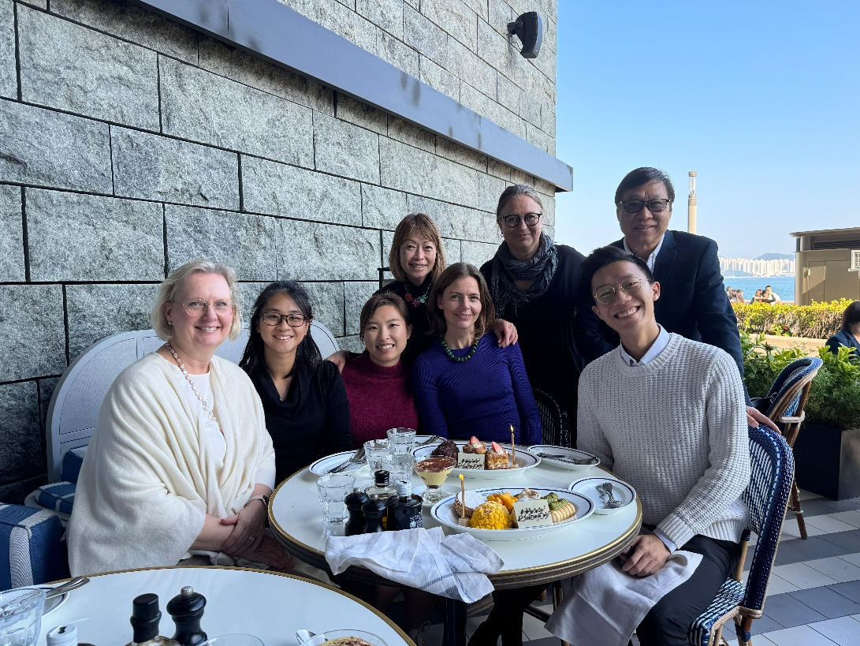
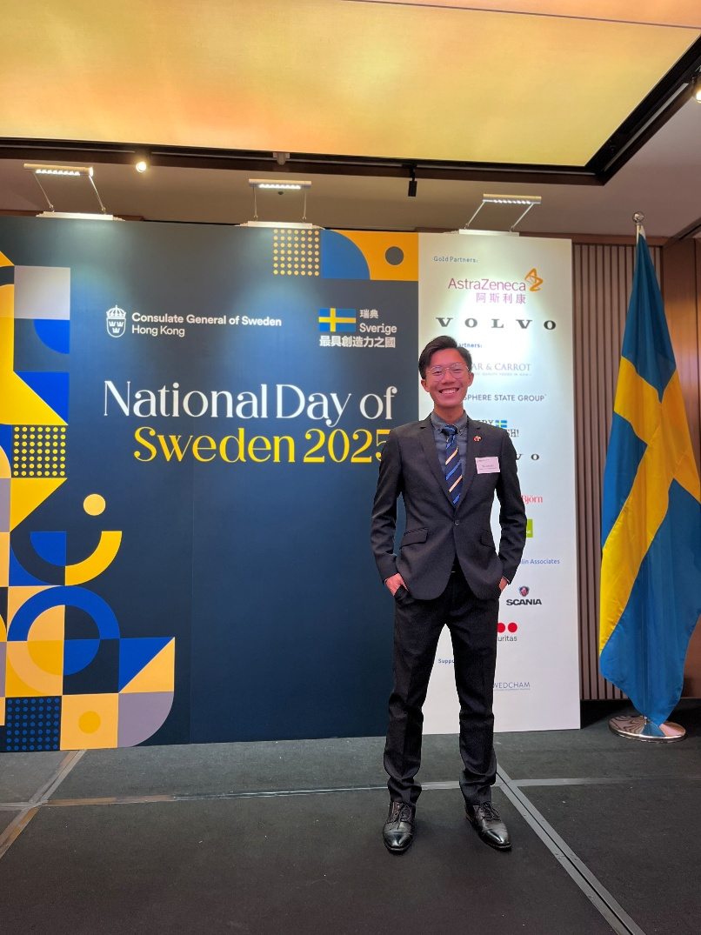
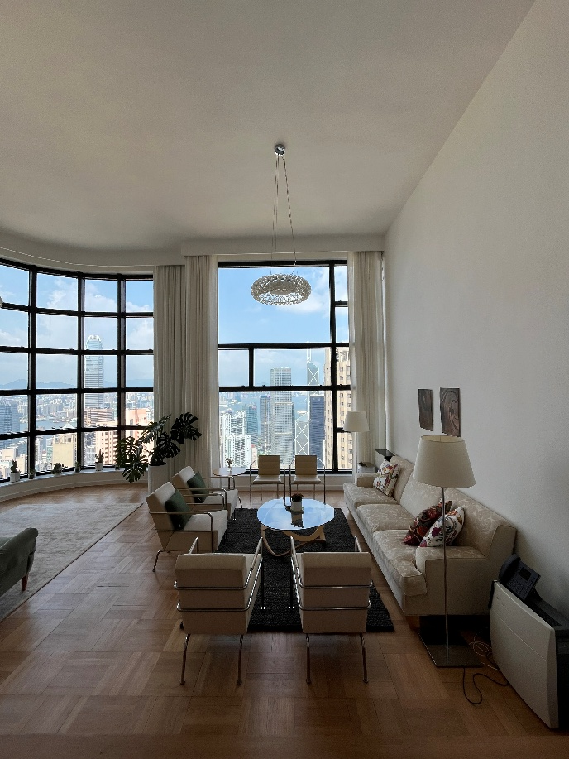
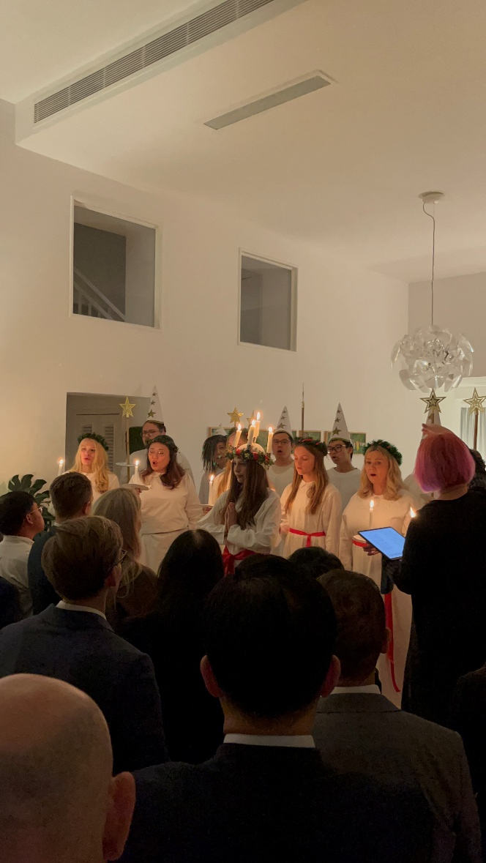
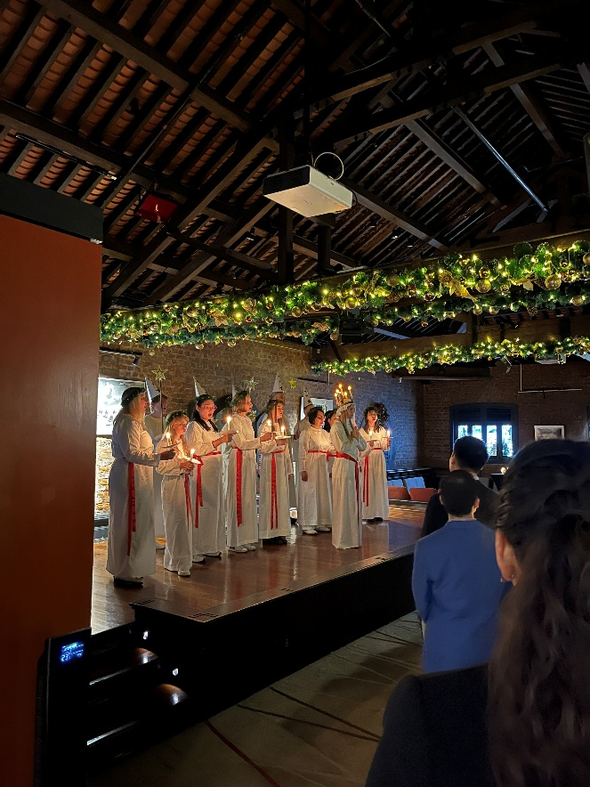
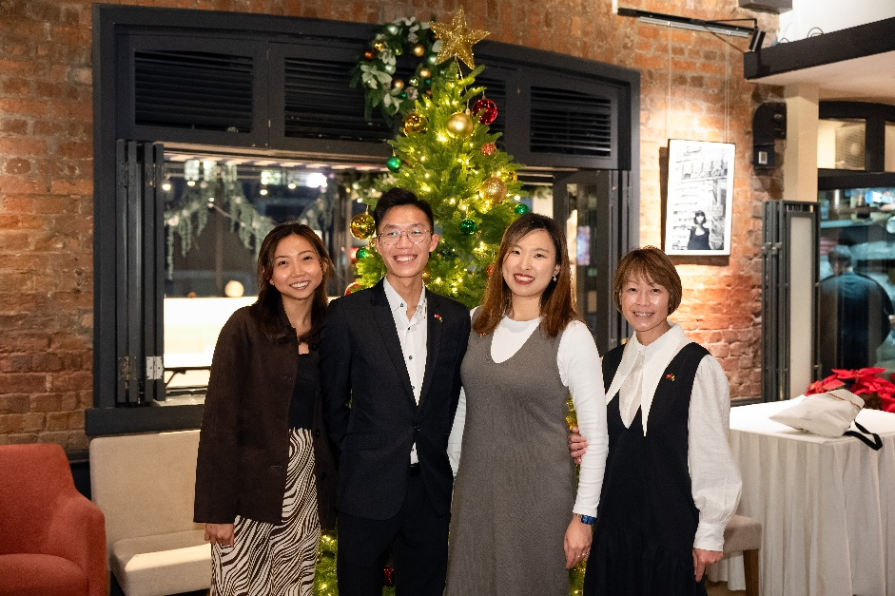
Career Journey
08

Slide 9
Next Journey
09

Slide 10



Masters
Advanced Masters in
International Relations & Diplomacy
10

Slide 11




Career Goals
11

Slide 12
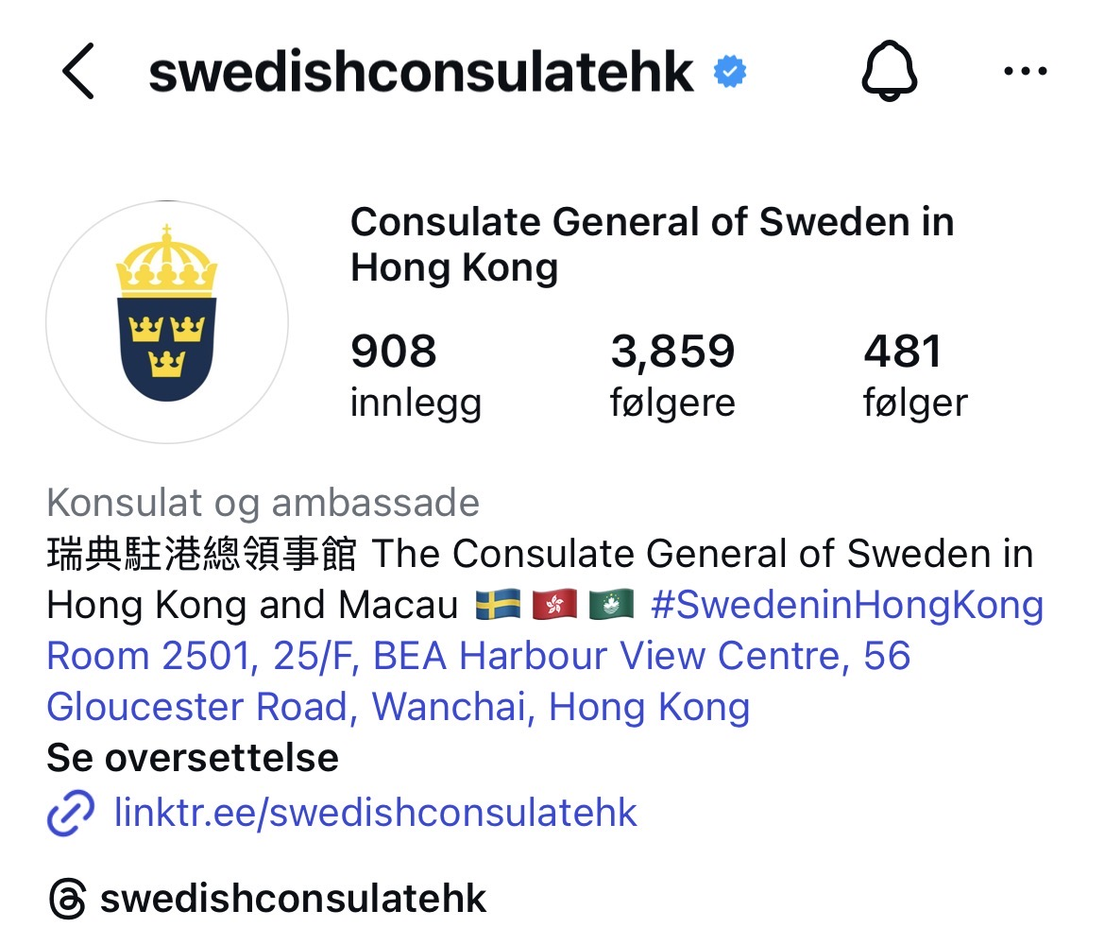
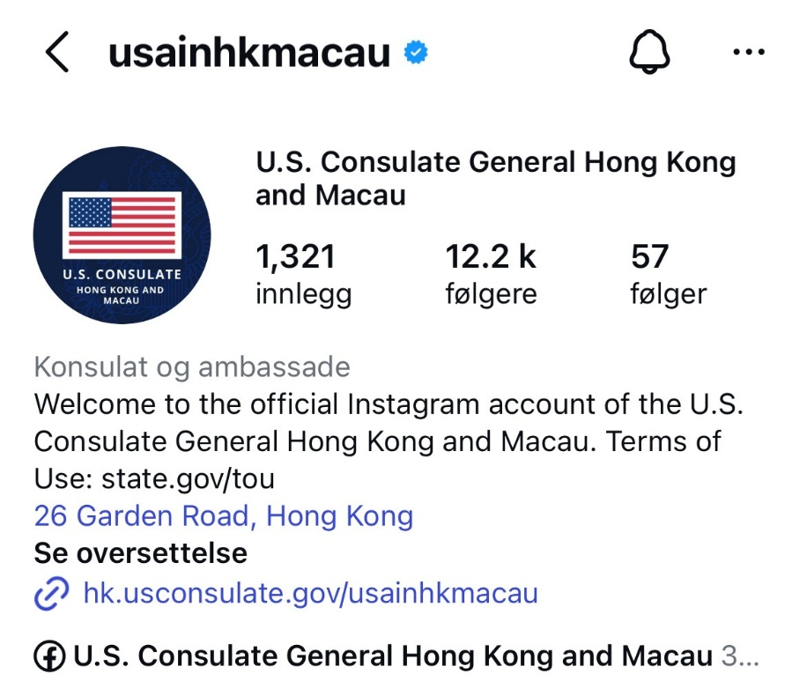
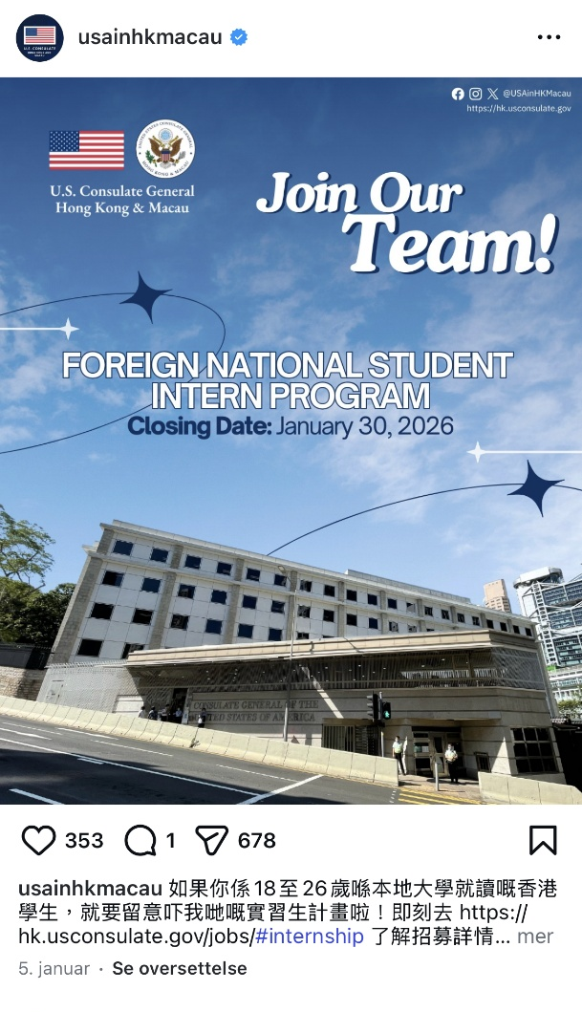
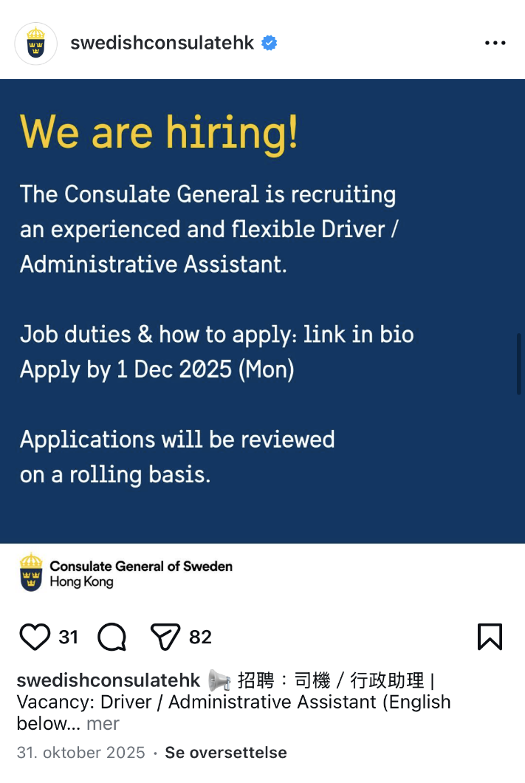
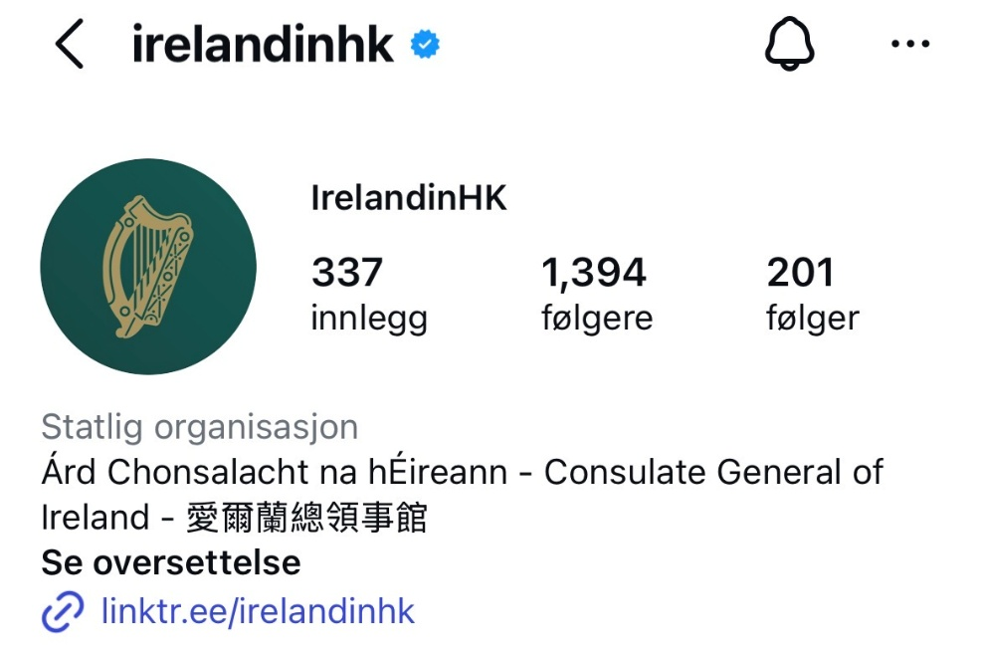
Opportunities
12

Slide 13
Final Tips
13

Slide 14

Networking
Always give a firm handshake! Never give a half handshake! (First Impressions are important)
When interacting with the opposite gender at a network event, ladies may take the lead in initiating a greeting gesture, whether it is a handshake, hug or cheek kiss (signals openness and connection); gentlemen may take a slightly more passive role (signals respect and consideration)
14

Slide 15
Networking
At a networking event, everyone is as nervous as you are, but you don’t have to show it.
If you are alone, look for others who are solo as well to connect with. The line for grabbing food is a great place to start while waiting your turn.
If you are with a group, form half circles to signal willingness to connect or try joining other half circles.
15

Slide 16
Networking
If two people are talking face-to-face or the circle is closed, try somewhere else.
Connect, don’t sell! Well-formed relationships will go a long way. Say “let me know if I can ever be of any help in the future”. Offer help and also ask to be referred.
Say “It was a pleasure talking to you this evening….” and create an excuse to exit a conversation. Gentlemen to gentlemen, offer an exit handshake.
16

Slide 17
Relationship building is an investment, don’t expect immediate return
13

Slide 18
Thank you
Tack så mycket

