Slide 1







Candy Li
Class of 2012, Chinese Language
Currently as the Head of Marketing at True North Education. I began my career as a newspaper editor, transitioned into top-tier online media, and later stepped into the MarTech industry—leading million-dollar digital campaigns. Along the way, I also had the opportunity to work with the world-class consultancy, McKinsey & Company.
My journey reflects an alternative path for language graduates—one fueled by curiosity about the real world and grounded in strong communication skills. These skills have empowered me to navigate and bridge transformations across industries, from traditional print journalism to AI-driven marketing automation.

Slide 2



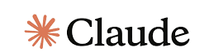
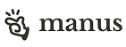

Career Options Beyond Teaching
1. Translation & Interpretation
(翻譯／詮譯)
- Roles: Translator, interpreter, localization specialist
- Industries: Legal, medical, tech, publishing
2. Business & Trade, Marketing
(國際業務／營銷／市場開發)
- Roles: Business development, marketing
- Value: Bridge between Chinese and global markets
3. Government & Diplomacy, PR
(國際溝通／政府／公關)
- Roles: Foreign service, policy analyst, cultural exchange
- Employers: Embassies, ministries, NGOs
4. Media & Journalism
(媒體)
- Roles: journalist, content editor, media strategist
- Edge: Access to Chinese-language sources and narratives
5. Digital & Localization
(數碼相關/ 本地化相關)
- Roles: SEO writer, AI language trainer, website editor
- Sectors: E-com, Software, gaming, e-learning
VS

Slide 3
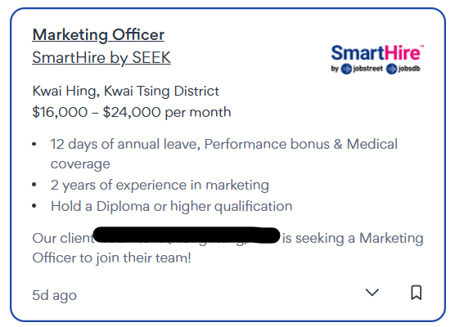
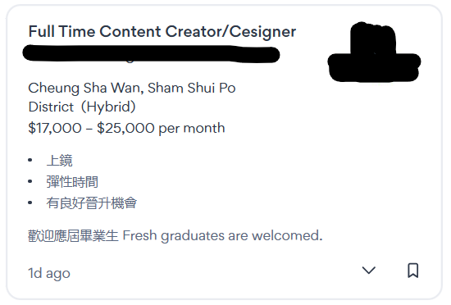
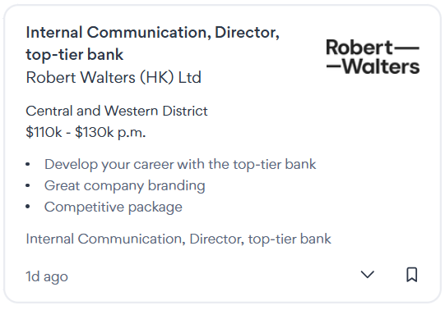

Job examples
00後成內地網絡作家新勢力-未畢業已賺百萬引熱議-現實是1萬字或僅賺20元
“有網絡作家就曾計算，讀者透過網文平台訂閱1,000字需要花費0.04元，平台給作者0.02元的分成。假設作者日更1萬字，有100人付費訂閱，作者的單日稿費收入就是20元。以此模式估算，一個月寫30萬字的收入僅600元，此外還有稅金等要繳付。”
星島頭條: https://www.stheadline.com/realtime-finance/3307551/

