Slide 1
What makes us unique as human beings?
Prof. Meichun Liu, Head
Department of Linguistics and Translation
Linguistic Wonder Land 2016

Slide 2
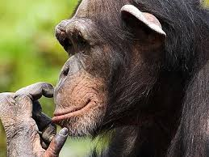
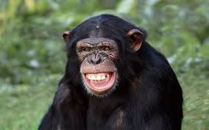
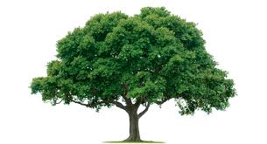
Have you ever imagined…
I saw a gorgeous young lady last summer in Africa…

Slide 3
It is Language…
that makes us:
Human, a unique species
Able to talk about the past and future, dreams and facts, feelings and hopes…
build and pass on civilization, history, cultural heritage, family legacy, science and technology…
Understand each other and seek to understand other possible existence in the universe
…..

Slide 4
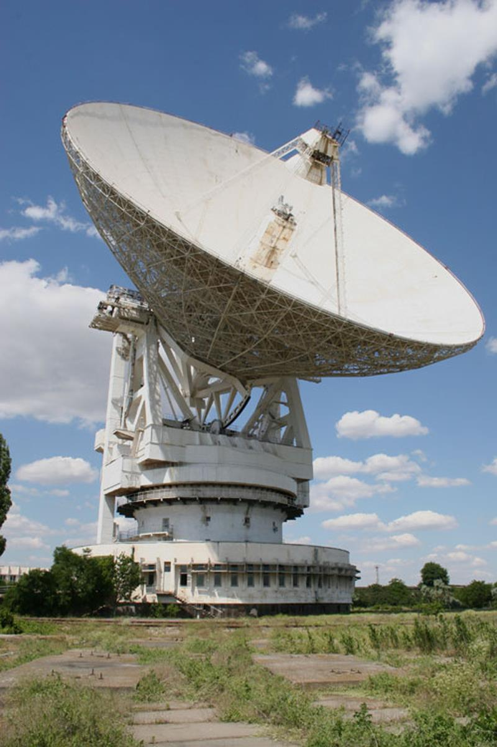
A Message from Earth
A Message from man

Slide 5
Have FUN with language!

