Slide 1

Neural oscillations as a lens on how the brain supports linguistic (sub)processes
Ashley Lewis

Slide 2

Roadmap
Refining the Lens.
Gender Agreement in Dutch – L1 vs L2 and Fossilization.
Syntactic Ambiguity – Violating Expectations.
Gender vs Number Agreement in Zulu – Does Regularity Matter?
Reading, Naturally.
Conclusions – What Could We See?

Slide 3
Roadmap
Refining the Lens.
Gender Agreement in Dutch – L1 vs L2 and Fossilization.
Syntactic Ambiguity – Violating Expectations.
Gender vs Number Agreement in Zulu – Does Regularity Matter?
Reading, Naturally.
Conclusions – What Could We See?

Slide 4
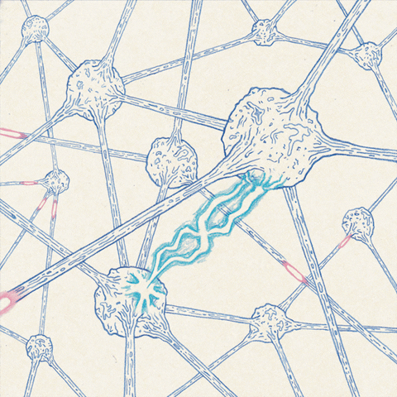
Refining the Lens
Neurons are examples of natural phenomena whose nature is to repeat.

Slide 5
Refining the Lens
Neurons are examples of natural phenomena whose nature is to repeat.
Repetitive firing of action potentials is what neurons 'do’.

Slide 6
Refining the Lens
Neurons are examples of natural phenomena whose nature is to repeat.
Repetitive firing of action potentials is what neurons 'do’.
Neurons are not isolated!

Slide 7
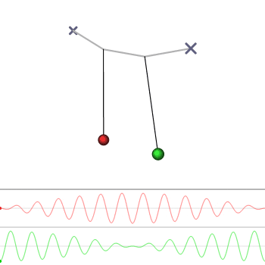
Refining the Lens
The behaviour of repetitive events can be described in the language of oscillations.

Slide 8
Refining the Lens
The behaviour of repetitive events can be described in the language of oscillations.
Three key features:

Slide 9
Refining the Lens
The behaviour of repetitive events can be described in the language of oscillations.
Three key features:
  Frequency.

Slide 10
Refining the Lens
The behaviour of repetitive events can be described in the language of oscillations.
Three key features:
  Frequency.
  Phase.

Slide 11
Refining the Lens
The behaviour of repetitive events can be described in the language of oscillations.
Three key features:
  Frequency.
  Phase.
  Amplitude.

Slide 12
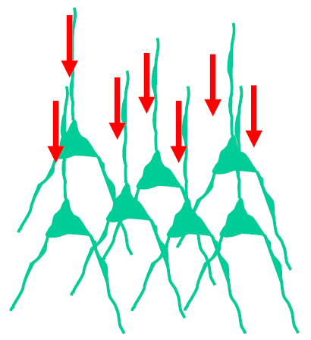
Refining the Lens
Synchronized neurons entrain one another.

Slide 13
Refining the Lens
Synchronized neurons entrain one another.
Can influence cognitive function by influencing resting membrane potential in downstream neurons.

Slide 14
Refining the Lens
Synchronized neurons entrain one another.
Can influence cognitive function by influencing resting membrane potential in downstream neurons.
Regions of cortex become more/less susceptible to firing action potentials.

Slide 15
Refining the Lens
ERP: event-related potentials.
Makeig, 2004

Slide 16
Refining the Lens
ERP: event-related potentials.
ERS: event-related synchronization.
Makeig, 2004

Slide 17
Refining the Lens
ERP: event-related potentials.
ERS: event-related synchronization.
ERD: event-related desynchronization.
Makeig, 2004

Slide 18
Refining the Lens
ERP: event-related potentials.
ERS: event-related synchronization.
ERD: event-related desynchronization.
PPR: partial phase resetting.
Makeig, 2004

Slide 19
Refining the Lens
Local changes in susceptibility of cortex to activating.
Siegel et al., 2012

Slide 20
Refining the Lens
Local changes in susceptibility of cortex to activating.
Meso-scale connectivity.
Siegel et al., 2012

Slide 21
Refining the Lens
Local changes in susceptibility of cortex to activating.
Meso-scale connectivity.
Window into coupling & uncoupling of cortical networks.
Siegel et al., 2012

Slide 22
Refining the Lens
Local changes in susceptibility of cortex to activating.
Meso-scale connectivity.
Window into coupling & uncoupling of cortical networks.
Cortical entrainment to speech.
Siegel et al., 2012

Slide 23

Refining the Lens
Brains are heavily connected.

Slide 24
Refining the Lens
Brains are heavily connected.
Local populations of neurons communicate with one another.

Slide 25
Refining the Lens
Brains are heavily connected.
Local populations of neurons communicate with one another.
Populations of neurons communicate with other populations of neurons.

Slide 26
Refining the Lens
Brains are heavily connected.
Local populations of neurons communicate with one another.
Populations of neurons communicate with other populations of neurons.
We think they do this via frequency-specific neural oscillations.

Slide 27
Roadmap
Refining the Lens.
Gender Agreement in Dutch – L1 vs L2 and Fossilization.
Syntactic Ambiguity – Violating Expectations.
Gender vs Number Agreement in Zulu – Does Regularity Matter?
Reading, Naturally.
Conclusions – What could We See?

Slide 28
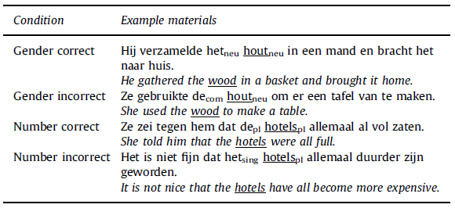
Agreement Violations in Dutch

Slide 29
Agreement Violations in Dutch

Slide 30
Methods Alert!

Slide 31
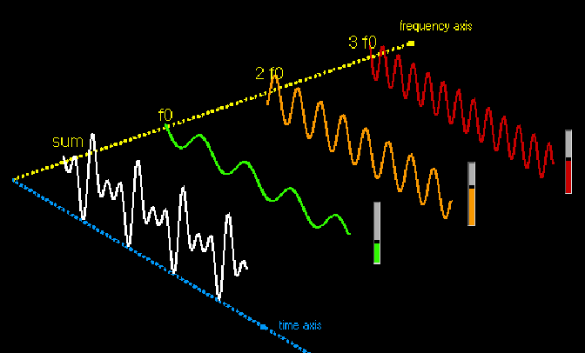
Spectral Analysis
Signal measured – combination of multiple underlying sources.

Slide 32
Spectral Analysis
Signal measured – combination of multiple underlying sources.
Decompose signal into spectrally distinct components.

Slide 33
Spectral Analysis
Signal measured – combination of multiple underlying sources.
Decompose signal into spectrally distinct components.
Fourier analysis to get power spectrum.

Slide 34
Time-resolved Spectral Analysis

Slide 35
Time-resolved Spectral Analysis

Slide 36
Time-resolved Spectral Analysis

Slide 37
Time-resolved Spectral Analysis

Slide 38
Time-resolved Spectral Analysis

Slide 39
Time-resolved Spectral Analysis

Slide 40
Time-resolved Spectral Analysis

Slide 41
Time-resolved Spectral Analysis

Slide 42
Time-resolved Spectral Analysis

Slide 43
Time-resolved Spectral Analysis

Slide 44
Time-resolved Spectral Analysis

Slide 45
Time-resolved Spectral Analysis

Slide 46
Cluster-based Permutation Statistics
Choose statistical test to use to compare 2 conditions.

Slide 47
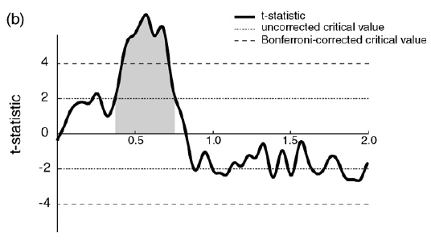
Cluster-based Permutation Statistics
Choose statistical test to use to compare 2 conditions.
Multiple comparisons problem.

Slide 48
Cluster-based Permutation Statistics
Choose statistical test to use to compare 2 conditions.
Multiple comparisons problem.
Permutation distribution to compare any observed effects against chance.

Slide 49
Cluster-based Permutation Statistics
Choose statistical test to use to compare 2 conditions.
Multiple comparisons problem.
Permutation distribution to compare any observed effects against chance.
Cluster-based to incorporate known physiological detail when it will likely improve sensitivity.

Slide 50
Agreement Violations in Dutch

Slide 51
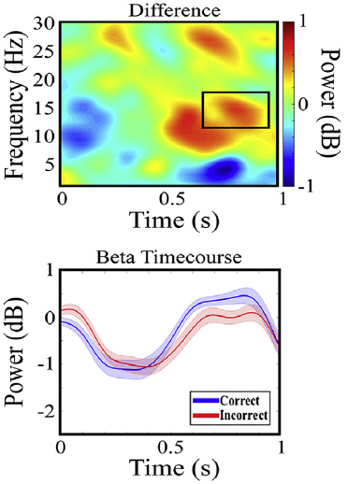
Gender Agreement Violations in Dutch L1 Speakers
Dutch L1 exhibit a less pronounced beta rebound for nouns that violate gender agreement.

Slide 52
Gender Agreement Violations in Dutch L1 Speakers
Dutch L1 exhibit a less pronounced beta rebound for nouns that violate gender agreement.
Marker of disruption of gender agreement processing.

Slide 53
Gender Agreement Violations in Dutch L1 Speakers
Dutch L1 exhibit a less pronounced beta rebound for nouns that violate gender agreement.
Marker of disruption of gender agreement processing.
Linked to updating of sentence-level context representation.

Slide 54
Gender Agreement Violations in German L2 Speakers of Dutch
German L2 speakers of Dutch do not show this beta effect.

Slide 55
Gender Agreement Violations in German L2 Speakers of Dutch
German L2 speakers of Dutch do not show this beta effect.
Large degree of overlap in grammatical gender between Dutch and German.

Slide 56
Gender Agreement Violations in German L2 Speakers of Dutch
German L2 speakers of Dutch do not show this beta effect.
Large degree of overlap in grammatical gender between Dutch and German.
Many false-friends.

Slide 57
Gender Agreement Violations in German L2 Speakers of Dutch

Slide 58
Gender Agreement Violations in German L2 Speakers of Dutch
Objective
German L2 speakers of Dutch do not show this beta effect.
Large degree of overlap in grammatical gender between Dutch and German.
Many false-friends.

Slide 59
Gender Agreement Violations in German L2 Speakers of Dutch
Objective
Subjective
German L2 speakers of Dutch do not show this beta effect.
Large degree of overlap in grammatical gender between Dutch and German.
Many false-friends.
German L2 speakers of Dutch do use gender when necessary – fossilization appears to have occurred.

Slide 60
Roadmap
Refining the Lens.
Gender Agreement in Dutch – L1 vs L2 and Fossilization.
Syntactic Ambiguity – Violating Expectations.
Gender vs Number Agreement in Zulu – Does Regularity Matter?
Reading, Naturally.
Conclusions – What Could We See?

Slide 61
Object-relative Garden Path Sentences in Dutch

Slide 62
Object-relative Garden Path Sentences in Dutch

Slide 63
Methods Alert!

Slide 64
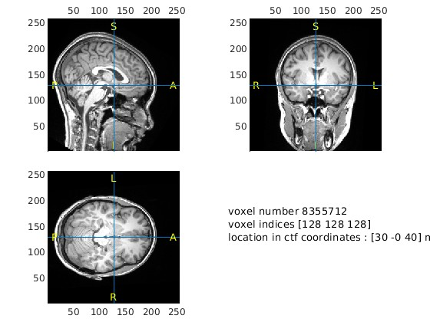
Source Reconstruction

Slide 65

Source Reconstruction

Slide 66

Source Reconstruction

Slide 67
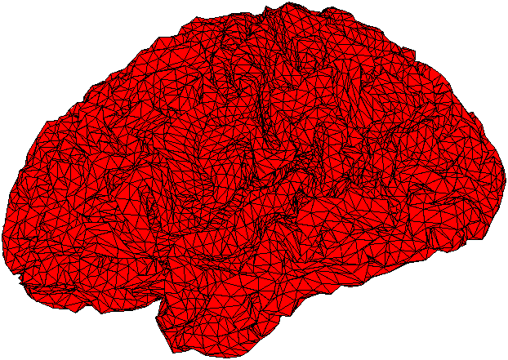
Source Reconstruction

Slide 68
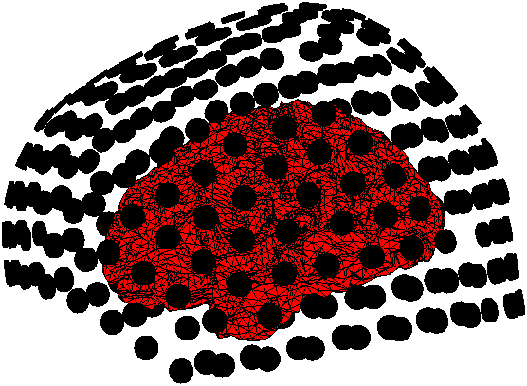
Source Reconstruction

Slide 69
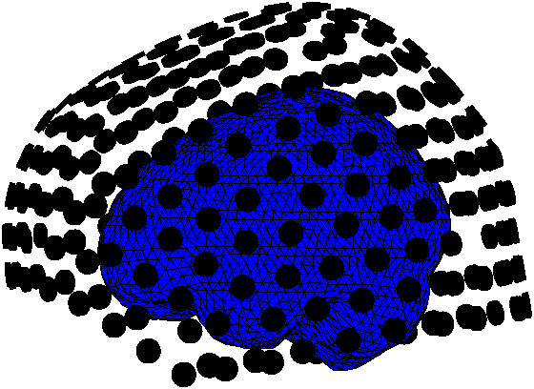
Source Reconstruction

Slide 70
Source Reconstruction
Geometrical objects describe how the sensors project to the sources – forward/leadfield model.

Slide 71
Source Reconstruction
Geometrical objects describe how the sensors project to the sources – forward/leadfield model.
Inverse problem is always ill-defined.

Slide 72
Source Reconstruction
Geometrical objects describe how the sensors project to the sources – forward/leadfield model.
Inverse problem is always ill-defined.
Good methods for placing certain restrictions on the problem space.

Slide 73
Source Reconstruction
Geometrical objects describe how the sensors project to the sources – forward/leadfield model.
Inverse problem is always ill-defined.
Good methods for placing certain restrictions on the problem space.
Beamforming – maximal gain at each source penalized when temporally correlated with other sources.

Slide 74
Object-relative Garden Path Sentences in Dutch

Slide 75
Person Agreement Violations

Slide 76
Expectation Violation – Object-relative Clauses

Slide 77
Person Agreement Violations

Slide 78
Expectation Violation – Object-relative Clauses

Slide 79
Object-relative Garden Path Sentences in Dutch
Beta power tracks not just syntactic violations, but also expectation violations more generally.

Slide 80
Object-relative Garden Path Sentences in Dutch
Beta power tracks not just syntactic violations, but also expectation violations more generally.
Midline theta power as an index of domain-general control – error detection.

Slide 81
Object-relative Garden Path Sentences in Dutch
Beta power tracks not just syntactic violations, but also expectation violations more generally.
Midline theta power as an index of domain-general control – error detection.
Spatial information allows us to disentangle different functional roles for beta and theta oscillations.

Slide 82
Roadmap
Refining the Lens.
Gender Agreement in Dutch – L1 vs L2 and Fossilization.
Syntactic Ambiguity – Violating Expectations.
Gender vs Number Agreement in Zulu – Does Regularity Matter?
Reading, Naturally.
Conclusions – What could We See?

Slide 83
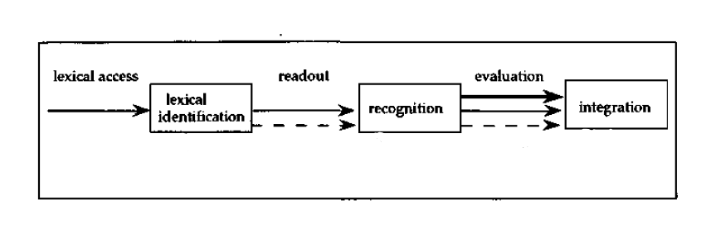
Gender Features and Agreement
Does gender transparency affect agreement processing?
Processing model of Faussart et al. (1999):
locating correct lexical entry
processing categorial and formal features
Number violation
Gender violation
processing agreement
Faussart, Jakubowicz & Costes, 1999
Faussart et al. (1999): When detecting an agreement violation during evaluation, the parser will return to earlier states in the model (lexical identification or recognition) and repeat some of the processing stages.
Notes:
Which state the parser returns to depends on the feature.

Slide 84
Gender Features and Agreement
Does gender transparency affect agreement processing?
Processing model of Faussart et al. (1999):
Number violation
Faussart, Jakubowicz & Costes, 1999
Gender violation
Even in languages with transparent gender marking on some nouns, the parser has to return to the lexical identification state.
Caffarra et al., 2014 and Caffarra & Barber, 2015 for Spanish; Caffarra et al., 2015 for Italian; Resende et al., 2019 for Brazilian Portuguese

Slide 85
Gender Features and Agreement
Hypothesis: in a language with a more transparent formal system of gender marking, the parser may only have to return to the state of lexical recognition when detecting a gender agreement violation:
Number violation
Gender violation
Claim: The Bantu language Zulu is such a language.

Slide 86
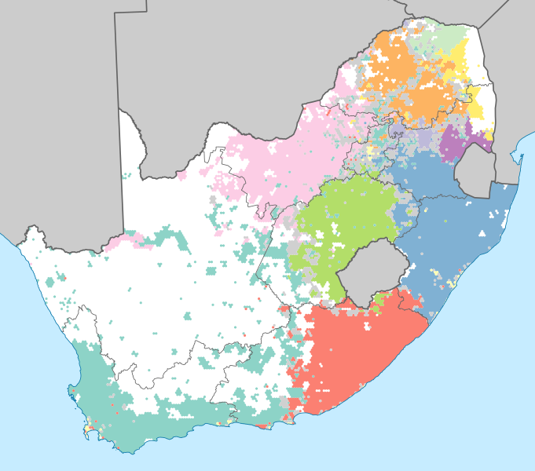
Zulu
Zulu (isiZulu; S.42, zulu1248): a Bantu language spoken in South Africa and some neighboring countries;
belongs to the Nguni group (which also includes Xhosa, Swati, Southern Ndebele and Zimbabwean Ndebele);
Home language of ~14 million South Africans (~25% of population; 30% of Africans);
Most widely spoken first language in South Africa.

Slide 87
Noun Class in Zulu
Gender | NC | Number | Zulu examples | DEM_{dist}
A | 1 | [singular] | u-m-fundi, ‘student’ | lowo
 | 2 | [plural] | a-ba-fundi, ‘students’ | labo
B | 3 | [singular] | u-m-buzo, ‘question’ | lowo
 | 4 | [plural] | i-mi-buzo, ‘questions’ | leyo
C | 5 | [singular] | i-∅-gama, ‘word’ | lelo
 | 6 | [plural] | a-ma-gama, ‘words’ | lawo
D | 7 | [singular] | i-si-cathulo, ‘shoe’ | leso
 | 8 | [plural] | i-zi-cathulo, ‘shoes’ | lezo
E | 9 | [singular] | i-n-komo, ‘cow’ | leyo
 | 10 | [plural] | i-zin-komo, ‘cows’ | lezo
F | 11 | [singular] | u-∅-phondo, ‘horn’ | lolo
 | 10 | [plural] | i-zim-pondo, ‘horns’ | lezo
All Zulu nouns are marked for
noun class (traditionally numbered).
Noun class = gender + number
Cope, 1984; Carstens, 1991, 2008; Corbett, 1991; Bresnan & Mchombo, 1995; Taljard & de Schryver, 2016; Fuchs & van der Wal, 2022 etc.
Table 1. The six major gender classes in Zulu.

Slide 88
Agreement Violations in Zulu
 | Example Sentence | DEM_{dist} | Noun
GC | Kuthangi babone leyo ngwe ijaha inyamazane. | [gen E, sg] | [gen E, sg]
 | ‘The day before yesterday they saw that leopard chasing the antelope.’ | (class 9) | (class 9)
GV | *Kuthangi babone lelo ngwe ijaha inyamazane. | [gen C, sg] | [gen E, sg]
 |  | (class 5) | (class 9)
NC | Izolo ngishiye lezo zitsha esitolo ngoba bezibiza. | [gen D, pl] | [gen D, pl]
 | ‘Yesterday I left those bowls at the store because they were expensive.’ | (class 8) | (class 8)
NV | *Izolo ngishiye leso zitsha esitolo ngoba bezibiza. | [gen D, sg] | [gen D, pl]
 |  | (class 7) | (class 8)
Table 2. Examples stimuli sentences.
GC = gender agreement correct; GV = gender agreement violation; NC = number agreement correct; NV = number agreement violation; gen = gender; sg = singular number; pl = plural number; green colour: grammatical DP; red colour: ungrammatical DP; bold: target word

Slide 89
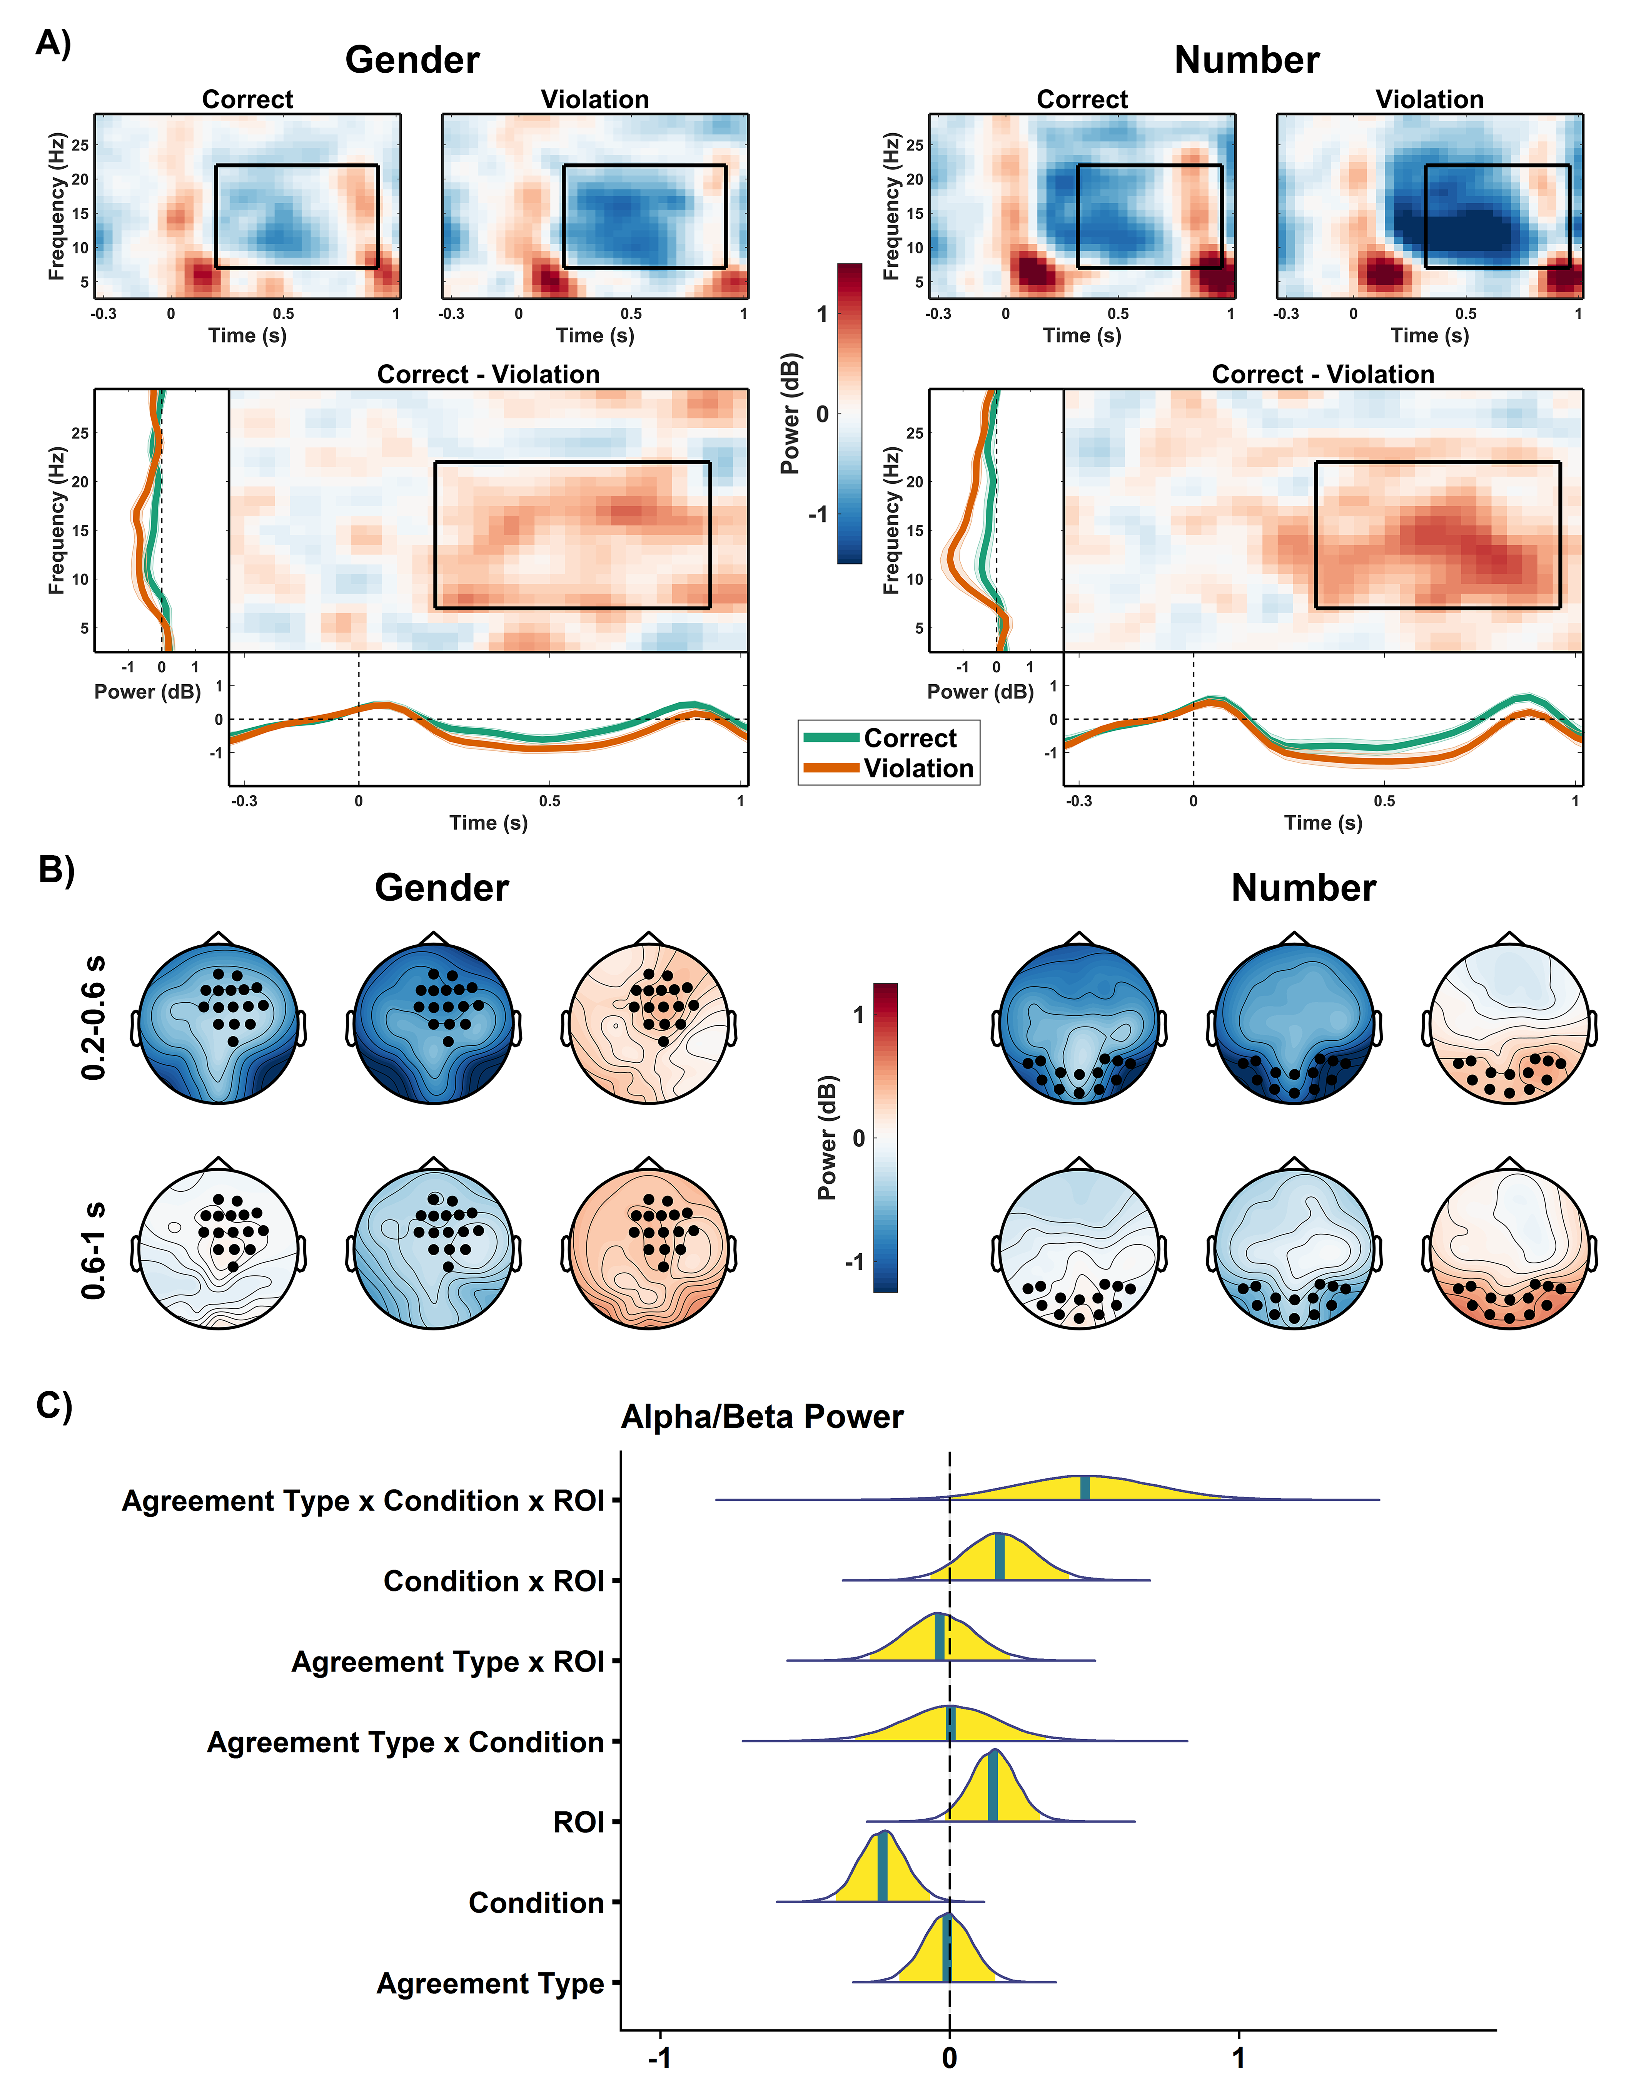
Alpha/Beta Power

Slide 90
Alpha/Beta Power

Slide 91
Alpha/Beta Power

Slide 92
Alpha/Beta Power

Slide 93
Alpha/Beta Power

Slide 94
Alpha/Beta Power
Methods Alert!

Slide 95
Alpha/Beta Power
Power ~ 1 + Condition * Agreement Type * ROI +
(1 + Agreement Type * Condition * ROI | Participant) +
(1 + Agreement Type * Condition * ROI | Item)

Slide 96
Alpha/Beta Power

Slide 97
Alpha/Beta Power
Alpha/Beta power linked to dynamic engagement of neural networks for relevant information types at the appropriate time.
Miller et al., 2018; Vassileiou et al. 2018; Lewis et al., 2015

Slide 98
Alpha/Beta Power
Alpha/Beta power linked to dynamic engagement of neural networks for relevant information types at the appropriate time.
Desynchronization may reflect working memory updating.
Miller et al., 2018; Vassileiou et al. 2018; Lewis et al., 2015

Slide 99
Alpha/Beta Power
Alpha/Beta power linked to dynamic engagement of neural networks for relevant information types at the appropriate time.
Desynchronization may reflect working memory updating.
Number violations
Miller et al., 2018; Vassileiou et al. 2018; Lewis et al., 2015

Slide 100
Alpha/Beta Power
Alpha/Beta power linked to dynamic engagement of neural networks for relevant information types at the appropriate time.
Desynchronization may reflect working memory updating.
Number violations – effects over posterior electrodes
Miller et al., 2018; Vassileiou et al. 2018; Lewis et al., 2015

Slide 101
Alpha/Beta Power
Alpha/Beta power linked to dynamic engagement of neural networks for relevant information types at the appropriate time.
Desynchronization may reflect working memory updating.
Number violations – effects over posterior electrodes – visual word form information is most relevant.
Miller et al., 2018; Vassileiou et al. 2018; Lewis et al., 2015

Slide 102
Alpha/Beta Power
Alpha/Beta power linked to dynamic engagement of neural networks for relevant information types at the appropriate time.
Desynchronization may reflect working memory updating.
Number violations – effects over posterior electrodes – visual word form information is most relevant.
Gender violations
Miller et al., 2018; Vassileiou et al. 2018; Lewis et al., 2015

Slide 103
Alpha/Beta Power
Alpha/Beta power linked to dynamic engagement of neural networks for relevant information types at the appropriate time.
Desynchronization may reflect working memory updating.
Number violations – effects over posterior electrodes – visual word form information is most relevant.
Gender violations – effects over frontal electrodes
Miller et al., 2018; Vassileiou et al. 2018; Lewis et al., 2015

Slide 104
Alpha/Beta Power
Alpha/Beta power linked to dynamic engagement of neural networks for relevant information types at the appropriate time.
Desynchronization may reflect working memory updating.
Number violations – effects over posterior electrodes – visual word form information is most relevant.
Gender violations – effects over frontal electrodes – lexicon appears to be consulted despite reliability of the form of the noun class prefix.
Miller et al., 2018; Vassileiou et al. 2018; Lewis et al., 2015

Slide 105
Gender Agreement Processing
Two possibilities for parser behaviour after gender agreement violations.
Number violation
Gender violation
Number violation
Gender violation
Notes:
Parser returns to lexical identification stage upon encountering a gender agreement violation.
Parser can avoid the extra step and return to the recognition stage to confirm/disconfirm the violation based on word form information alone.
We should be able to find evidence in our ERP and/or time frequency data to help distinguish between these two possibilities.

Slide 106
Gender Agreement Processing
Two possibilities for parser behaviour after gender agreement violations.
Clear evidence for the former, despite regularity of gender agreement marking in Zulu.
Number violation
Gender violation
Number violation
Gender violation
Notes:
Parser returns to lexical identification stage upon encountering a gender agreement violation.
Parser can avoid the extra step and return to the recognition stage to confirm/disconfirm the violation based on word form information alone.
We should be able to find evidence in our ERP and/or time frequency data to help distinguish between these two possibilities.

Slide 107
Roadmap
Refining the Lens.
Gender Agreement in Dutch – L1 vs L2 and Fossilization.
Syntactic Ambiguity – Violating Expectations.
Gender vs Number Agreement in Zulu – Does Regularity Matter?
Reading, Naturally.
Conclusions – What could We See?

Slide 108
Background
When people read naturally in most languages they move their eyes from left to right through the text.

Slide 109
Background
When people read naturally in most languages they move their eyes from left to right through the text.
Many studies investigating neural oscillations in sentence reading observe left hemisphere alpha power effects.

Slide 110
Background
When people read naturally in most languages they move their eyes from left to right through the text.
Many studies investigating neural oscillations in sentence reading observe left hemisphere alpha power effects.
Alpha power facilitates gaze direction.

Slide 111
Background
When people read naturally in most languages they move their eyes from left to right through the text.
Many studies investigating neural oscillations in sentence reading observe left hemisphere alpha power effects.
Alpha power facilitates gaze direction.
Are these lateralized alpha power effects observed in reading a reflection of gaze facilitation when reading from left to right?

Slide 112
Background
When people read naturally in most languages they move their eyes from left to right through the text.
Many studies investigating neural oscillations in sentence reading observe left hemisphere alpha power effects.
Alpha power facilitates gaze direction.
Are these lateralized alpha power effects observed in reading a reflection of gaze facilitation when reading from left to right?
Do we still observe alpha power lateralization for reading at central fixation?

Slide 113
Background
When people read naturally in most languages they move their eyes from left to right through the text.
Many studies investigating neural oscillations in sentence reading observe left hemisphere alpha power effects.
Alpha power facilitates gaze direction.
Are these lateralized alpha power effects observed in reading a reflection of gaze facilitation when reading from left to right?
Do we still observe alpha power lateralization for reading at central fixation?

Slide 114
Natural Reading

Slide 115
Natural Reading

Slide 116
Central Reading

Slide 117
Central Reading

Slide 118
Central Reading

Slide 119
Central Reading

Slide 120
Natural Reading

Slide 121
Natural Reading

Slide 122
Natural Reading
Compared both gaze density and alpha power between fixation and reading.

Slide 123
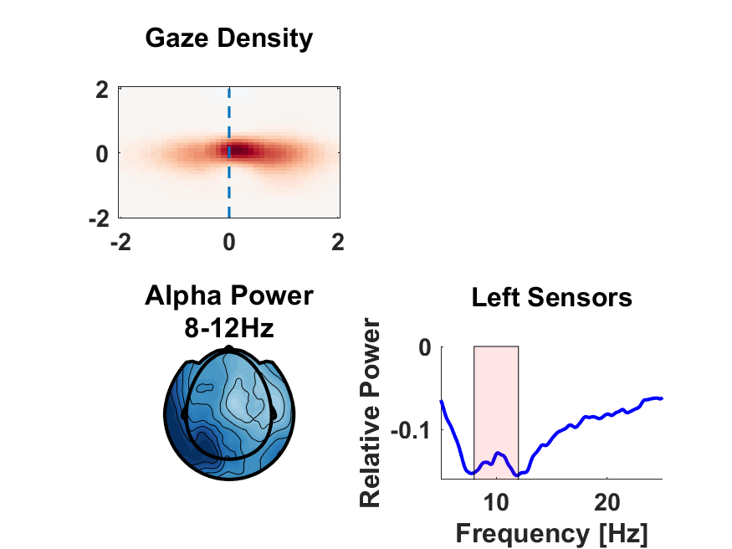
Natural Reading
Compared both gaze density and alpha power between fixation and reading.
Gaze bias to the right.

Slide 124
Natural Reading
Compared both gaze density and alpha power between fixation and reading.
Gaze bias to the right.
Alpha power decrease lateralized to the left.

Slide 125
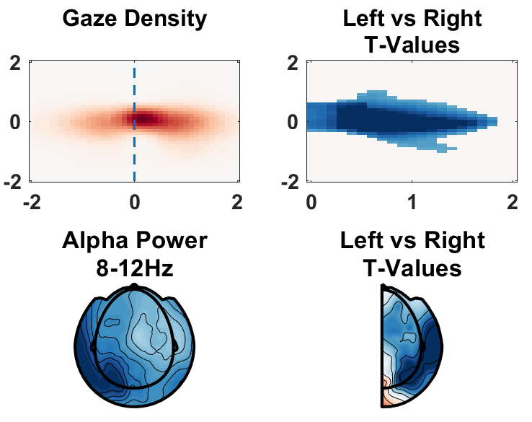
Natural Reading
Compared both gaze density and alpha power between fixation and reading.
Gaze bias to the right.
Alpha power decrease lateralized to the left.

Slide 126
Natural Reading
Compared both gaze density and alpha power between fixation and reading.
Gaze bias to the right.
Alpha power decrease lateralized to the left.
Gaze contingent alpha lateralization.

Slide 127
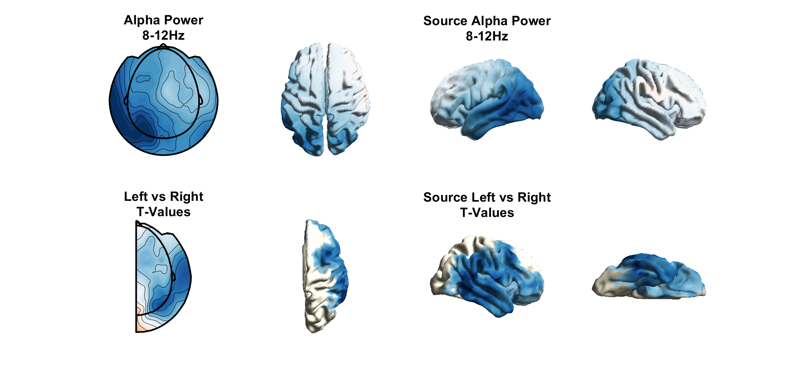
Natural Reading

Slide 128
Central Reading

Slide 129
Central Reading

Slide 130
Central Reading

Slide 131
Central Reading

Slide 132
Central Reading
Compared both gaze density and alpha power between fixation and reading.

Slide 133
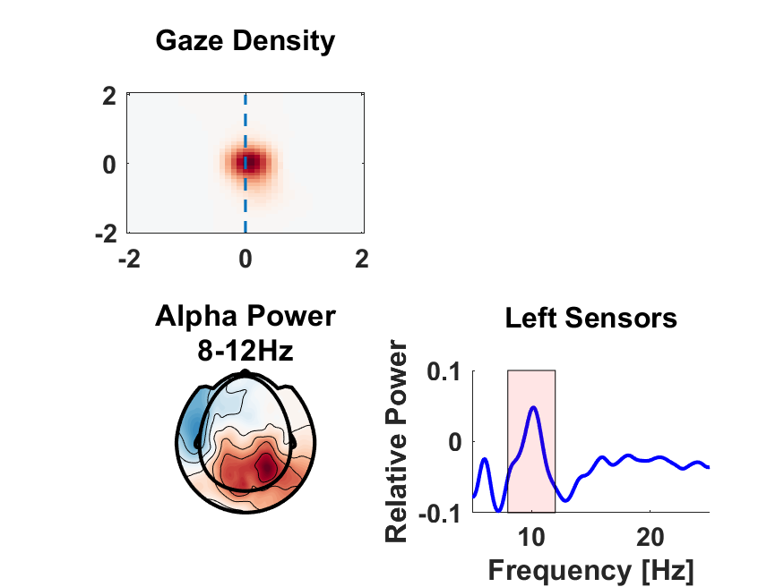
Central Reading
Compared both gaze density and alpha power between fixation and reading.
Very minor (if any) gaze bias to the right.

Slide 134
Central Reading
Compared both gaze density and alpha power between fixation and reading.
Very minor (if any) gaze bias to the right.
Alpha power decrease lateralized to the left.

Slide 135
Central Reading
Compared both gaze density and alpha power between fixation and reading.
Very minor (if any) gaze bias to the right.
Alpha power decrease lateralized to the left.
Alpha increases with fewer eye movements.

Slide 136
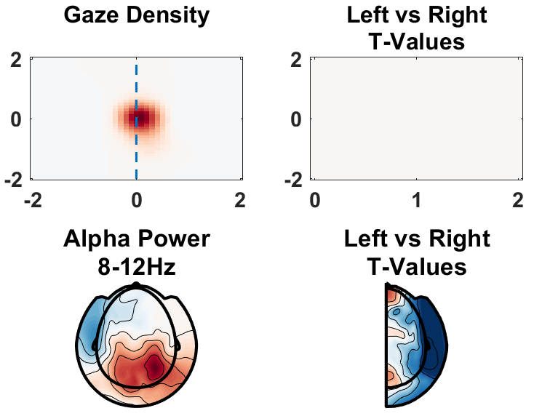
Central Reading
Compared both gaze density and alpha power between fixation and reading.
Very minor (if any) gaze bias to the right.
Alpha power decrease lateralized to the left.
Alpha increases with fewer eye movements.

Slide 137
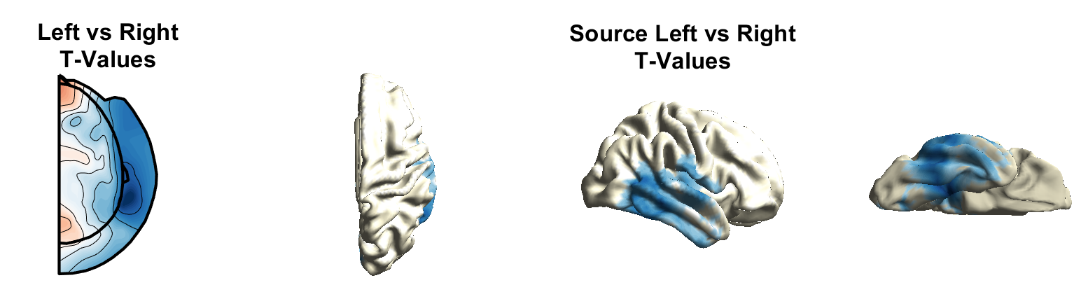
Natural vs Central Reading
Natural
Central

Slide 138
Reading, Naturally
Natural reading: clear gaze bias to the right and alpha power decrease lateralized to the left.

Slide 139
Reading, Naturally
Natural reading: clear gaze bias to the right and alpha power decrease lateralized to the left.
Central reading: no gaze bias but still left lateralized alpha power decrease.

Slide 140
Reading, Naturally
Natural reading: clear gaze bias to the right and alpha power decrease lateralized to the left.
Central reading: no gaze bias but still left lateralized alpha power decrease.
Spatial distribution for alpha lateralization more widespread for natural reading.

Slide 141
Reading, Naturally
Natural reading: clear gaze bias to the right and alpha power decrease lateralized to the left.
Central reading: no gaze bias but still left lateralized alpha power decrease.
Spatial distribution for alpha lateralization more widespread for natural reading.
Reading direction does not fully explain alpha power lateralization – probably a language comprehension component to it that should be further explored.

Slide 142
Roadmap
Refining the Lens.
Gender Agreement in Dutch – L1 vs L2 and Fossilization.
Syntactic Ambiguity – Violating Expectations.
Gender vs Number Agreement in Zulu – Does Regularity Matter?
Reading, Naturally.
Conclusions – What Could We See?

Slide 143
Looking Back
Determiner-noun gender agreement mismatches in Dutch disrupt construction of sentence-level context representation for L1 speakers – German L2 speakers of Dutch show effect only for their subjective gender representations.

Slide 144
Looking Back
Determiner-noun gender agreement mismatches in Dutch disrupt construction of sentence-level context representation for L1 speakers – German L2 speakers of Dutch show effect only for their subjective gender representations.
The same beta power modulations were observed for expectation violations that are not ungrammatical (garden-path sentences) – theta tracks domain-general control.

Slide 145
Looking Back
Determiner-noun gender agreement mismatches in Dutch disrupt construction of sentence-level context representation for L1 speakers – German L2 speakers of Dutch show effect only for their subjective gender representations.
The same beta power modulations were observed for expectation violations that are not ungrammatical (garden-path sentences) – theta tracks domain-general control.
Determiner-noun gender and number agreement mismatches in Zulu are differentiated according to the spatial distribution of beta power.

Slide 146
Looking Back
Determiner-noun gender agreement mismatches in Dutch disrupt construction of sentence-level context representation for L1 speakers – German L2 speakers of Dutch show effect only for their subjective gender representations.
The same beta power modulations were observed for expectation violations that are not ungrammatical (garden-path sentences) – theta tracks domain-general control.
Determiner-noun gender and number agreement mismatches in Zulu are differentiated according to the spatial distribution of beta power.
Left-lateralized alpha power during reading is present whether one reads naturally or at central fixation – gaze bias only for natural reading.

Slide 147
Looking Forward
Neural oscillations provide a lens onto a variety of (sub)-processes of language comprehension – in particular controlled gating of working memory contents.

Slide 148
Looking Forward
Neural oscillations provide a lens onto a variety of (sub)-processes of language comprehension – in particular controlled gating of working memory contents.
Dichotomy between beta and theta for domain-specific vs domain-general cognitive control during reading.

Slide 149
Looking Forward
Neural oscillations provide a lens onto a variety of (sub)-processes of language comprehension – in particular controlled gating of working memory contents.
Dichotomy between beta and theta for domain-specific vs domain-general cognitive control during reading.
Grammatical agreement and syntactic ambiguity offer two fruitful linguistic phenomena for probing different aspects of control in reading.

Slide 150
Looking Forward
Neural oscillations provide a lens onto a variety of (sub)-processes of language comprehension – in particular controlled gating of working memory contents.
Dichotomy between beta and theta for domain-specific vs domain-general cognitive control during reading.
Grammatical agreement and syntactic ambiguity offer two fruitful linguistic phenomena for probing different aspects of control in reading.
Morphological (de)composition in sentence context.

Slide 151
Looking Forward
Neural oscillations provide a lens onto a variety of (sub)-processes of language comprehension – in particular controlled gating of working memory contents.
Dichotomy between beta and theta for domain-specific vs domain-general cognitive control during reading.
Grammatical agreement and syntactic ambiguity offer two fruitful linguistic phenomena for probing different aspects of control in reading.
Morphological (de)composition in sentence context.
Modern Reading is different.

Slide 152
Natural Reading
Ehinger et al., 2019

Slide 153
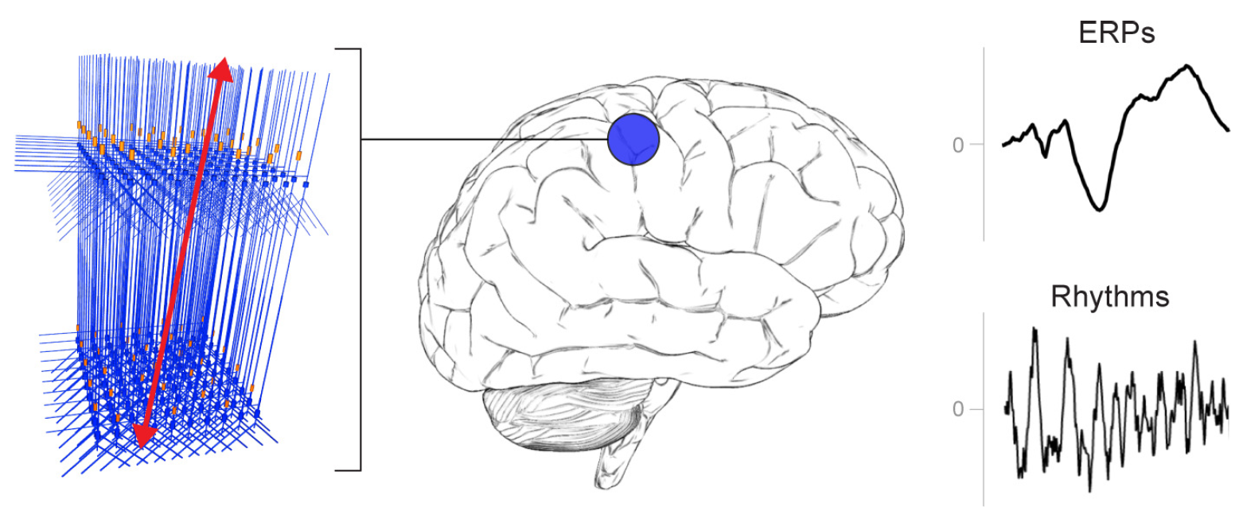
Computational Modelling
Neymotin et al., 2020

Slide 154
Computational Modelling
Neymotin et al., 2020

Slide 155
Binaural Beat Stimulation
Kim et al., 2023

Slide 156
Thank you!

